Slide 1
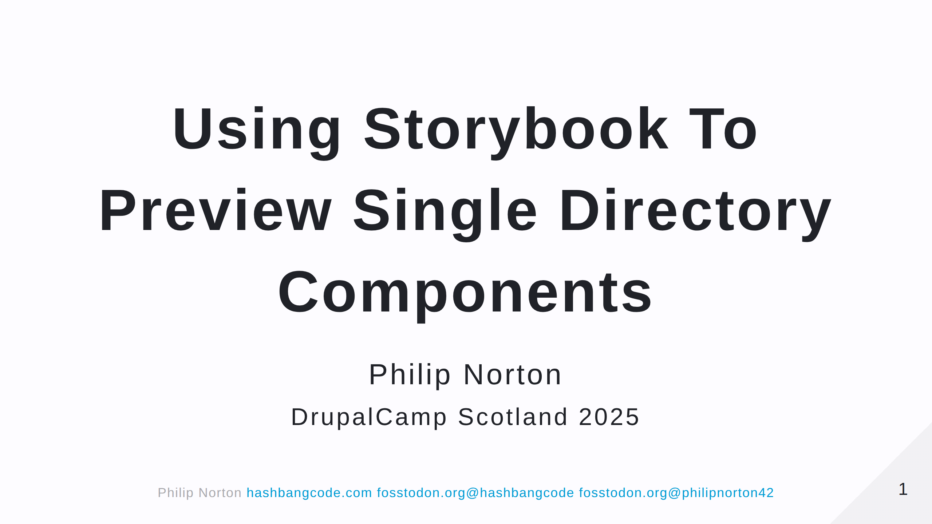

Slide 2
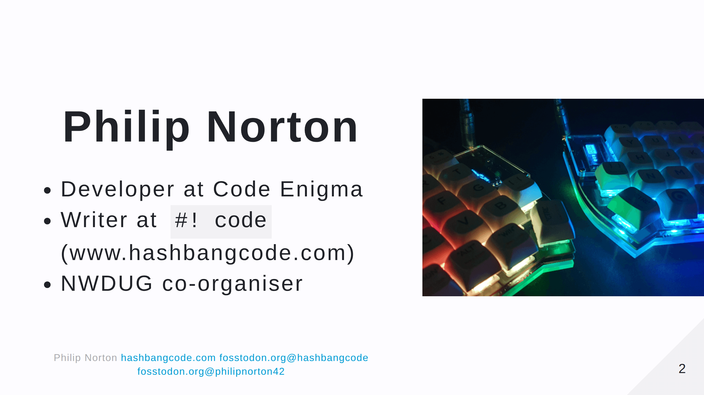
Notes:
- Doing Drupal for about 15 years. - Programming in general for about 20 now. - That is a picture of a Lily58 mechanical keyboard.

Slide 3
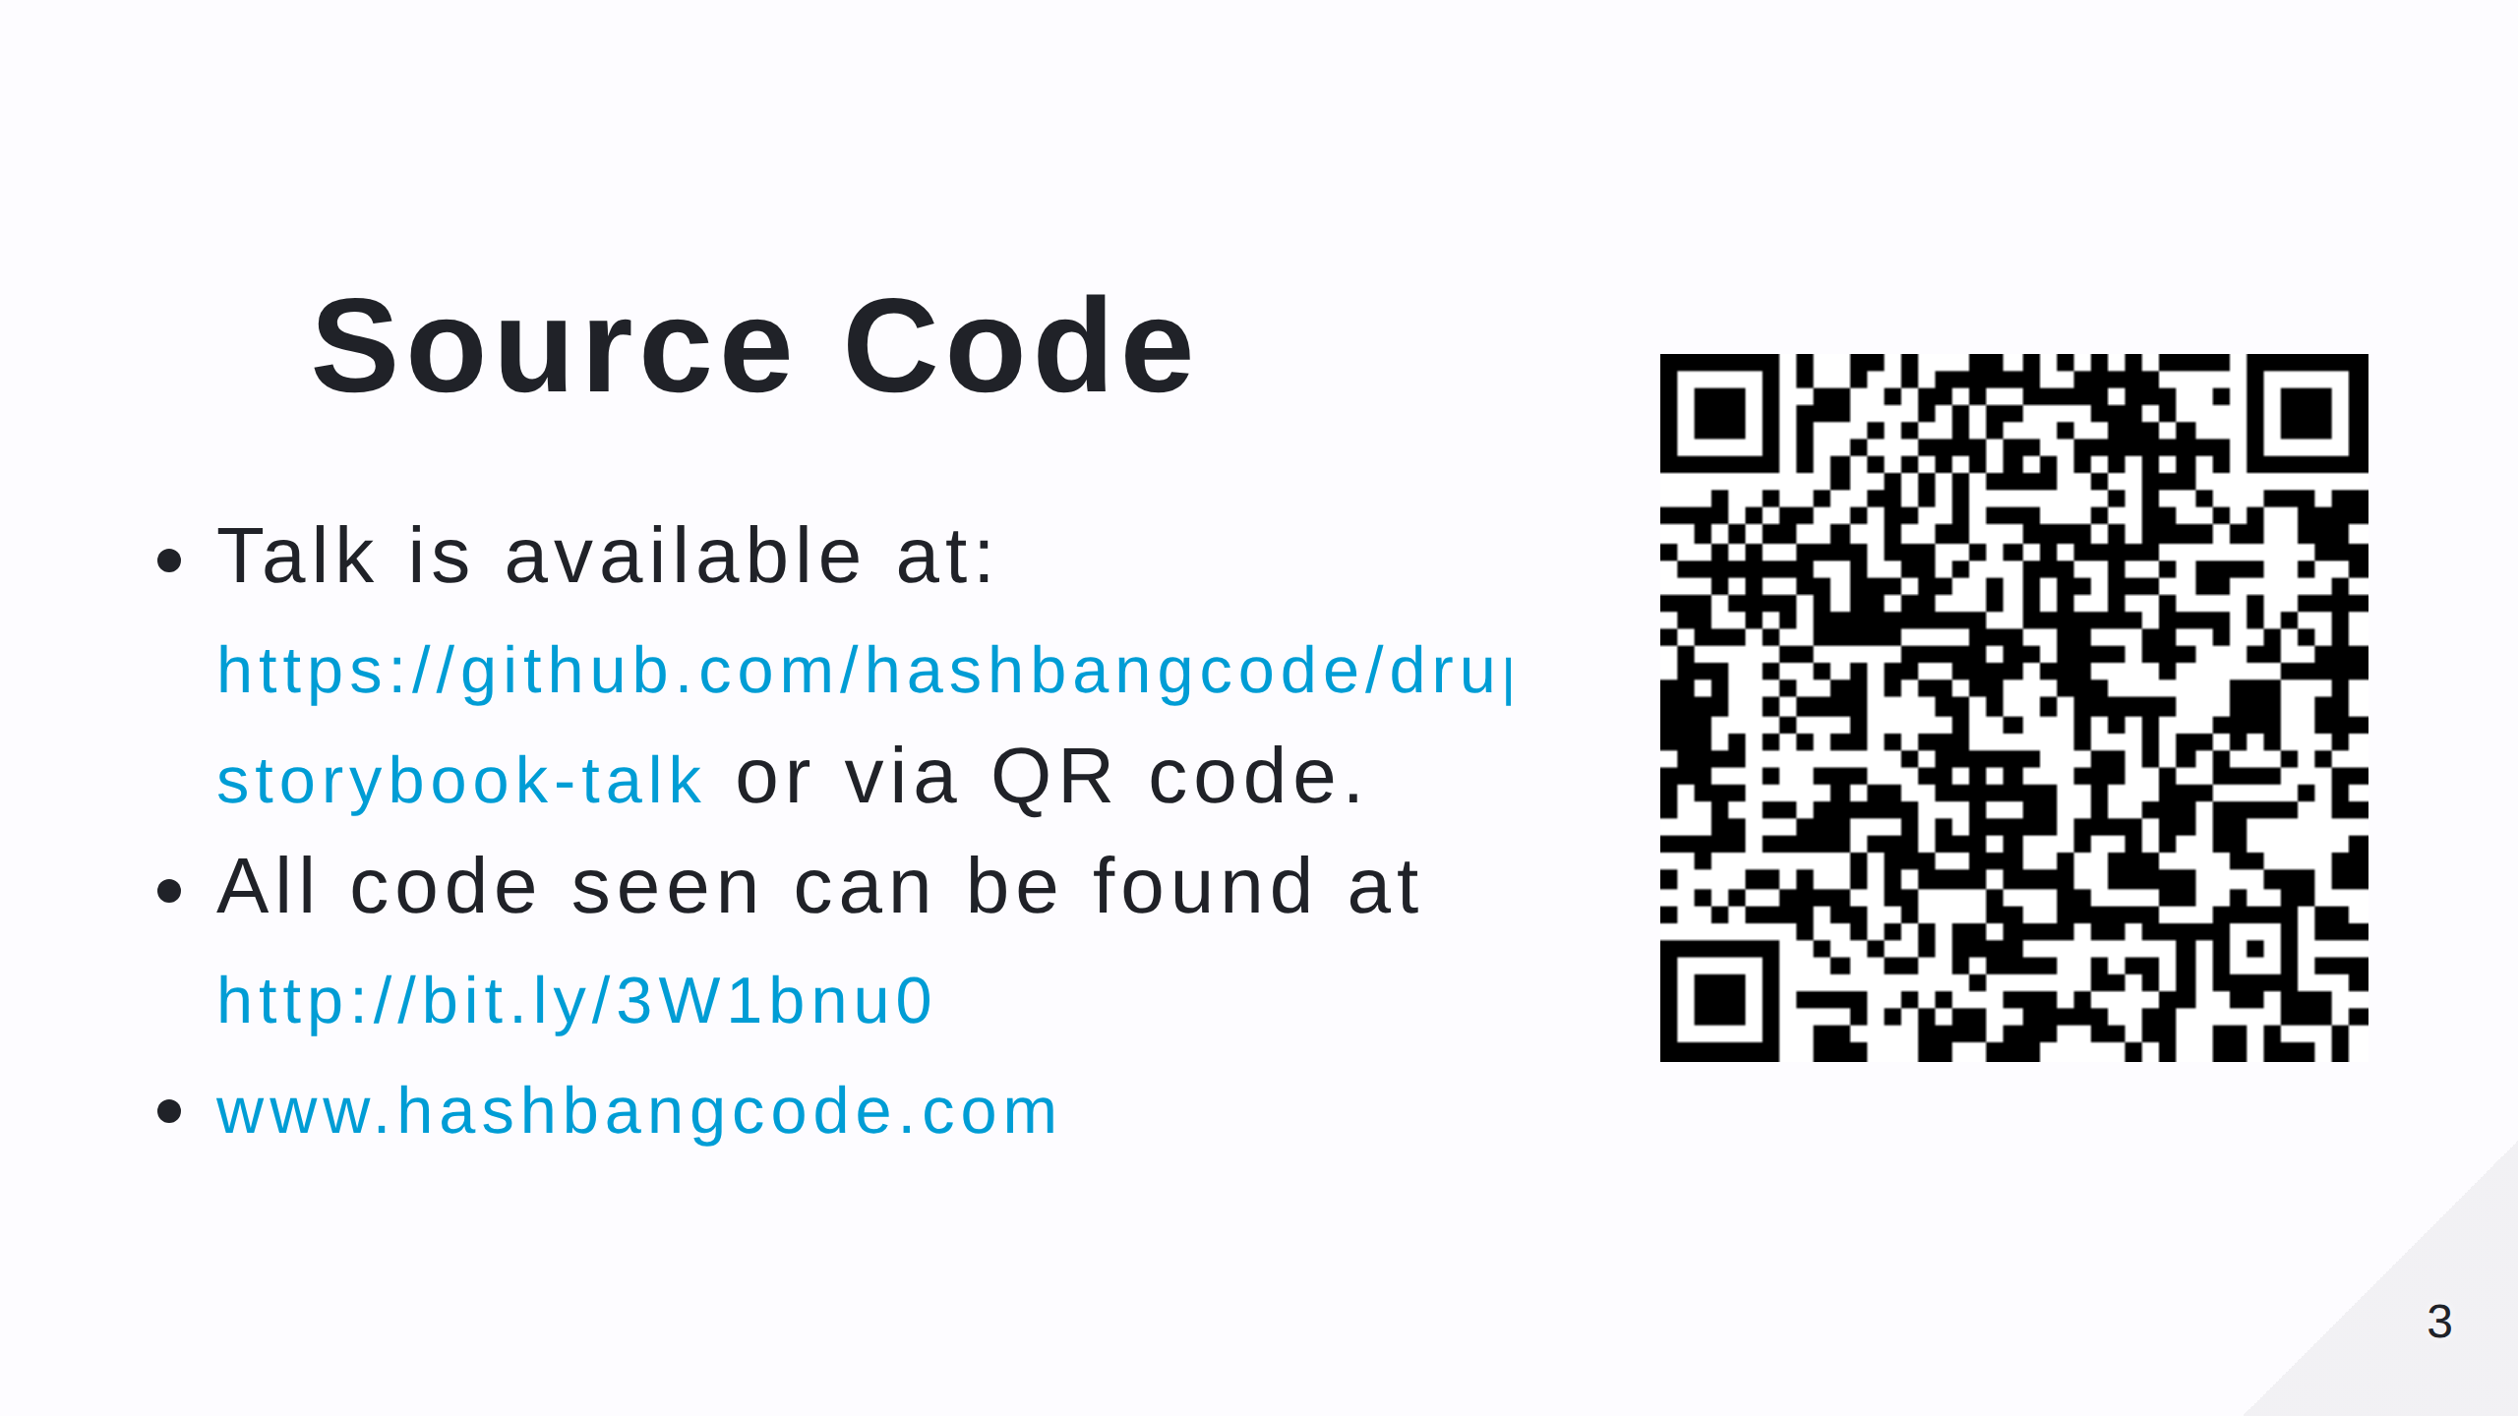
Notes:
- Scan the QR code for the talk repo. Which has links to all of the resources you need. - There's also a Drupal and Storybook article on my site.

Slide 4
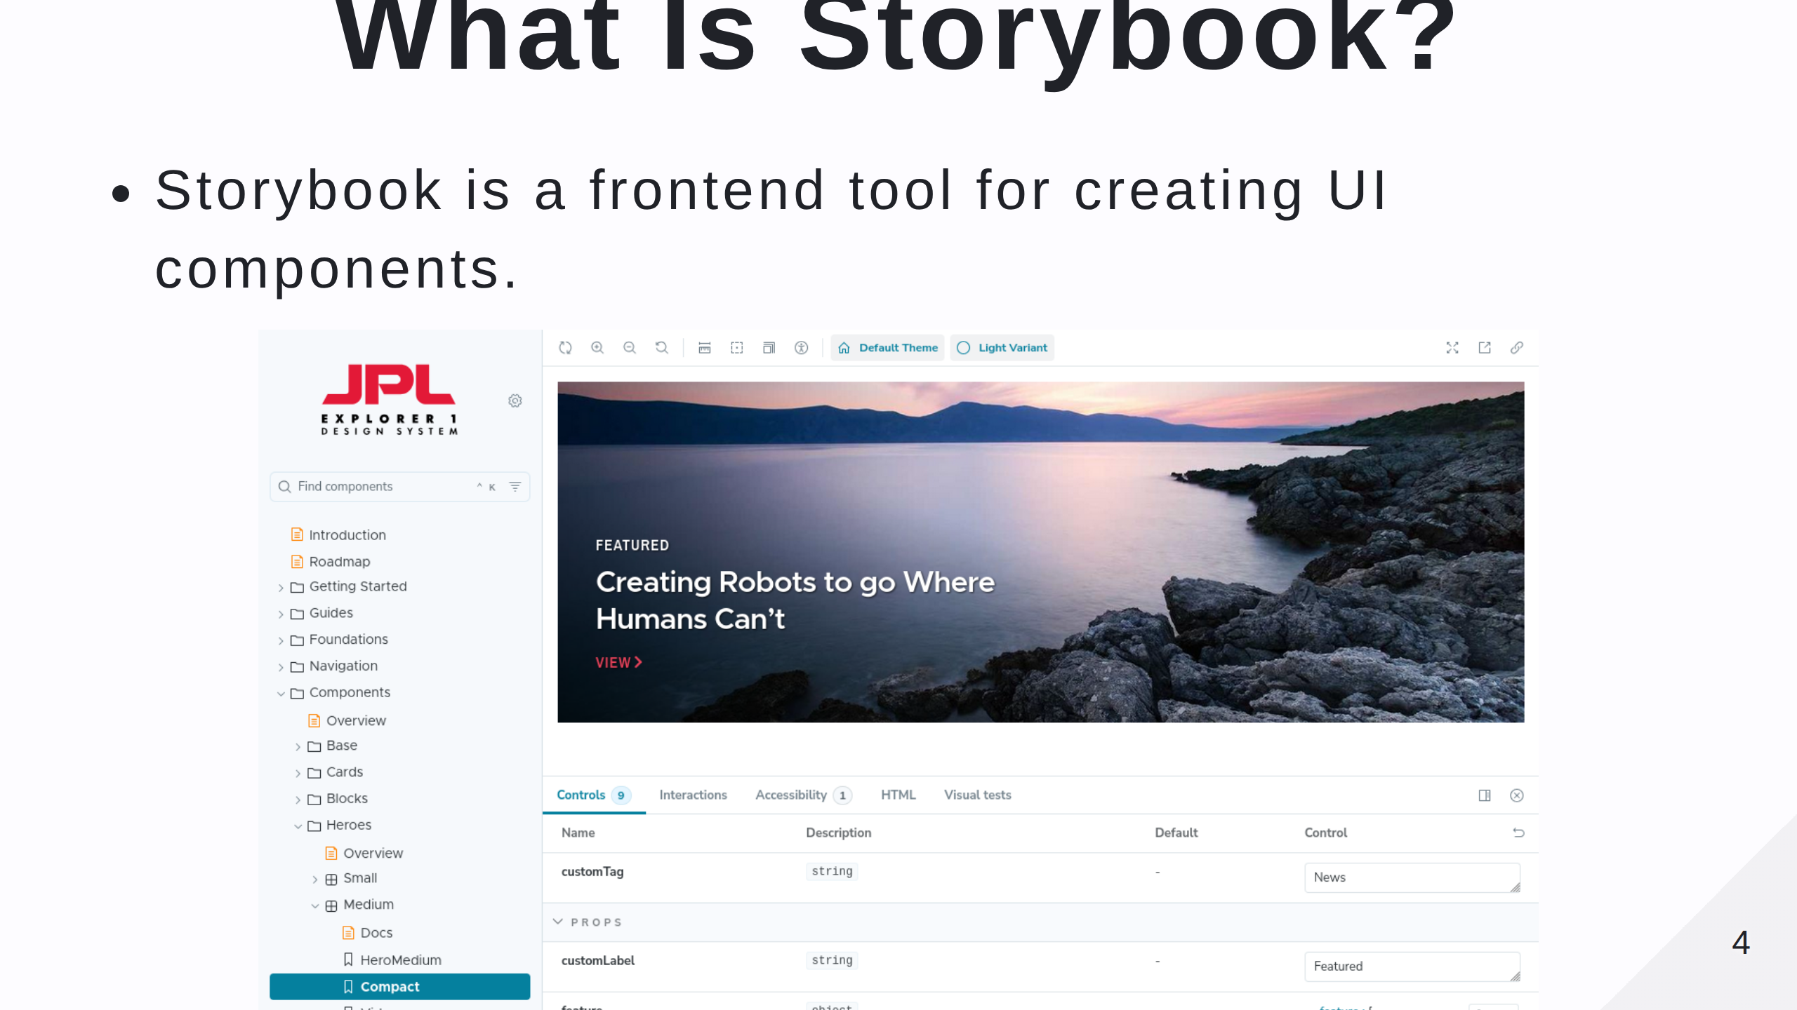
Notes:
I've been looking at Storybook for a few years, but there's always been a disconnect between Storybook and Drupal. I could build the stories in Storybook, but I'd then have to rebuild them in Drupal. Here is an example of Storybook used by the JPL.

Slide 5
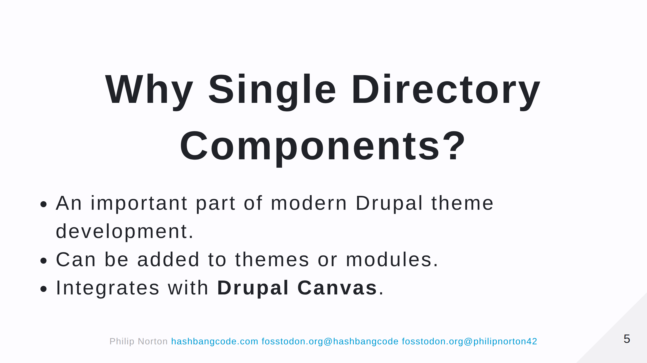
Notes:
Now is a good time to get into SDC.

Slide 6
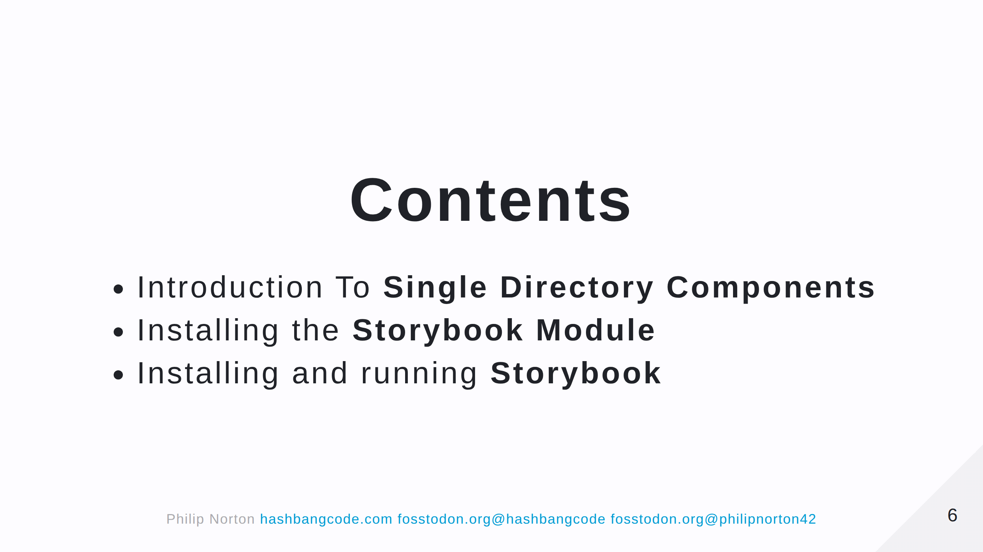
Notes:
That changed with SDC and is facilitied by the Storybook module.

Slide 7


Slide 8
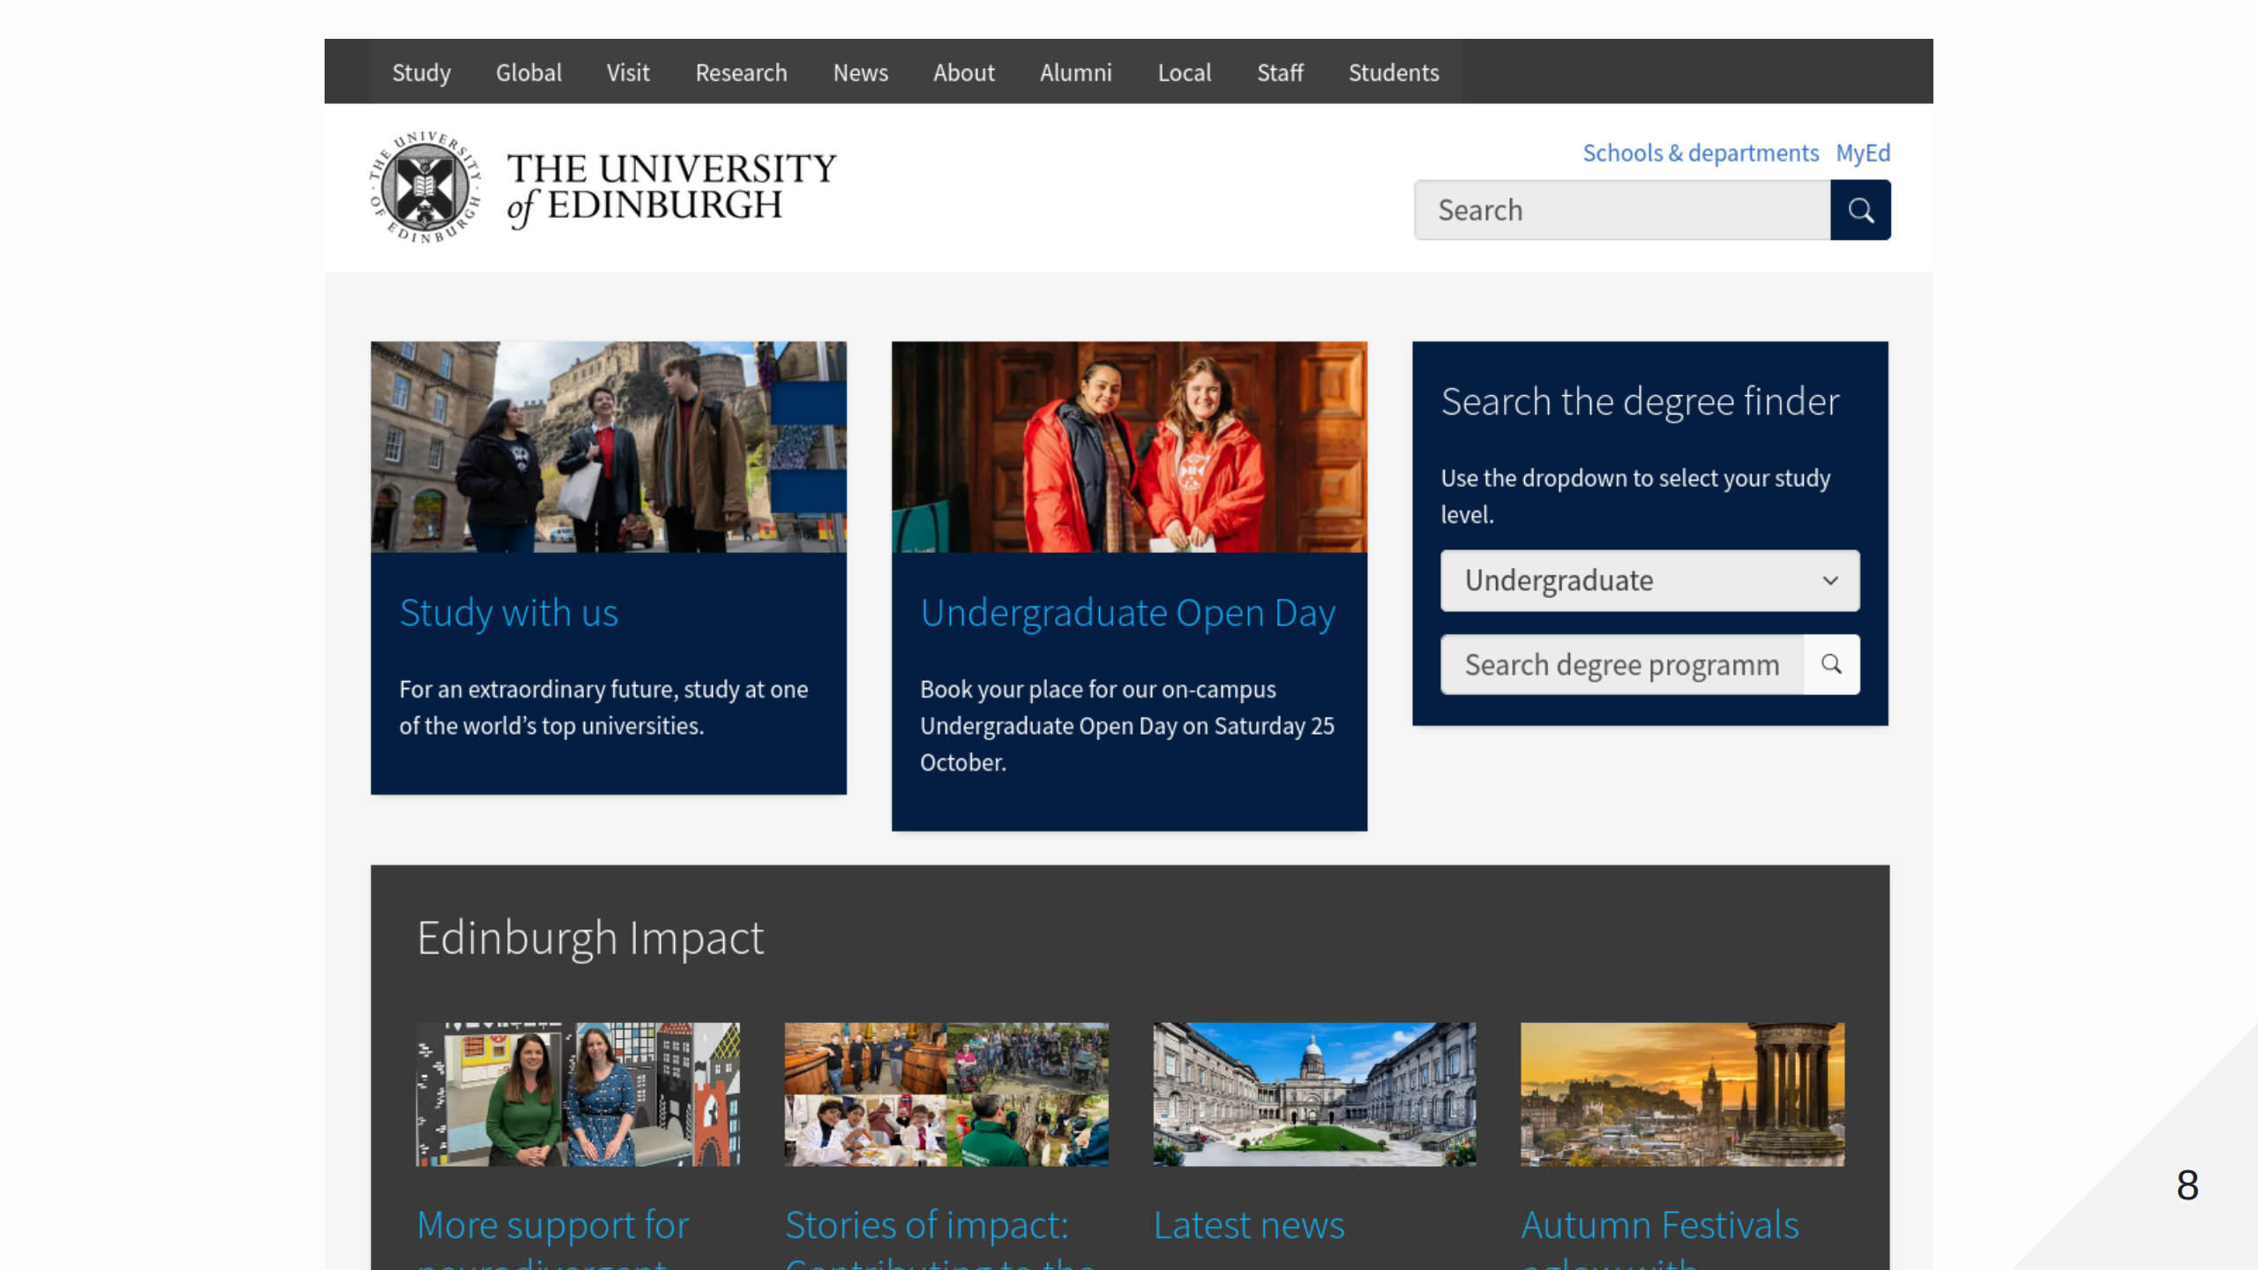

Slide 9
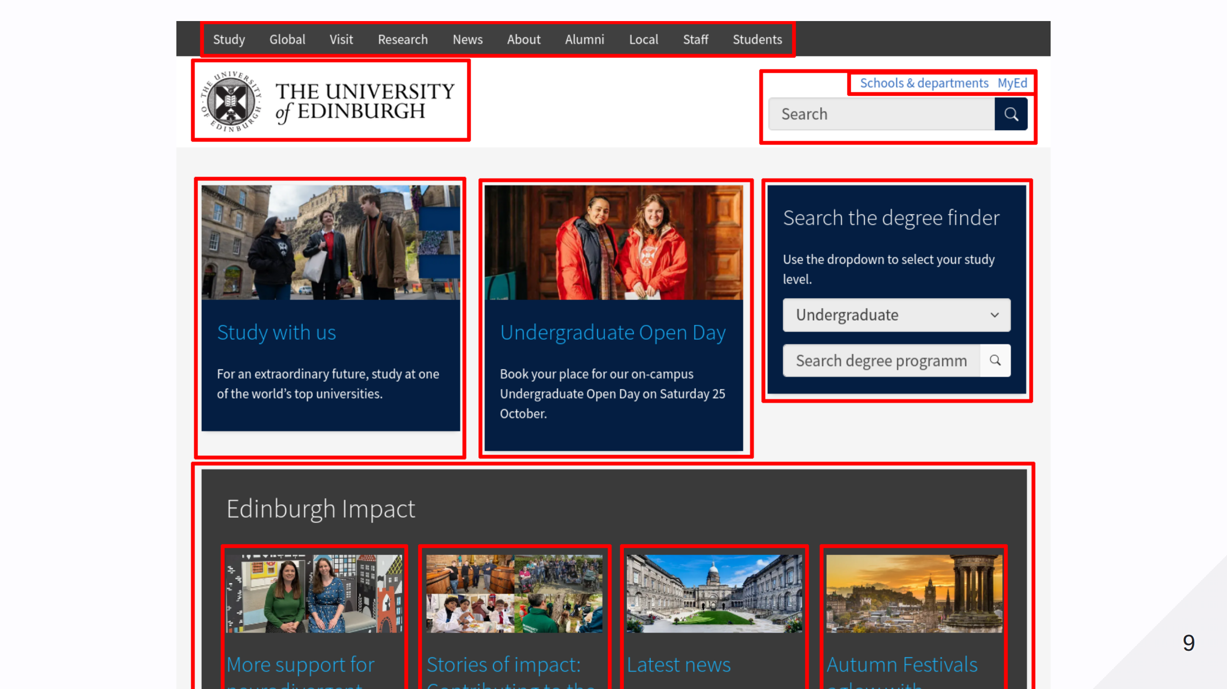

Slide 10
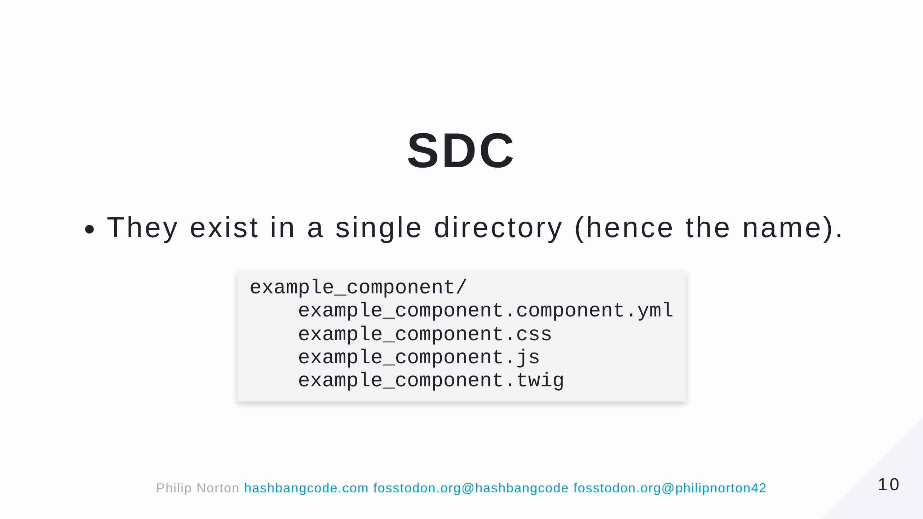
Notes:
This directory can exist in a theme or module. Let's look at each of the files.

Slide 11
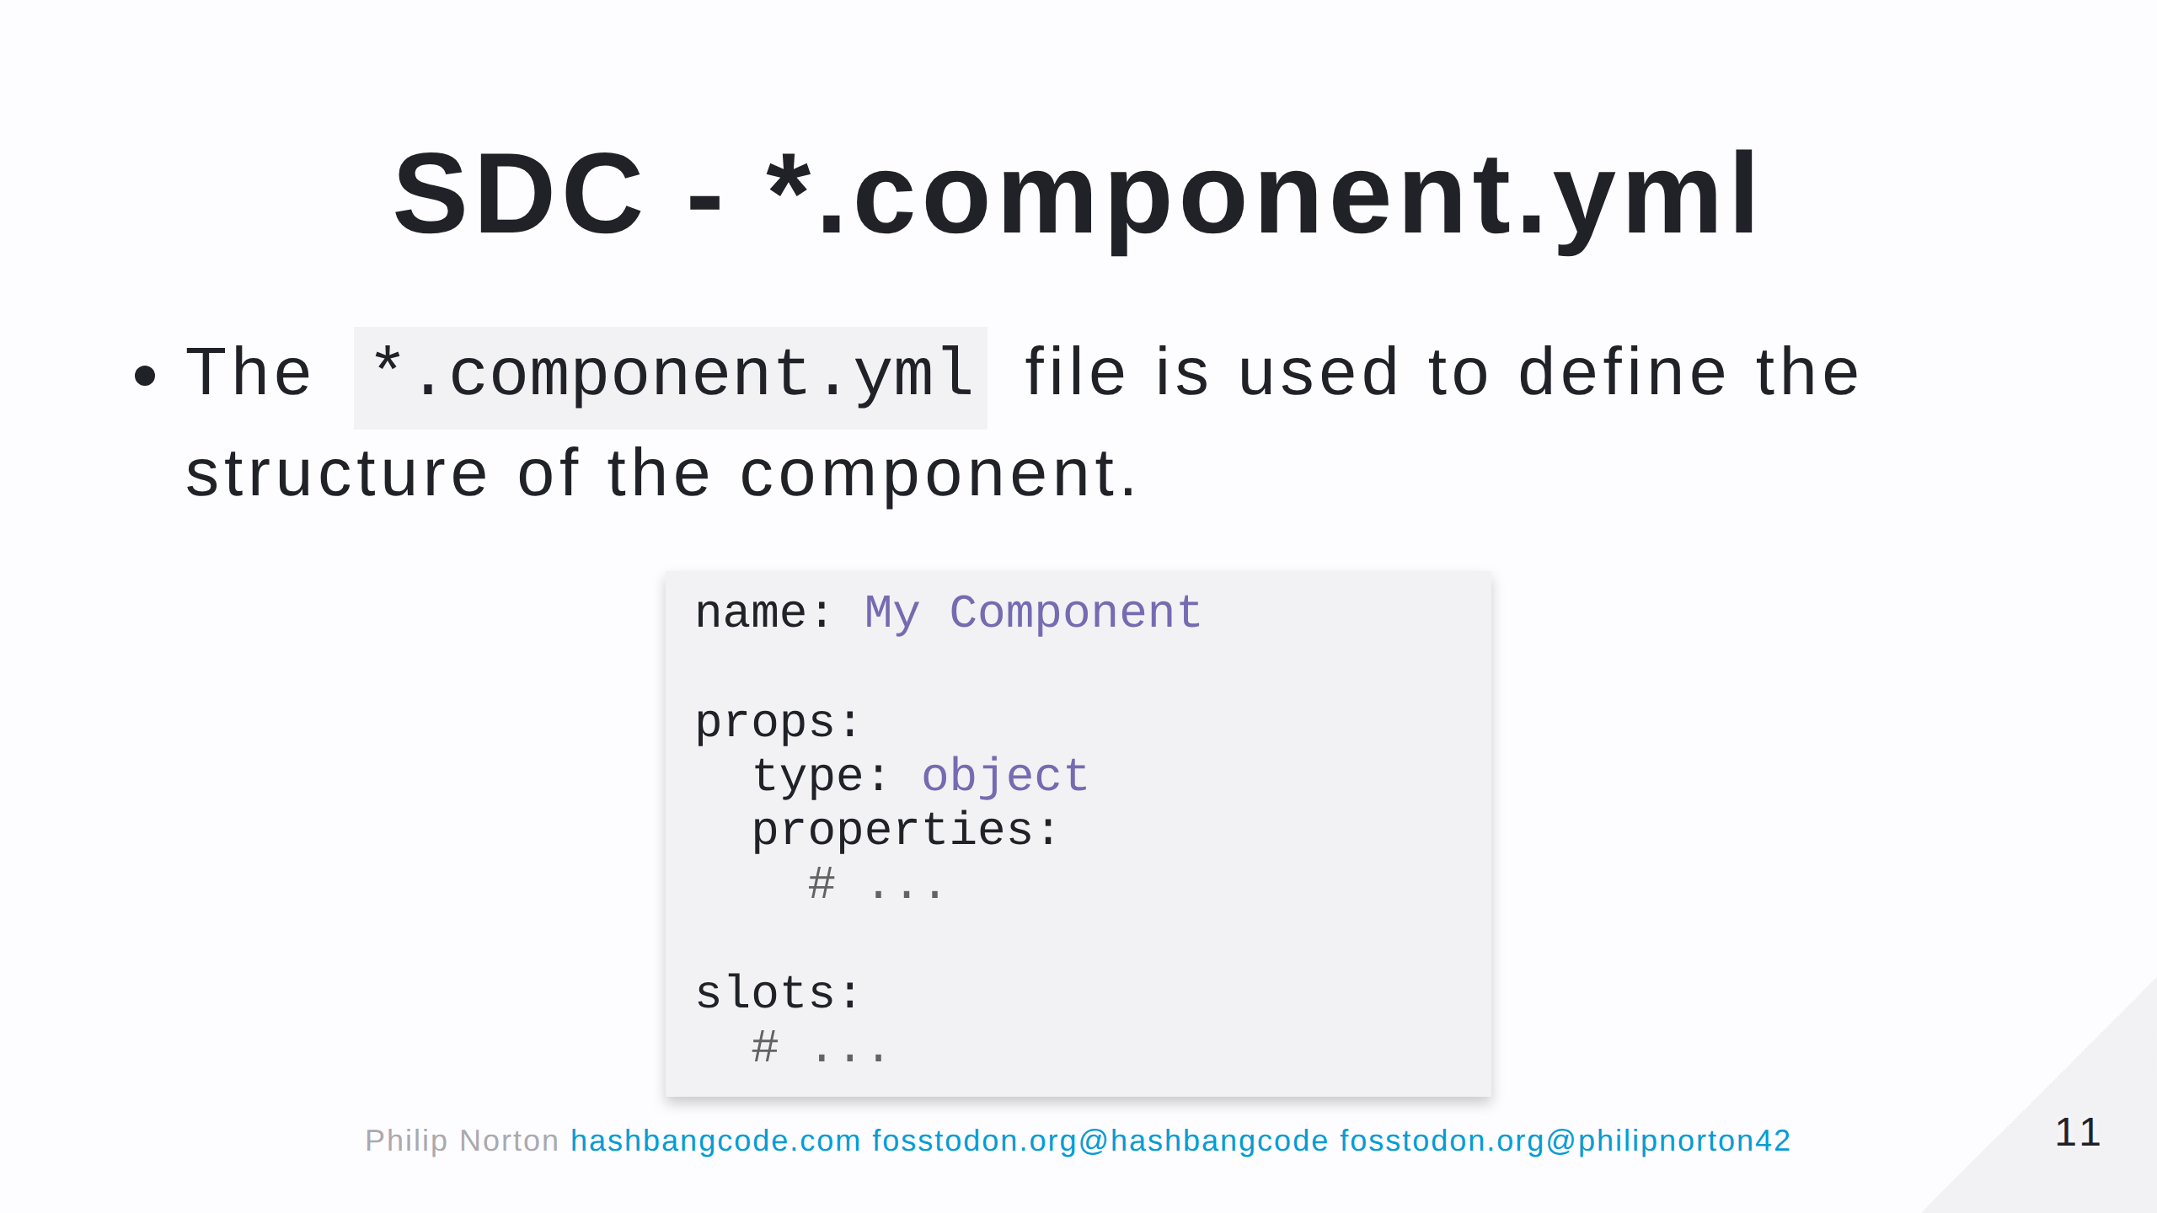
Notes:
Note that when you create a component in a module this file is heavily validated. In the theme, you can 'get away' with a bit more.

Slide 12
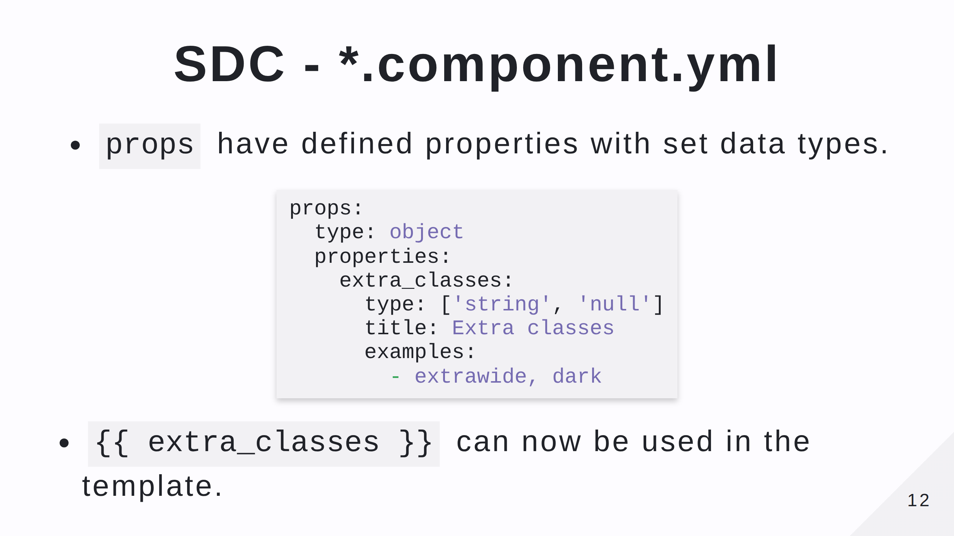

Slide 13
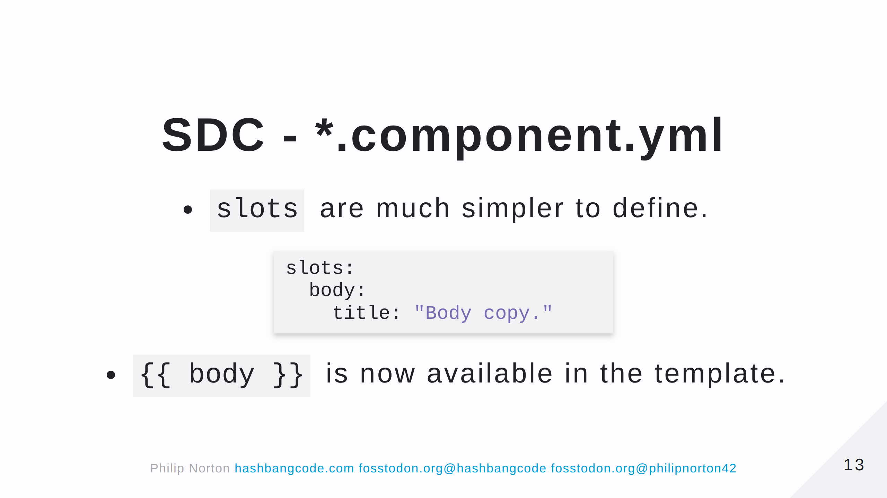

Slide 14
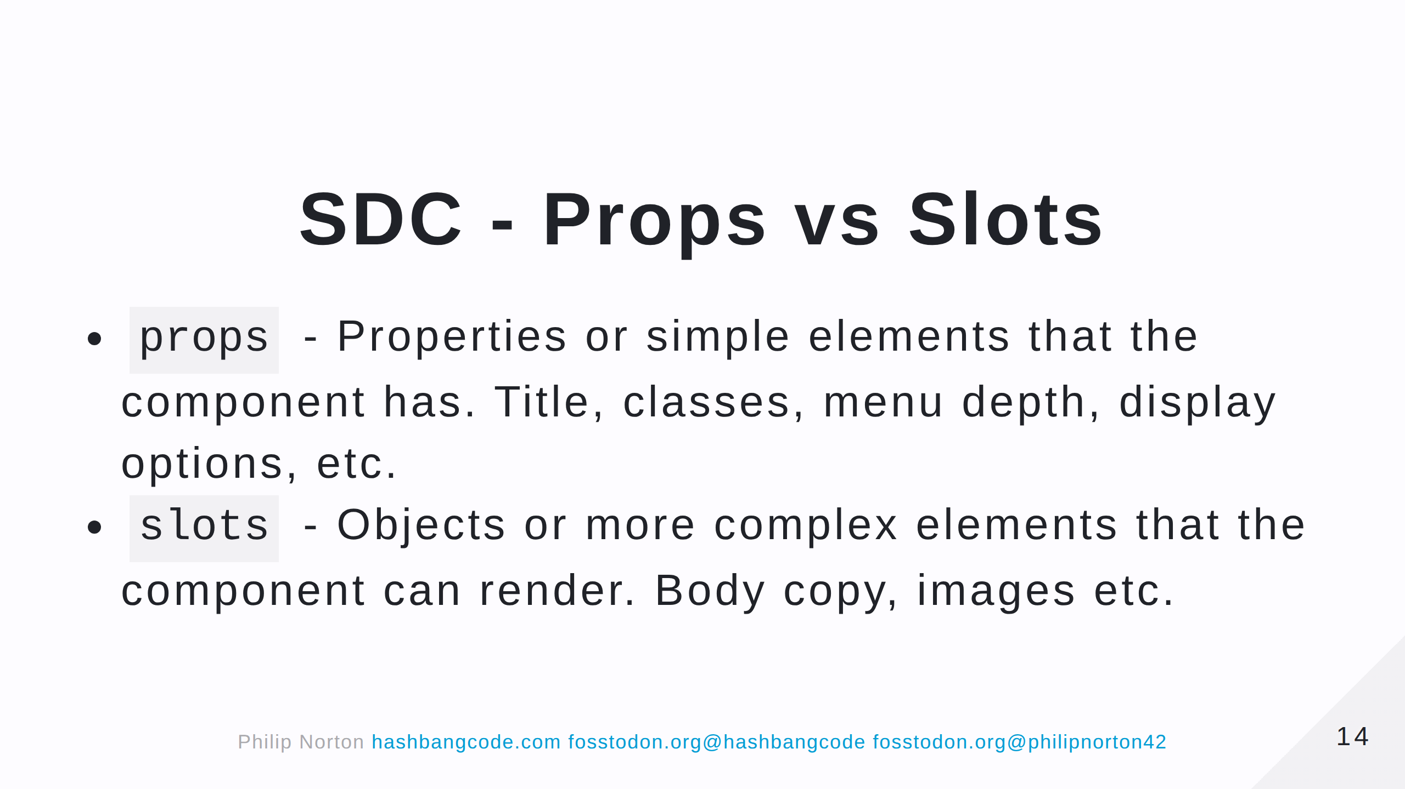

Slide 15
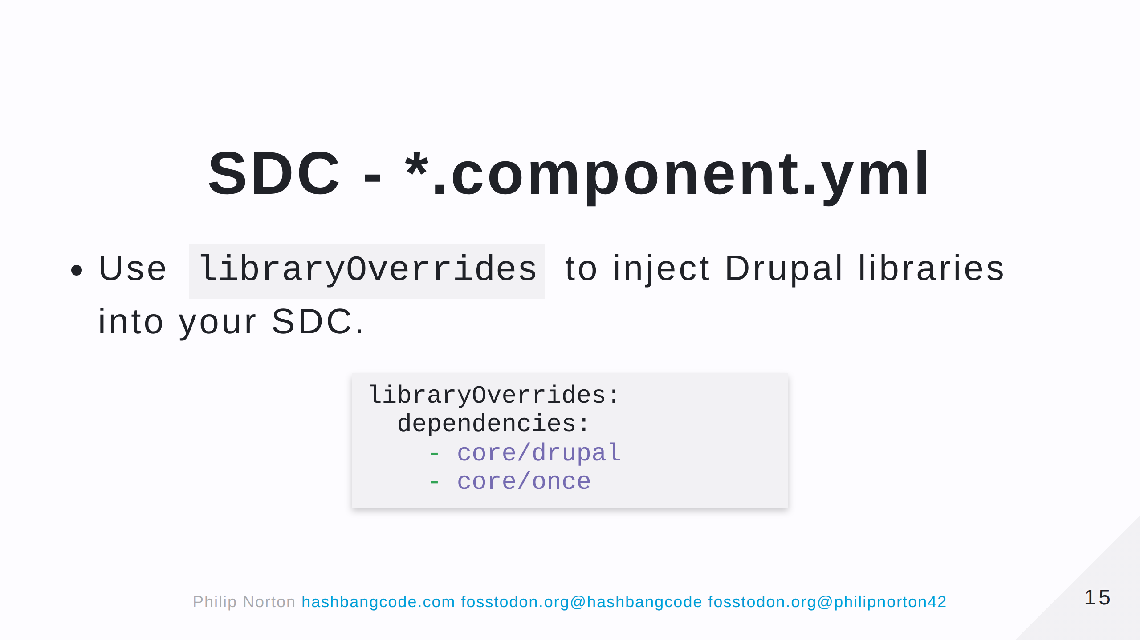

Slide 16
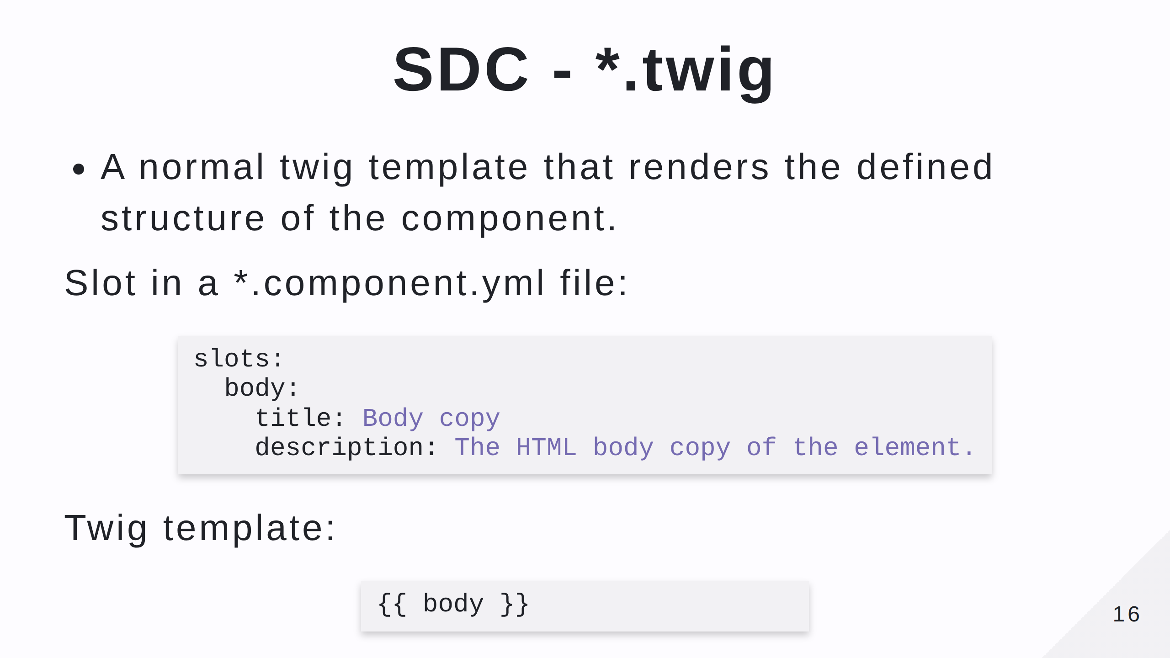

Slide 17
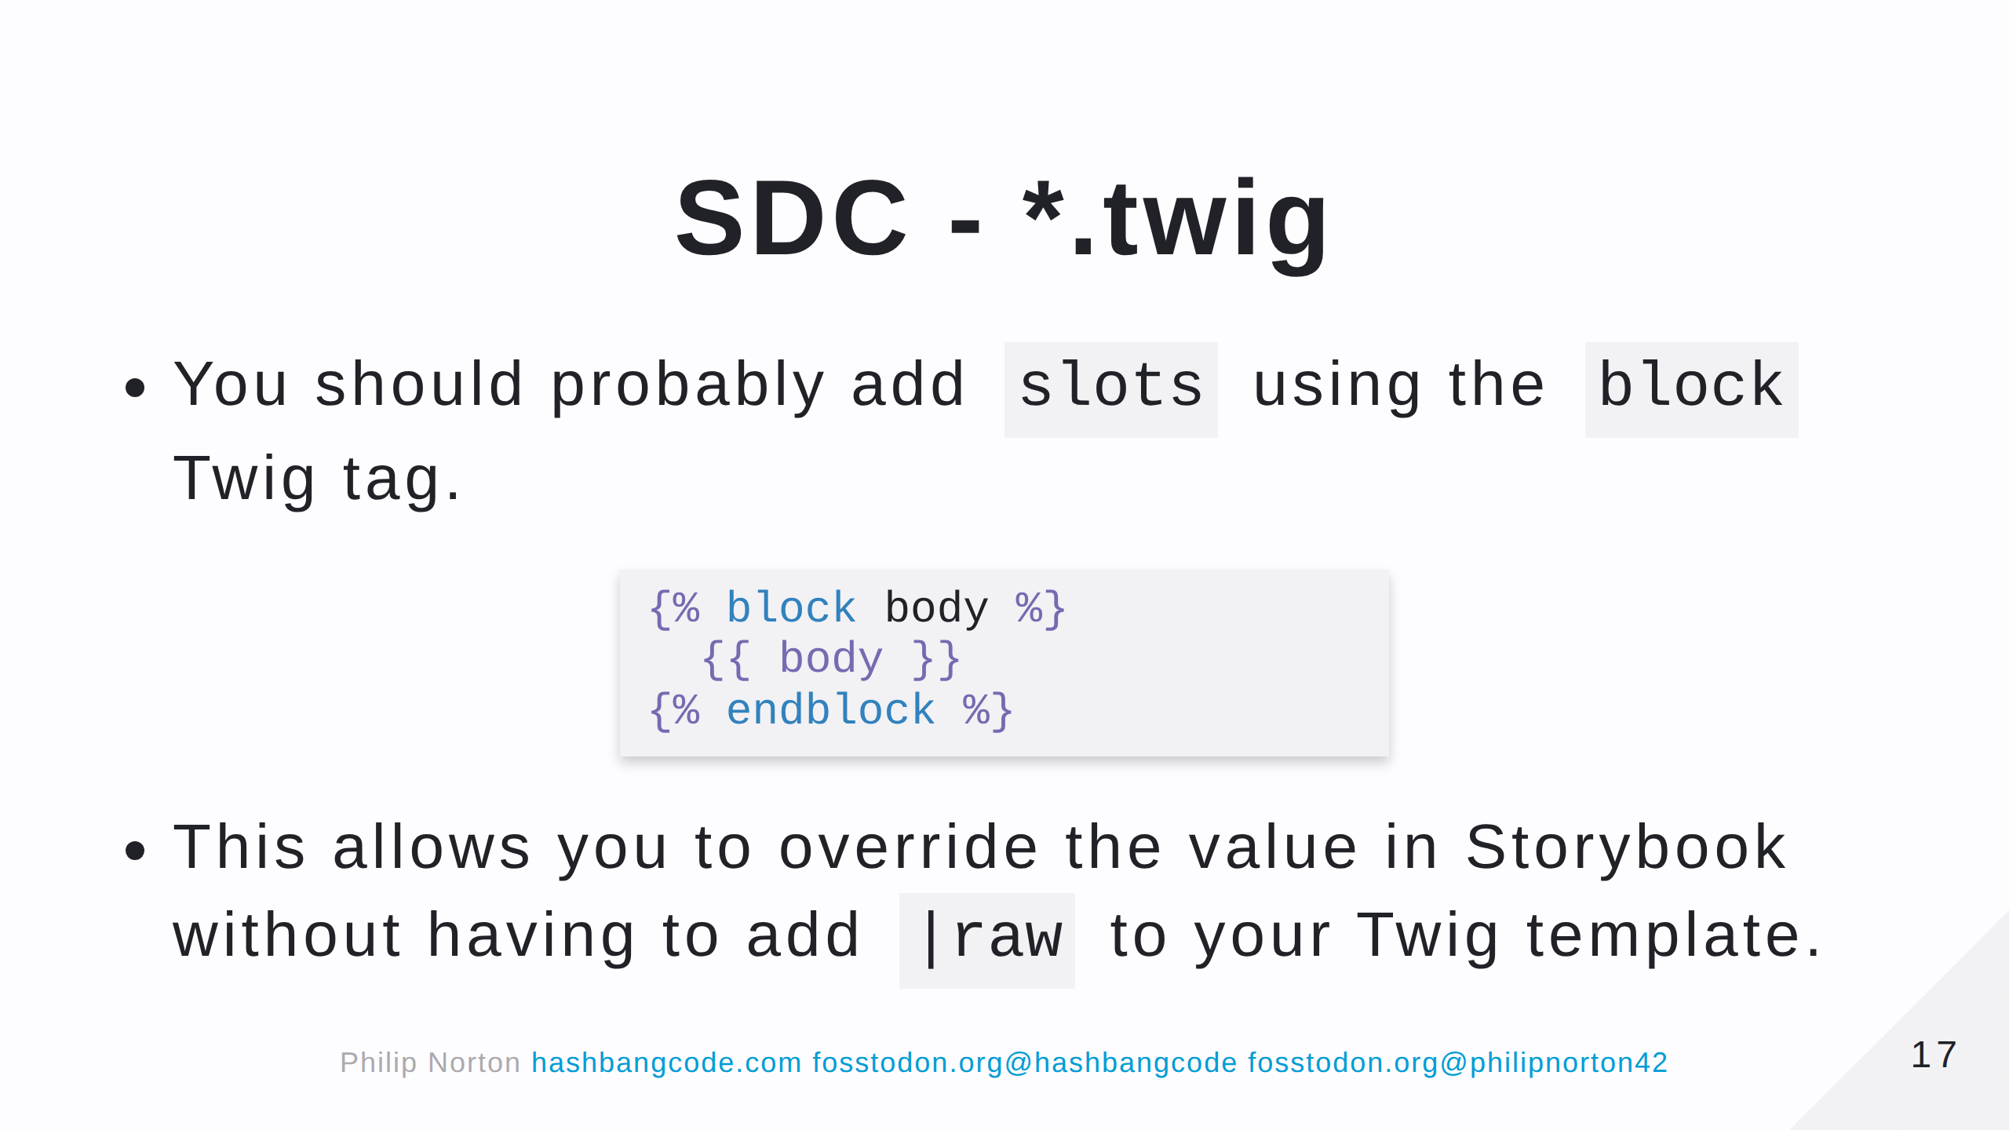

Slide 18
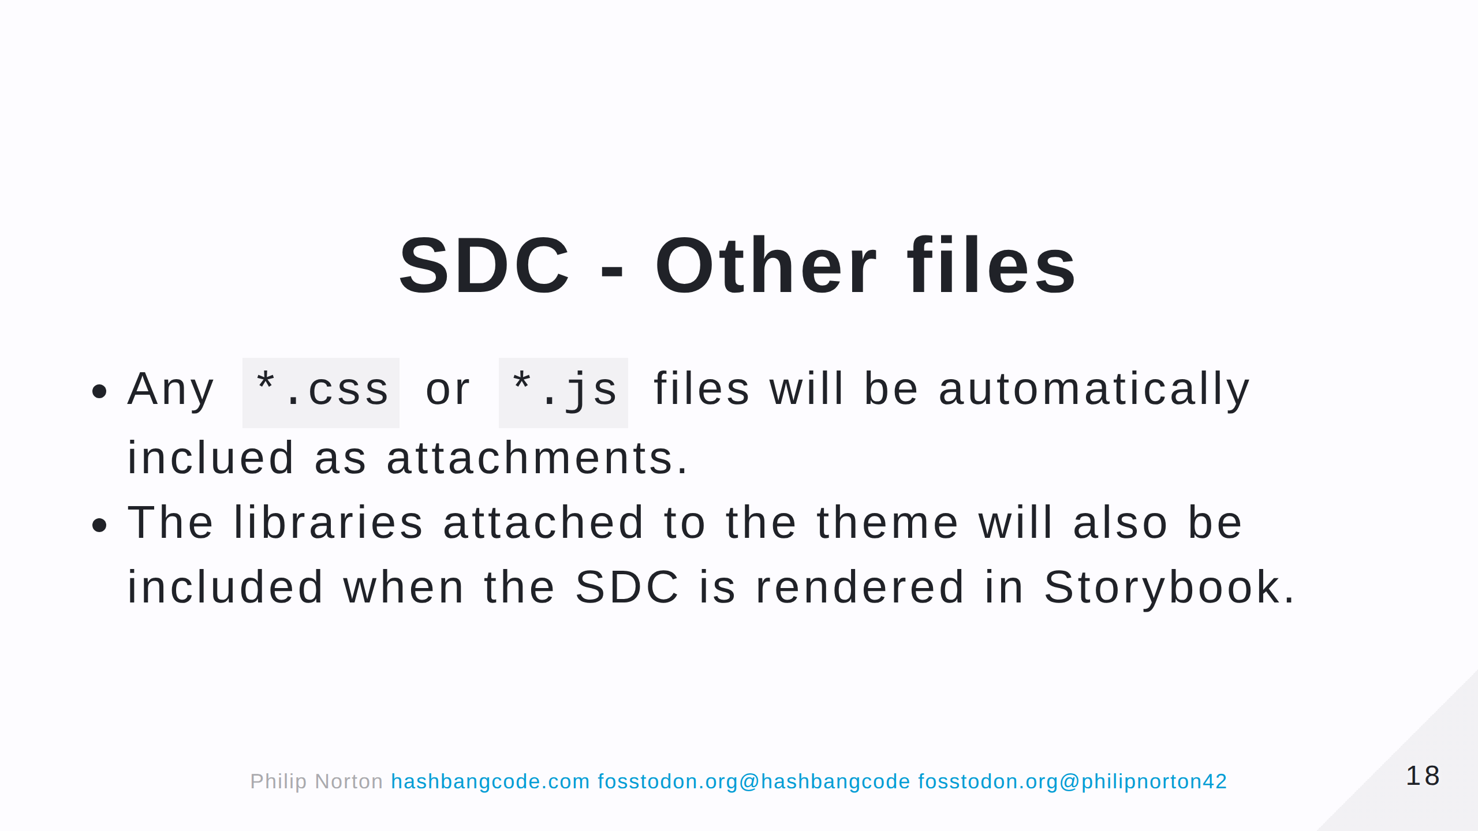

Slide 19
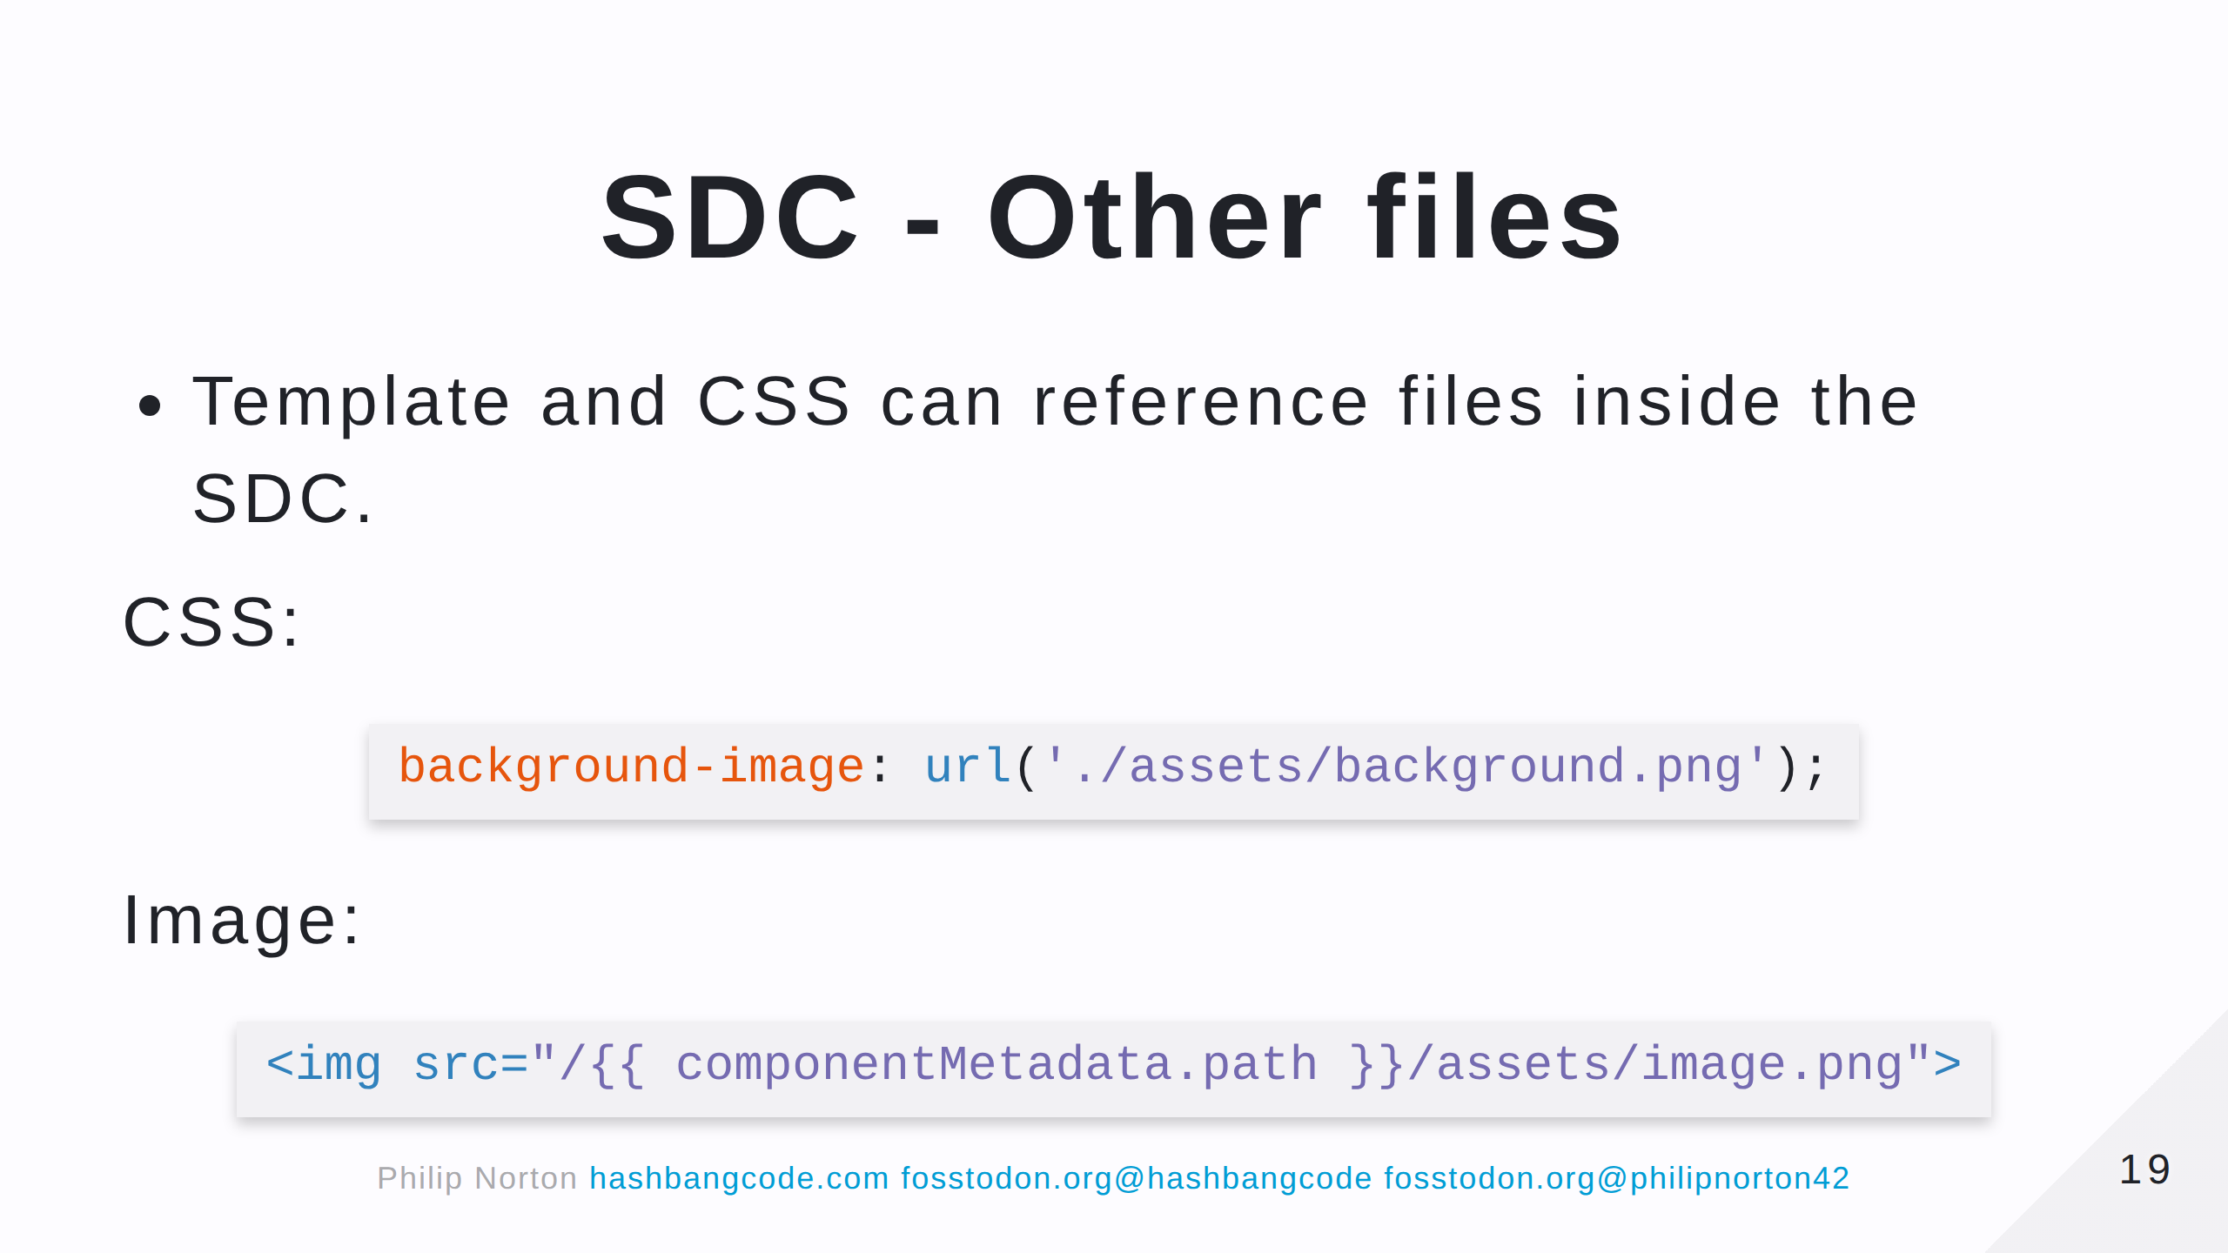
Notes:
The componentMetadata object contains some information about the component. In this case we are using the .path property that contains the current path of the SDC.

Slide 20
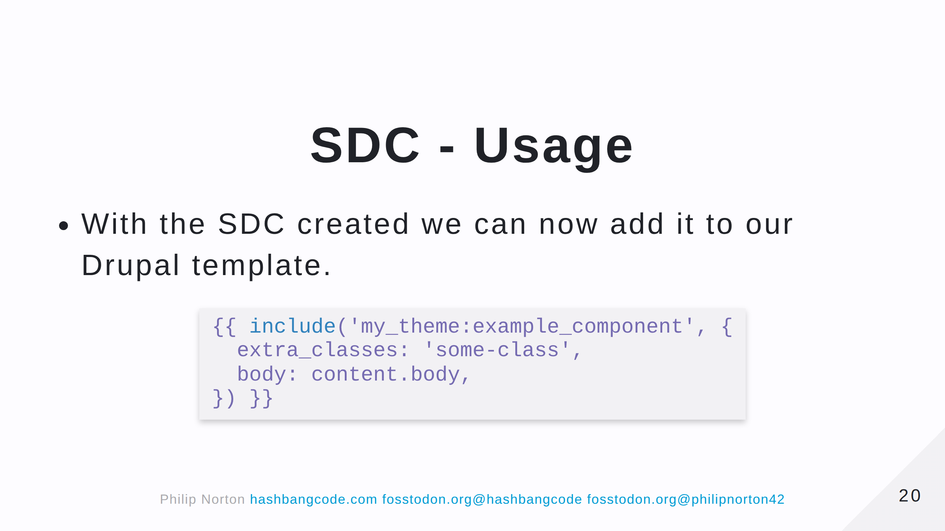

Slide 21
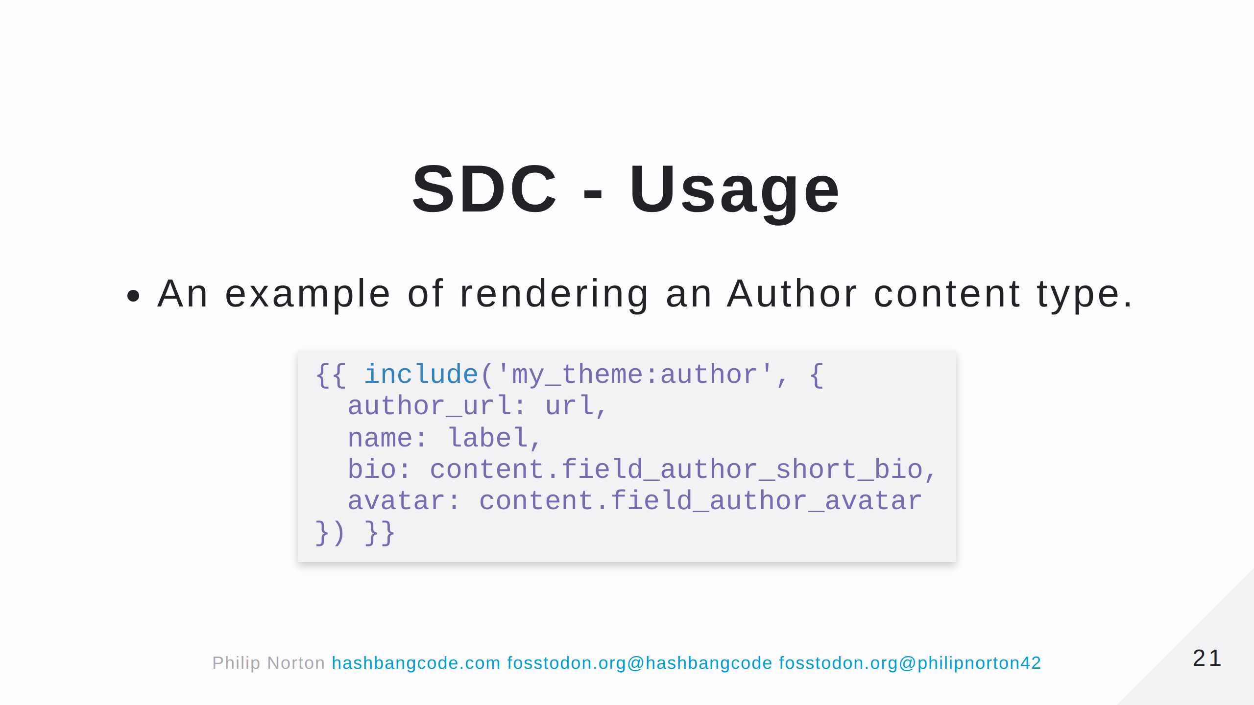

Slide 22
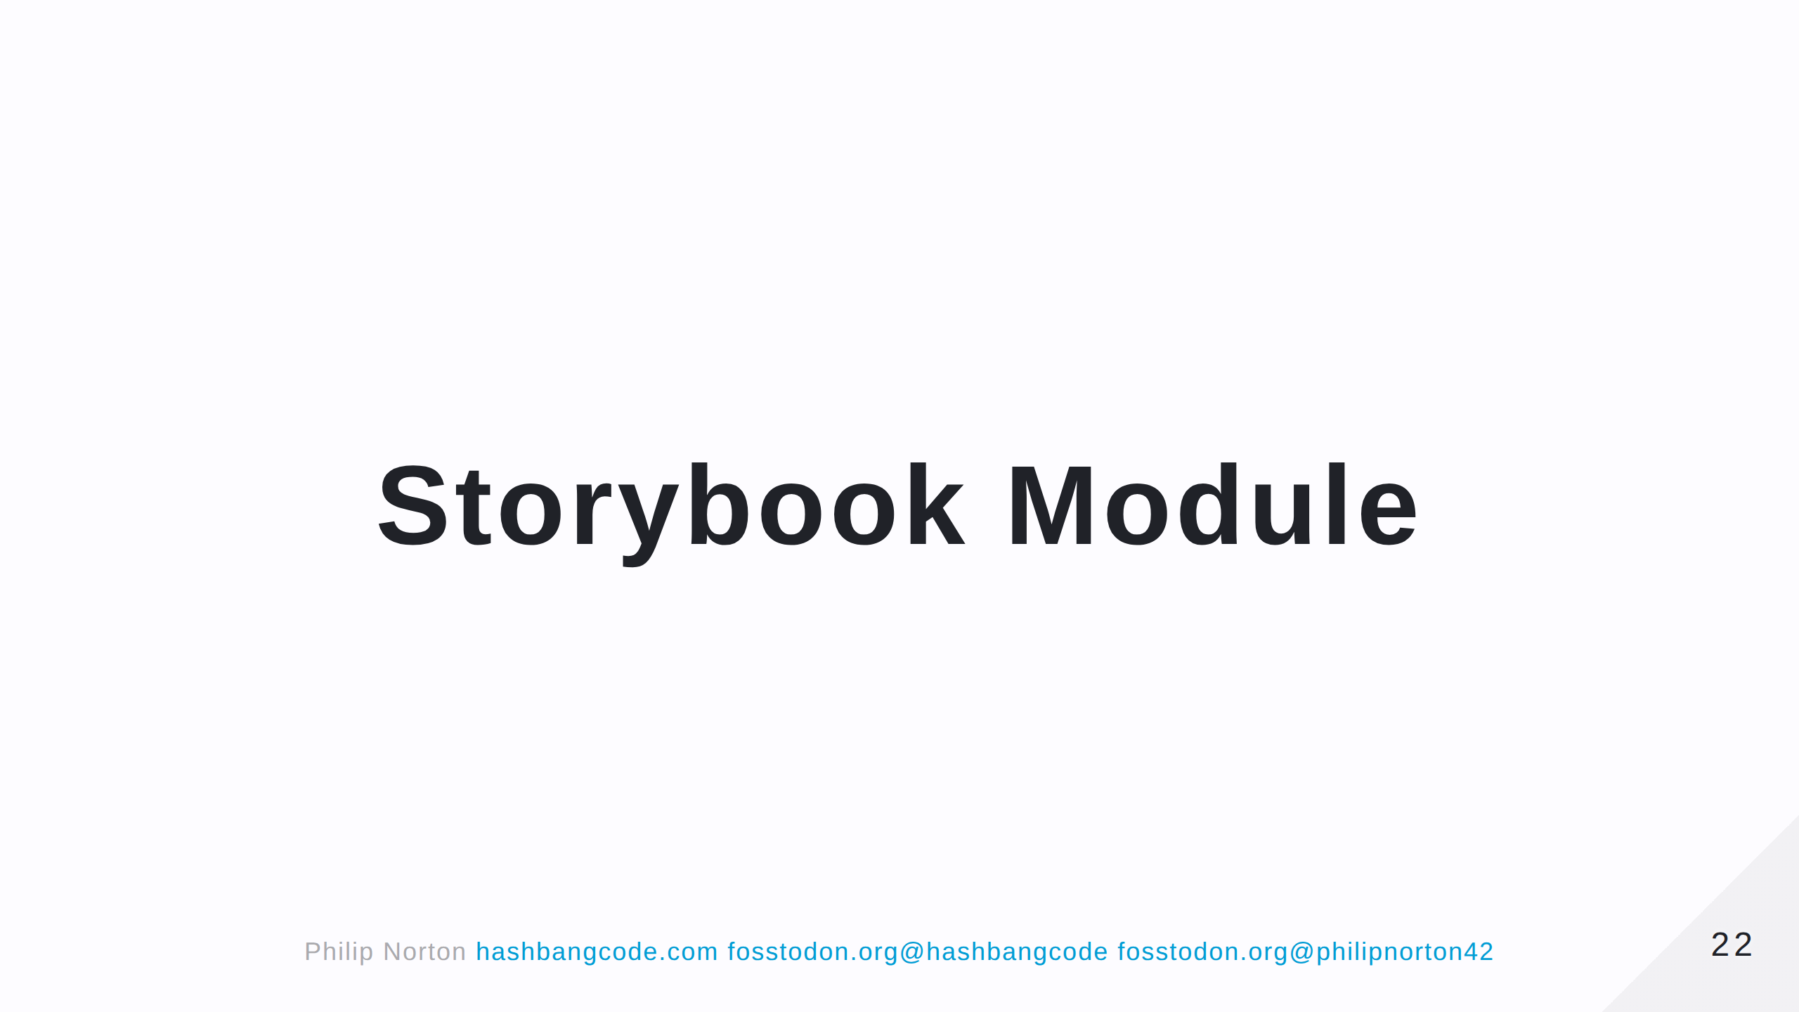

Slide 23
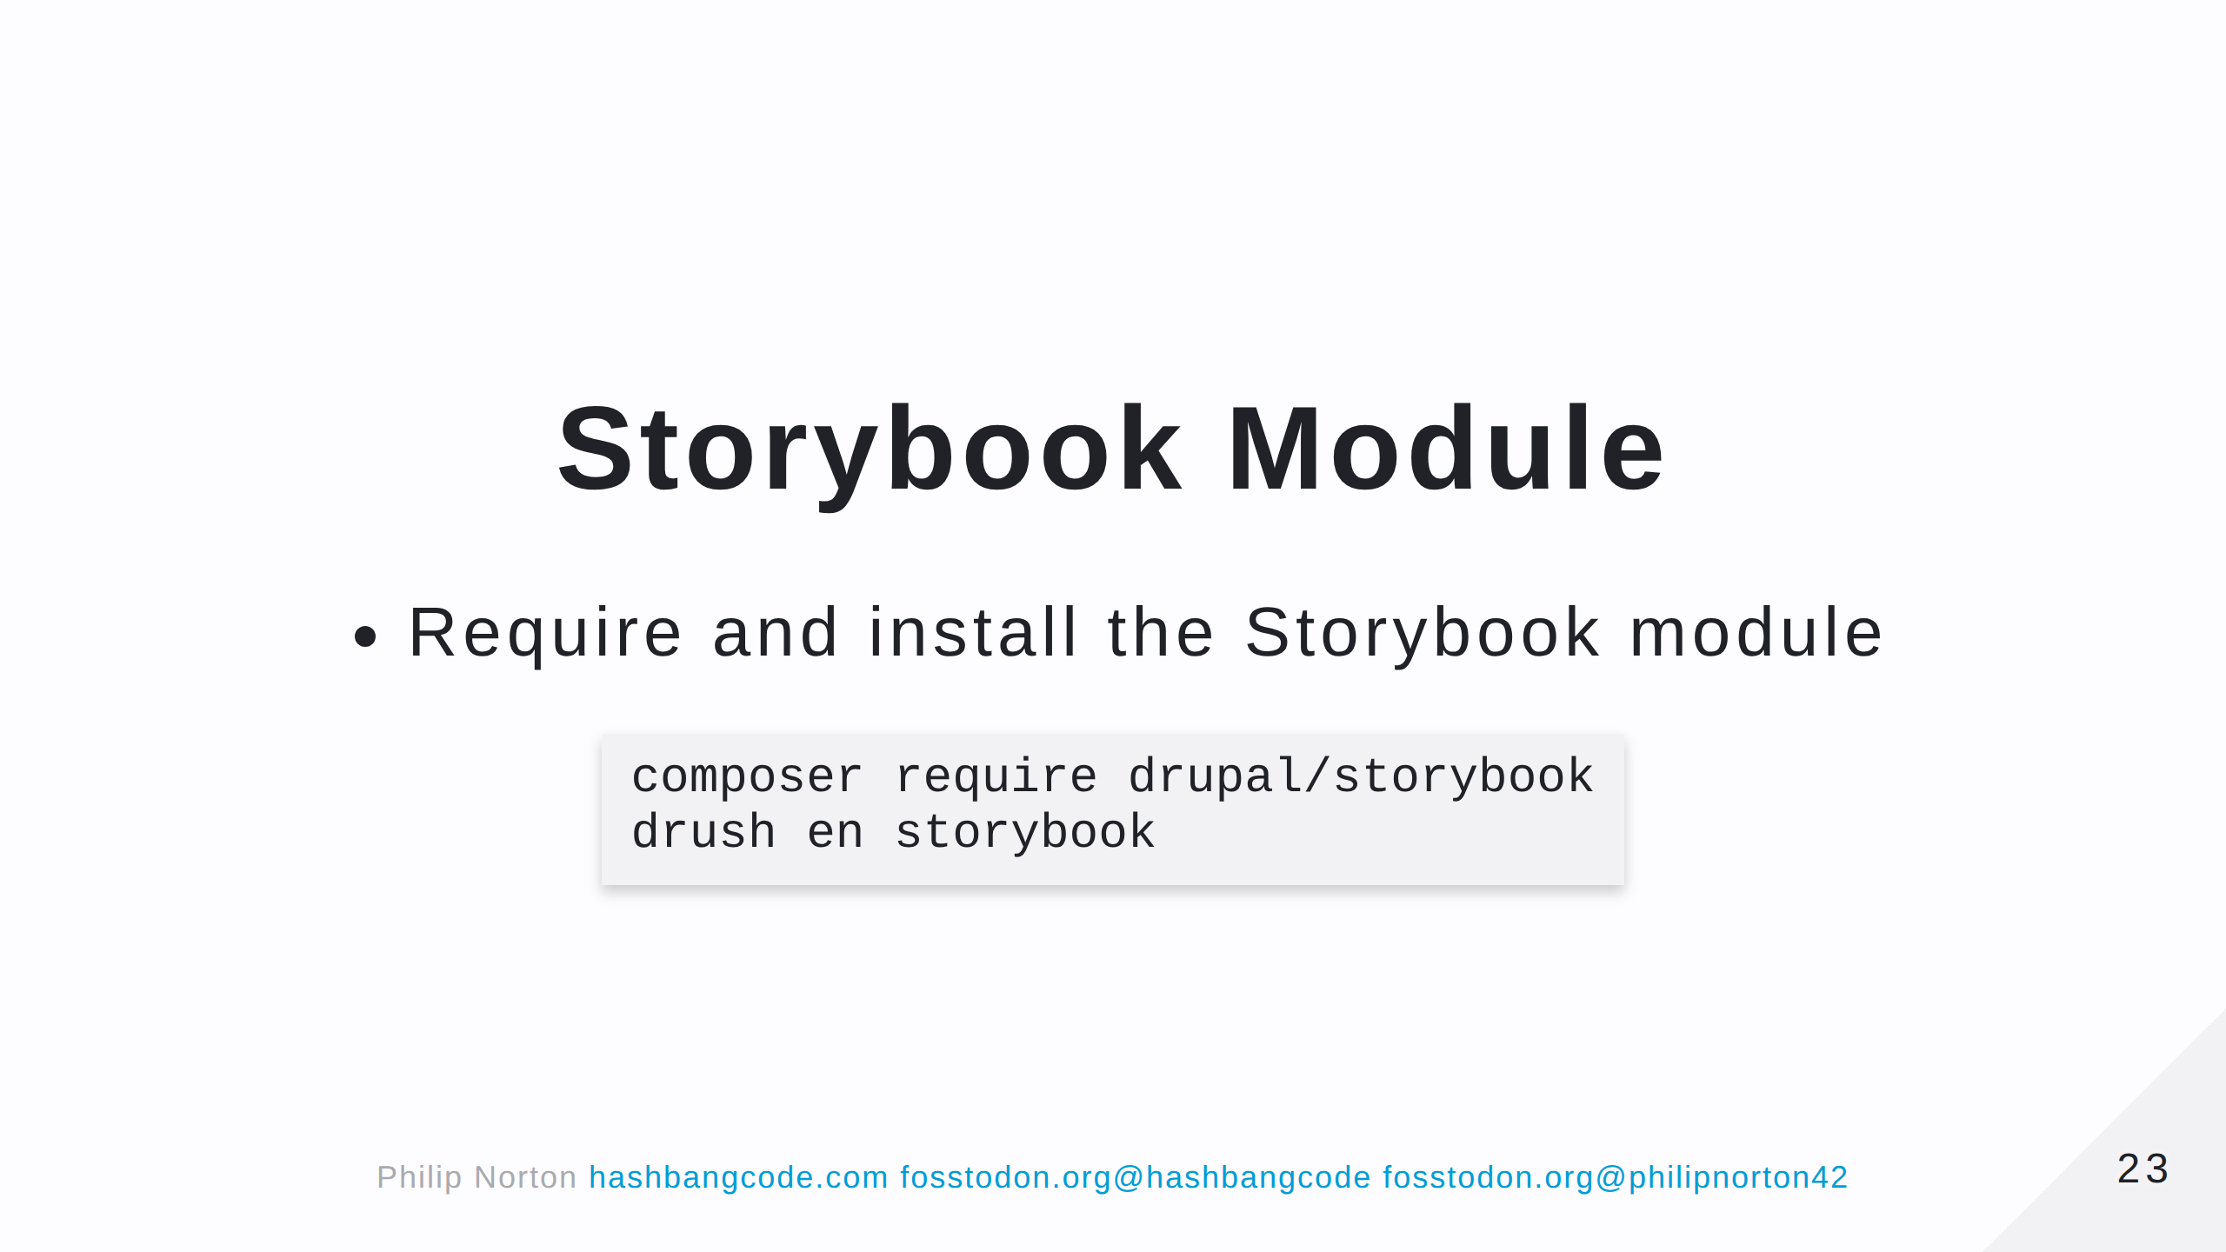

Slide 24
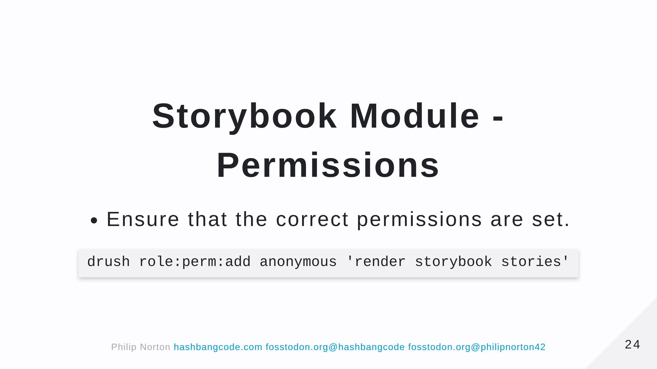

Slide 25
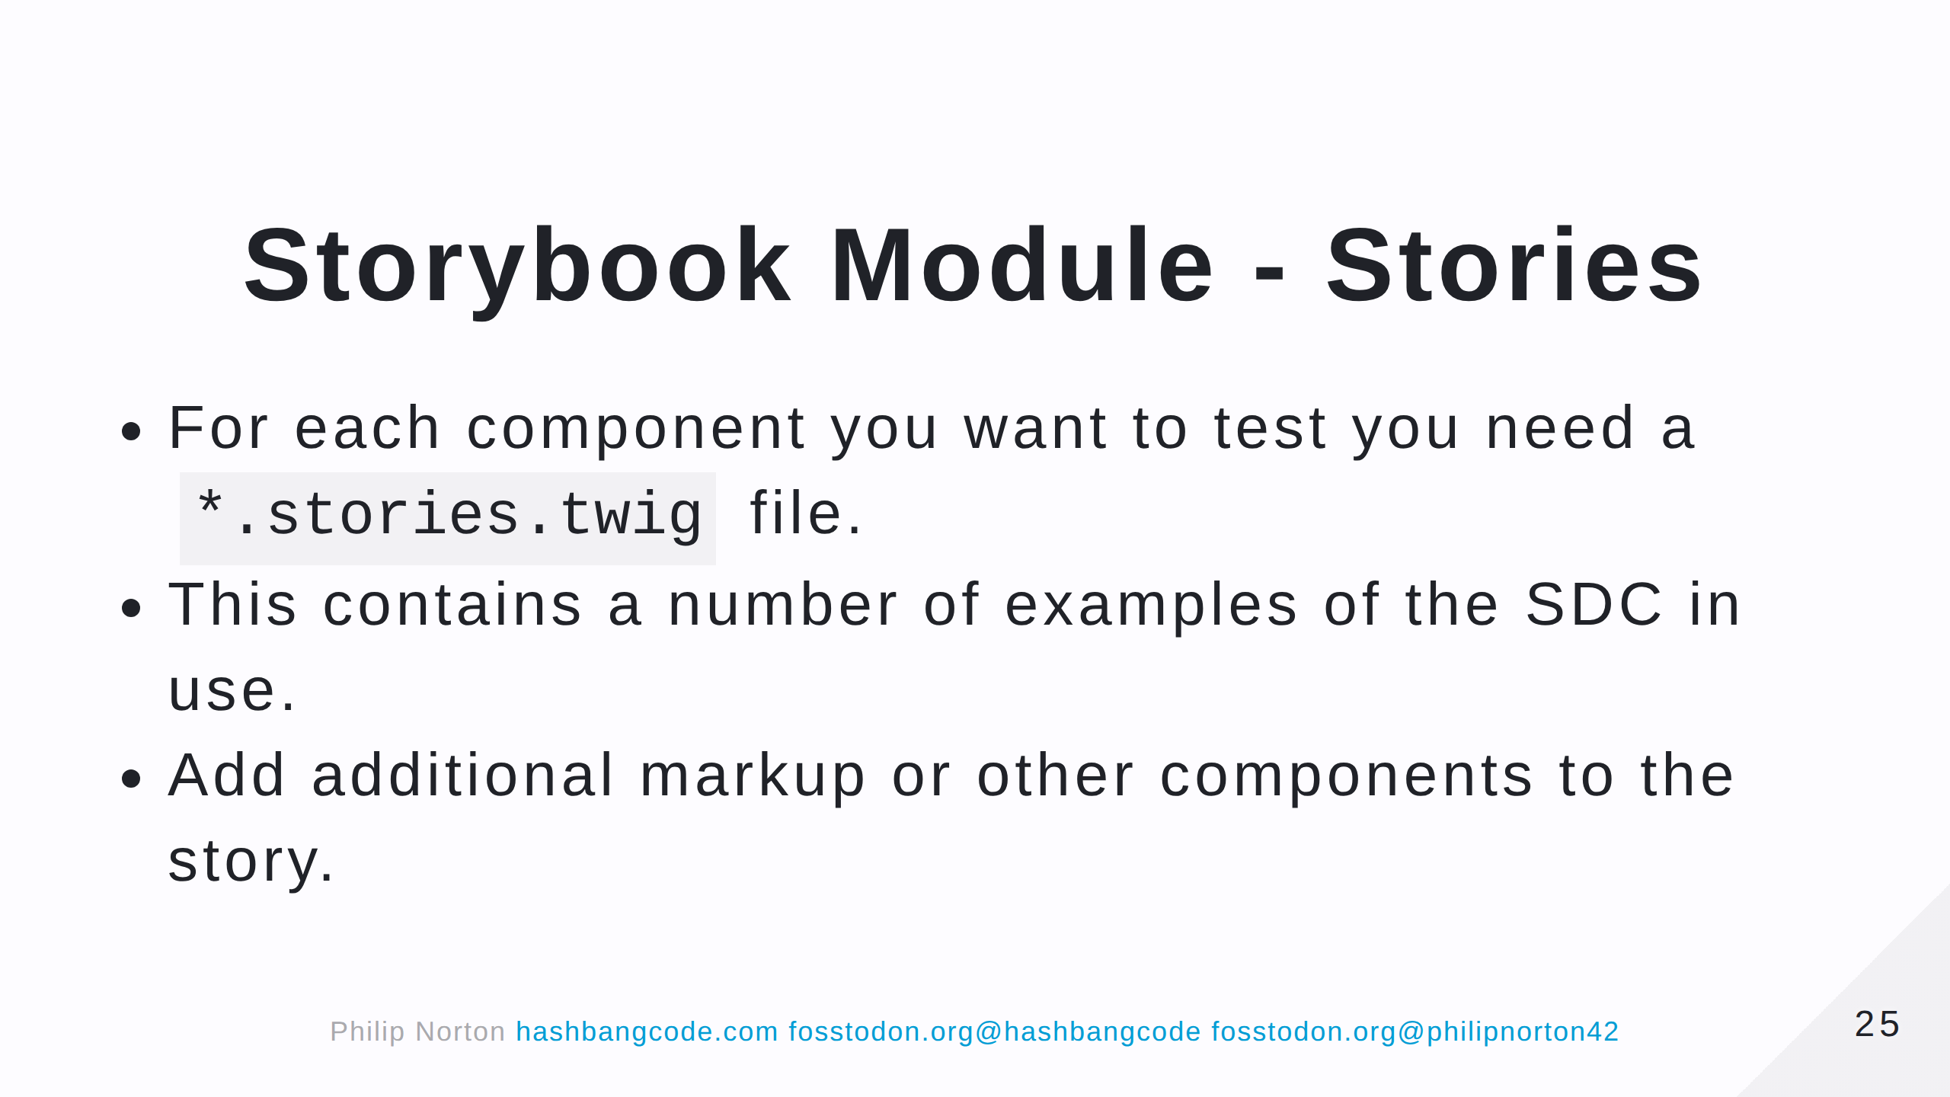

Slide 26
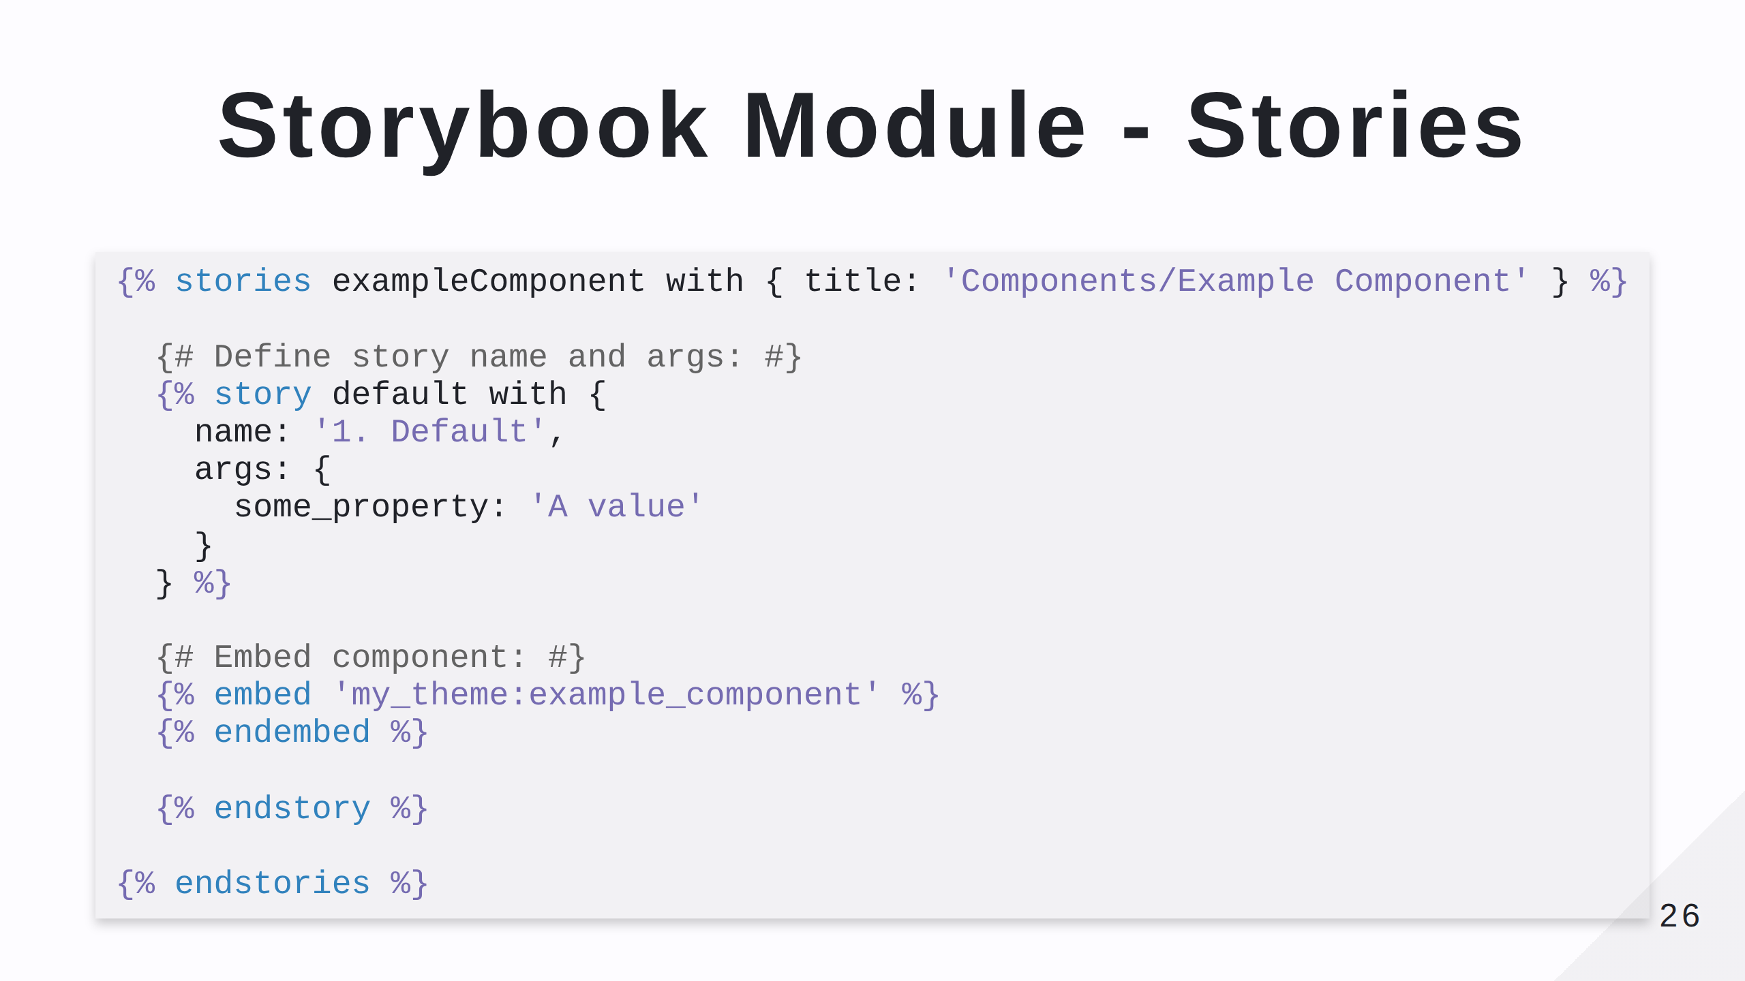

Slide 27
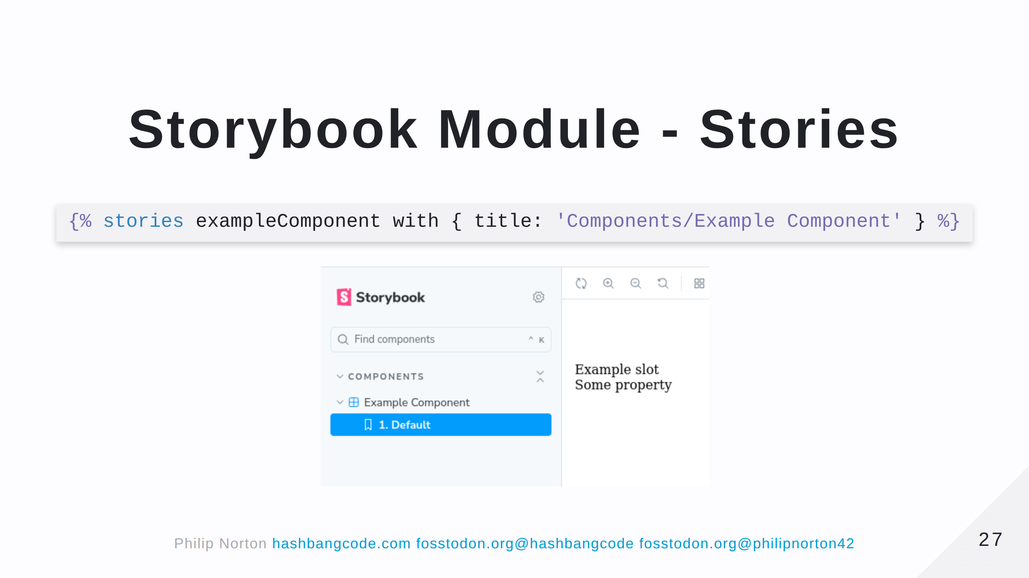

Slide 28
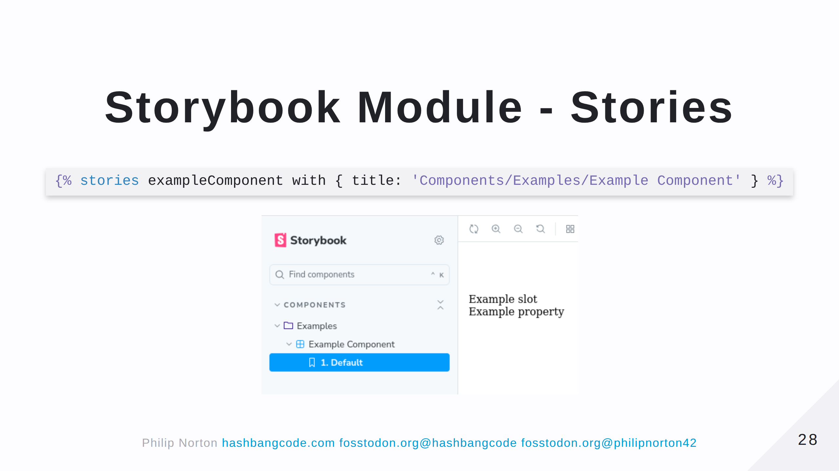

Slide 29
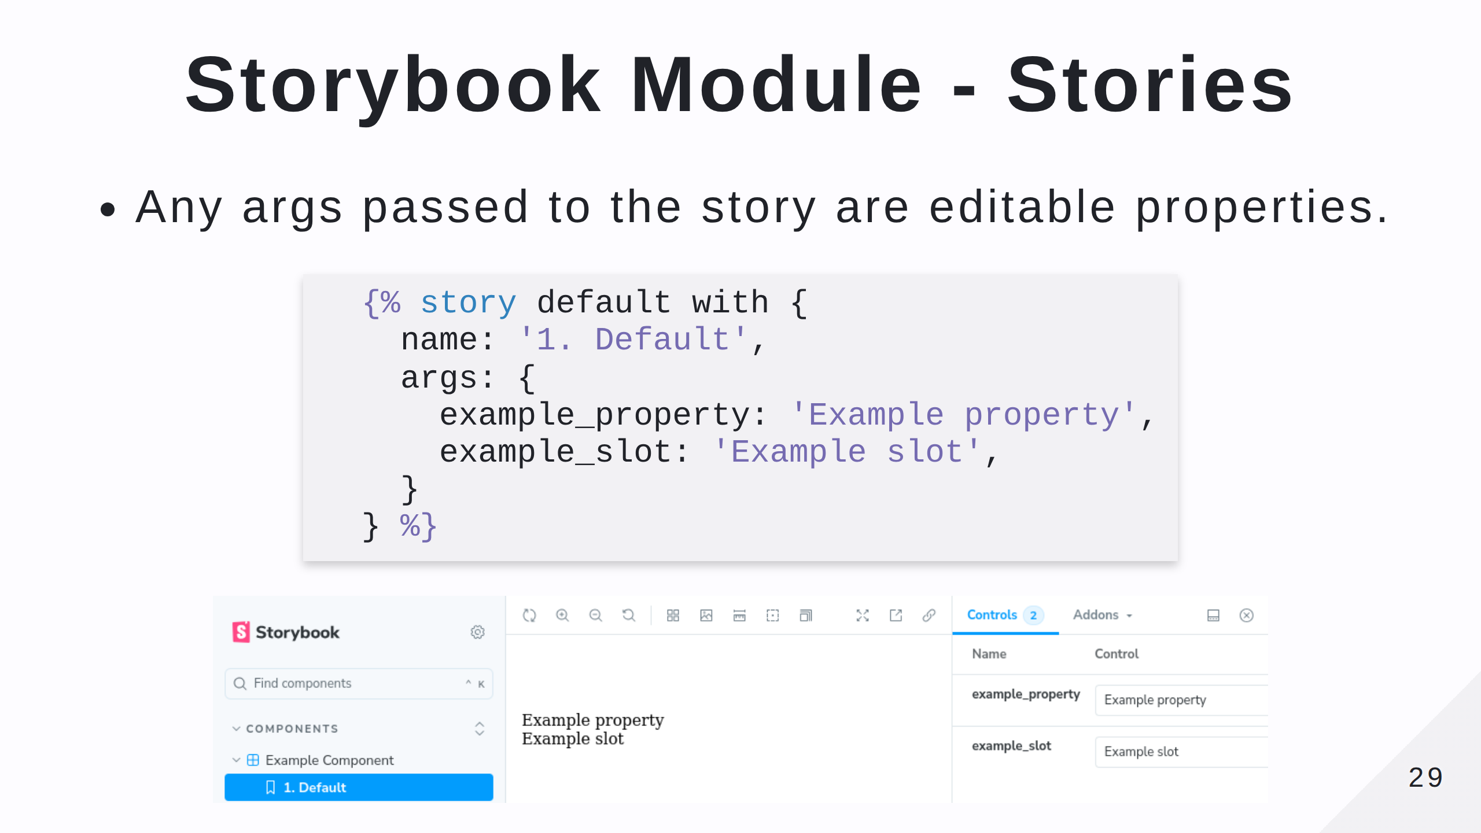

Slide 30
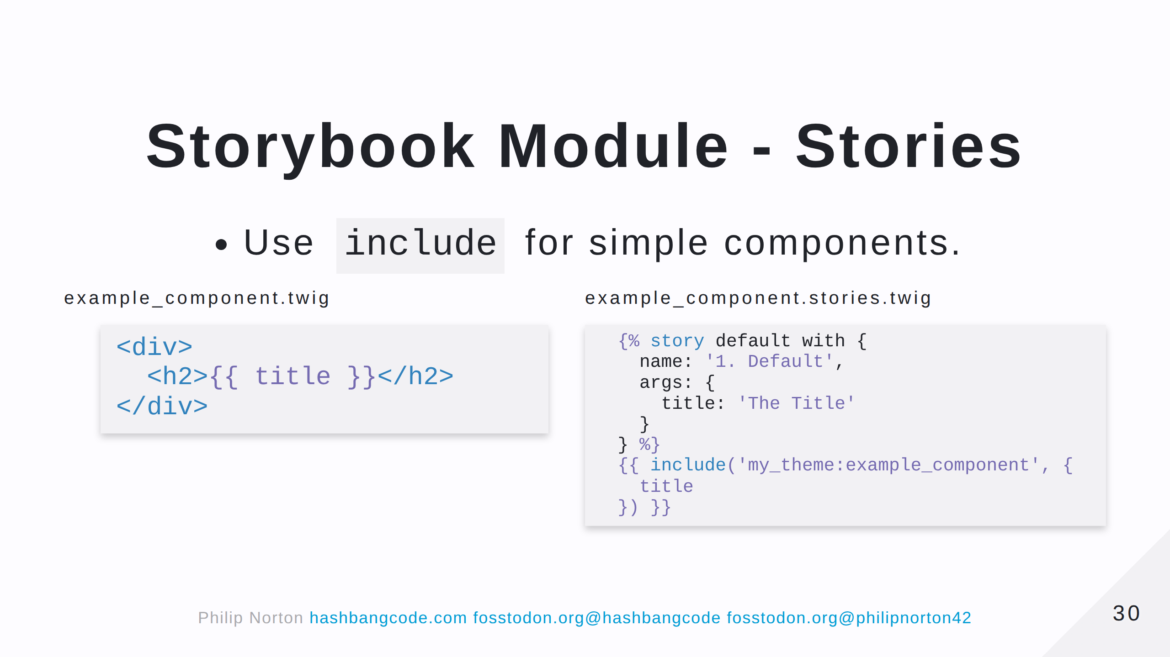

Slide 31
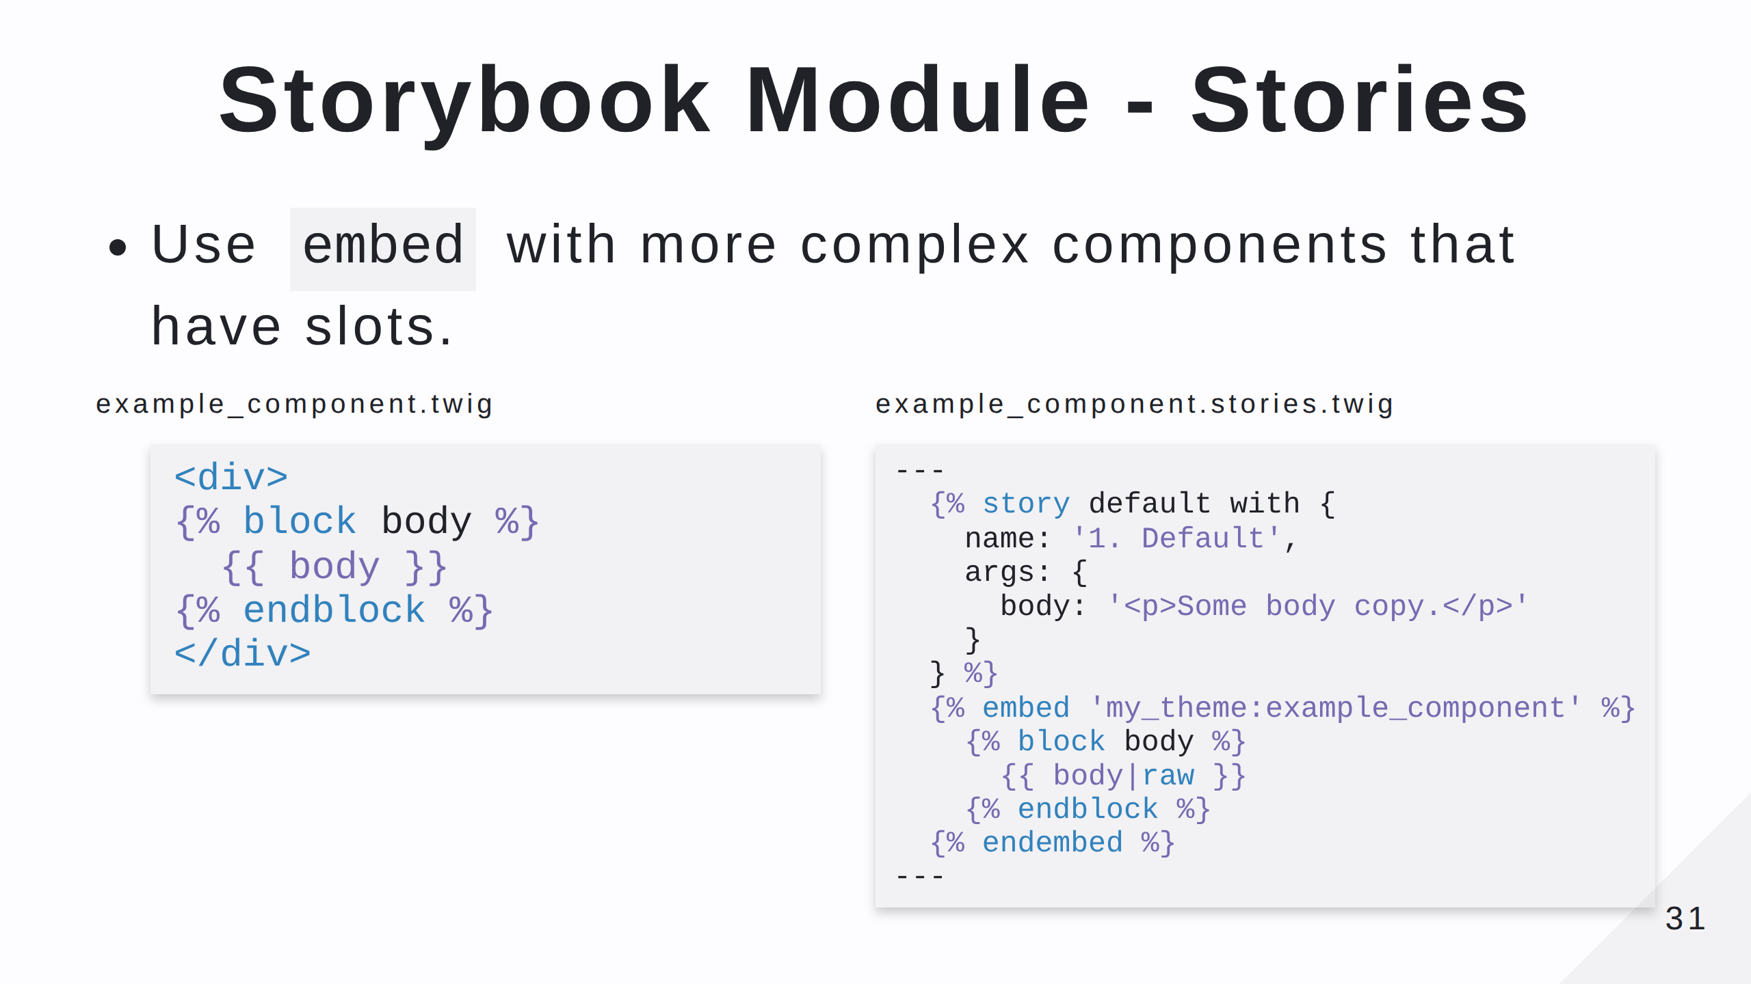
Notes:
Note that in this case any `props` we have defined will be passed to the template automatically.

Slide 32
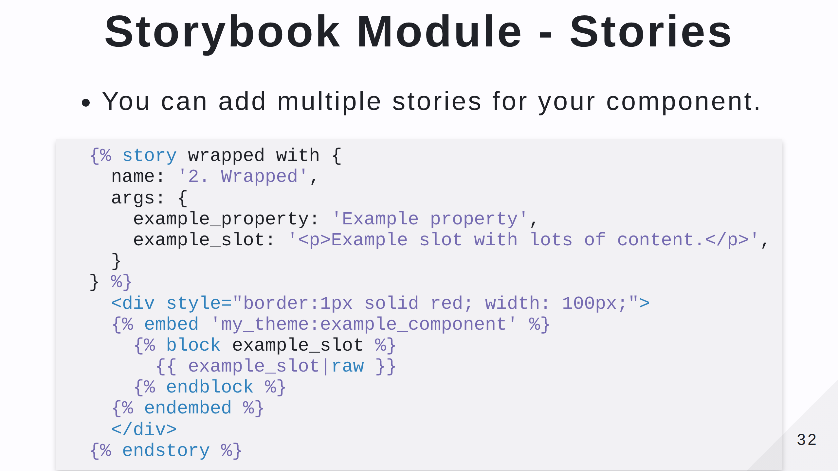
Notes:
This show a second story where the element in question is wrapped in a restrictive red box. You can add stories to show different content for your component, but also think about the surrounding elements on the page. Adding in some example markup to show the component in situ can be really useful.

Slide 33
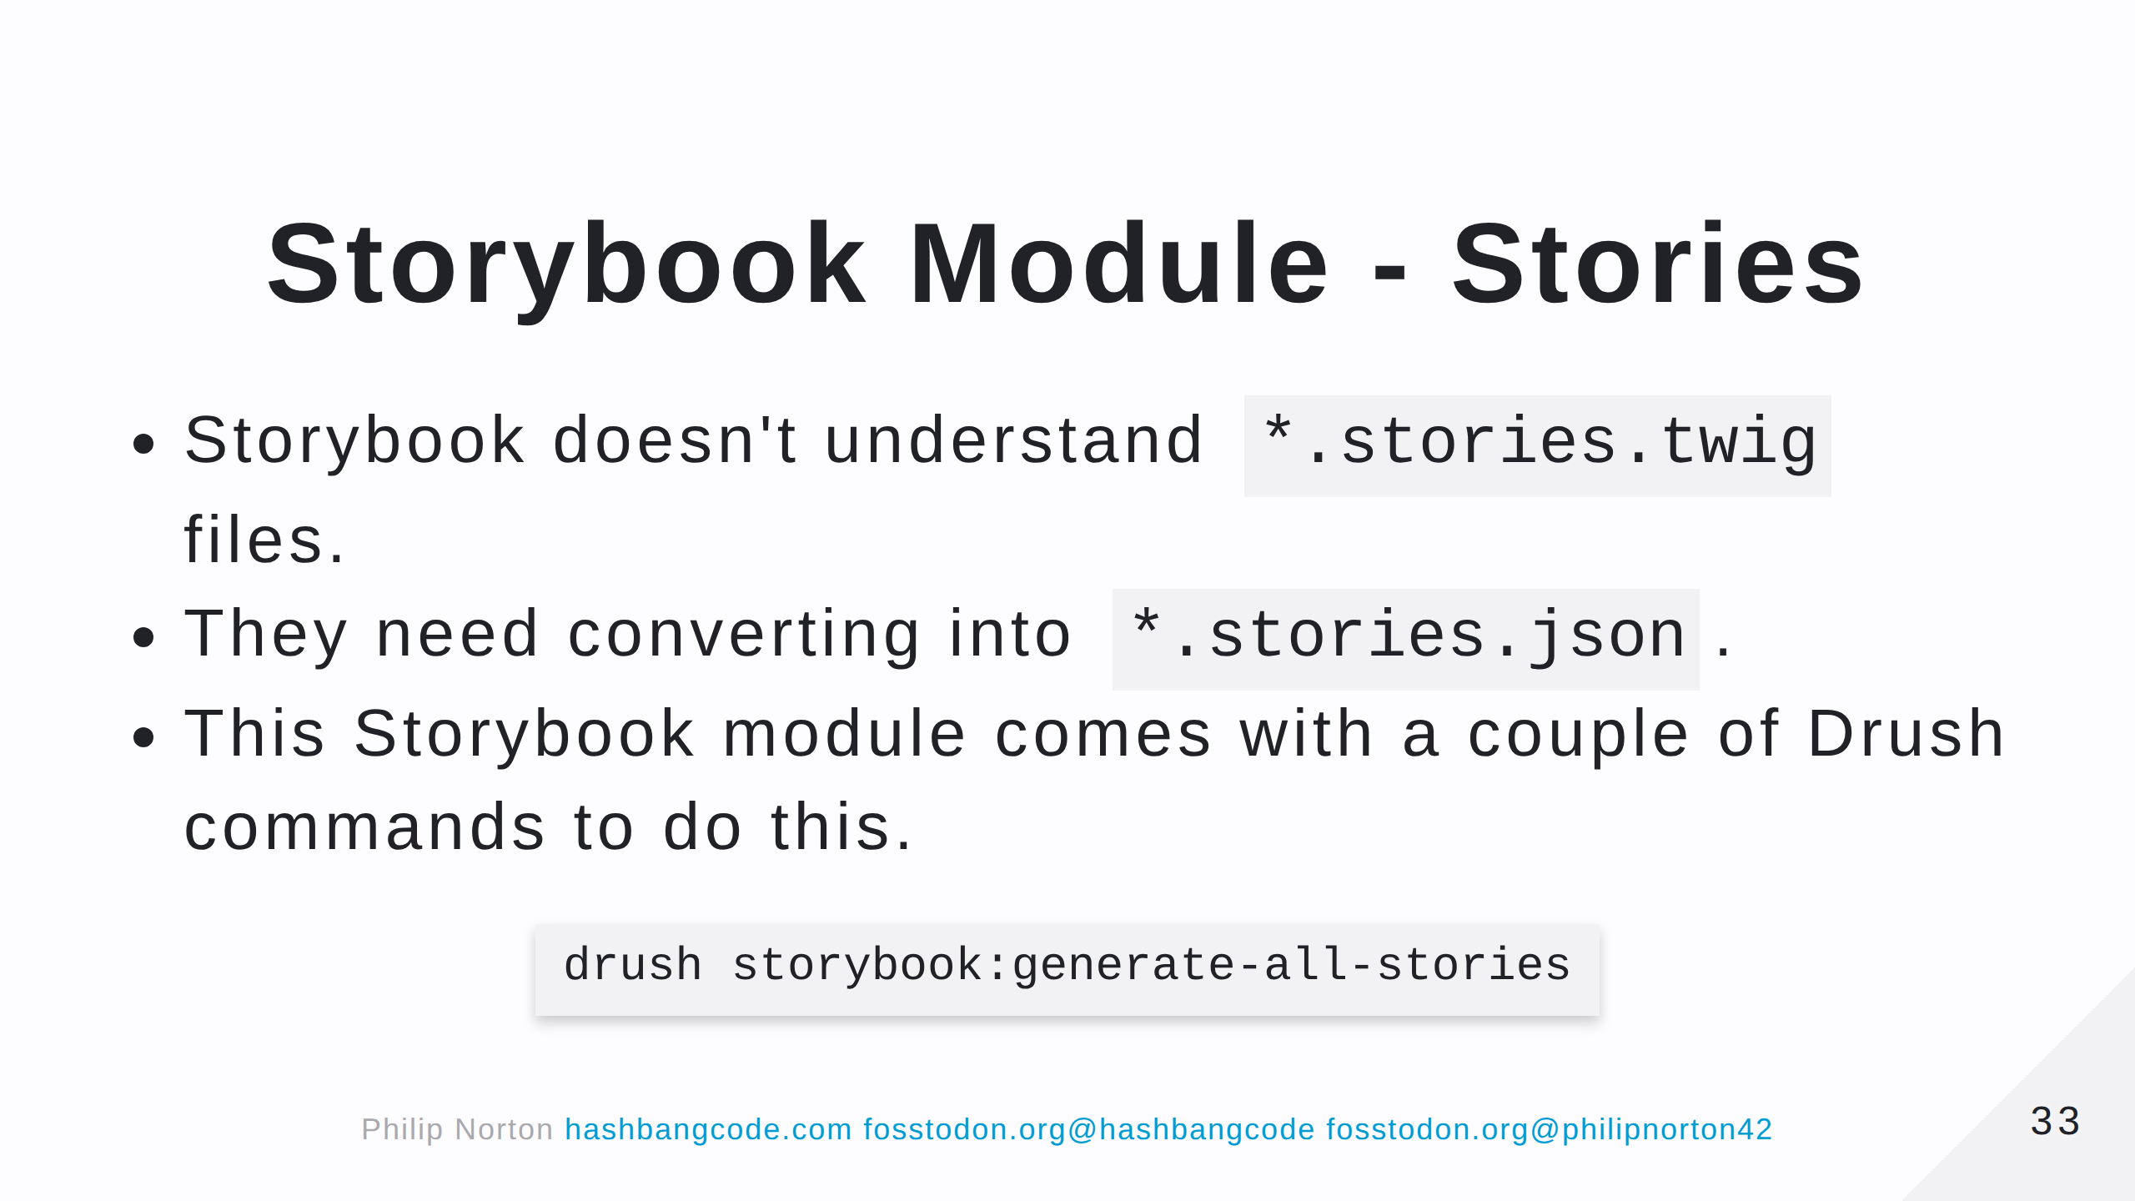

Slide 34
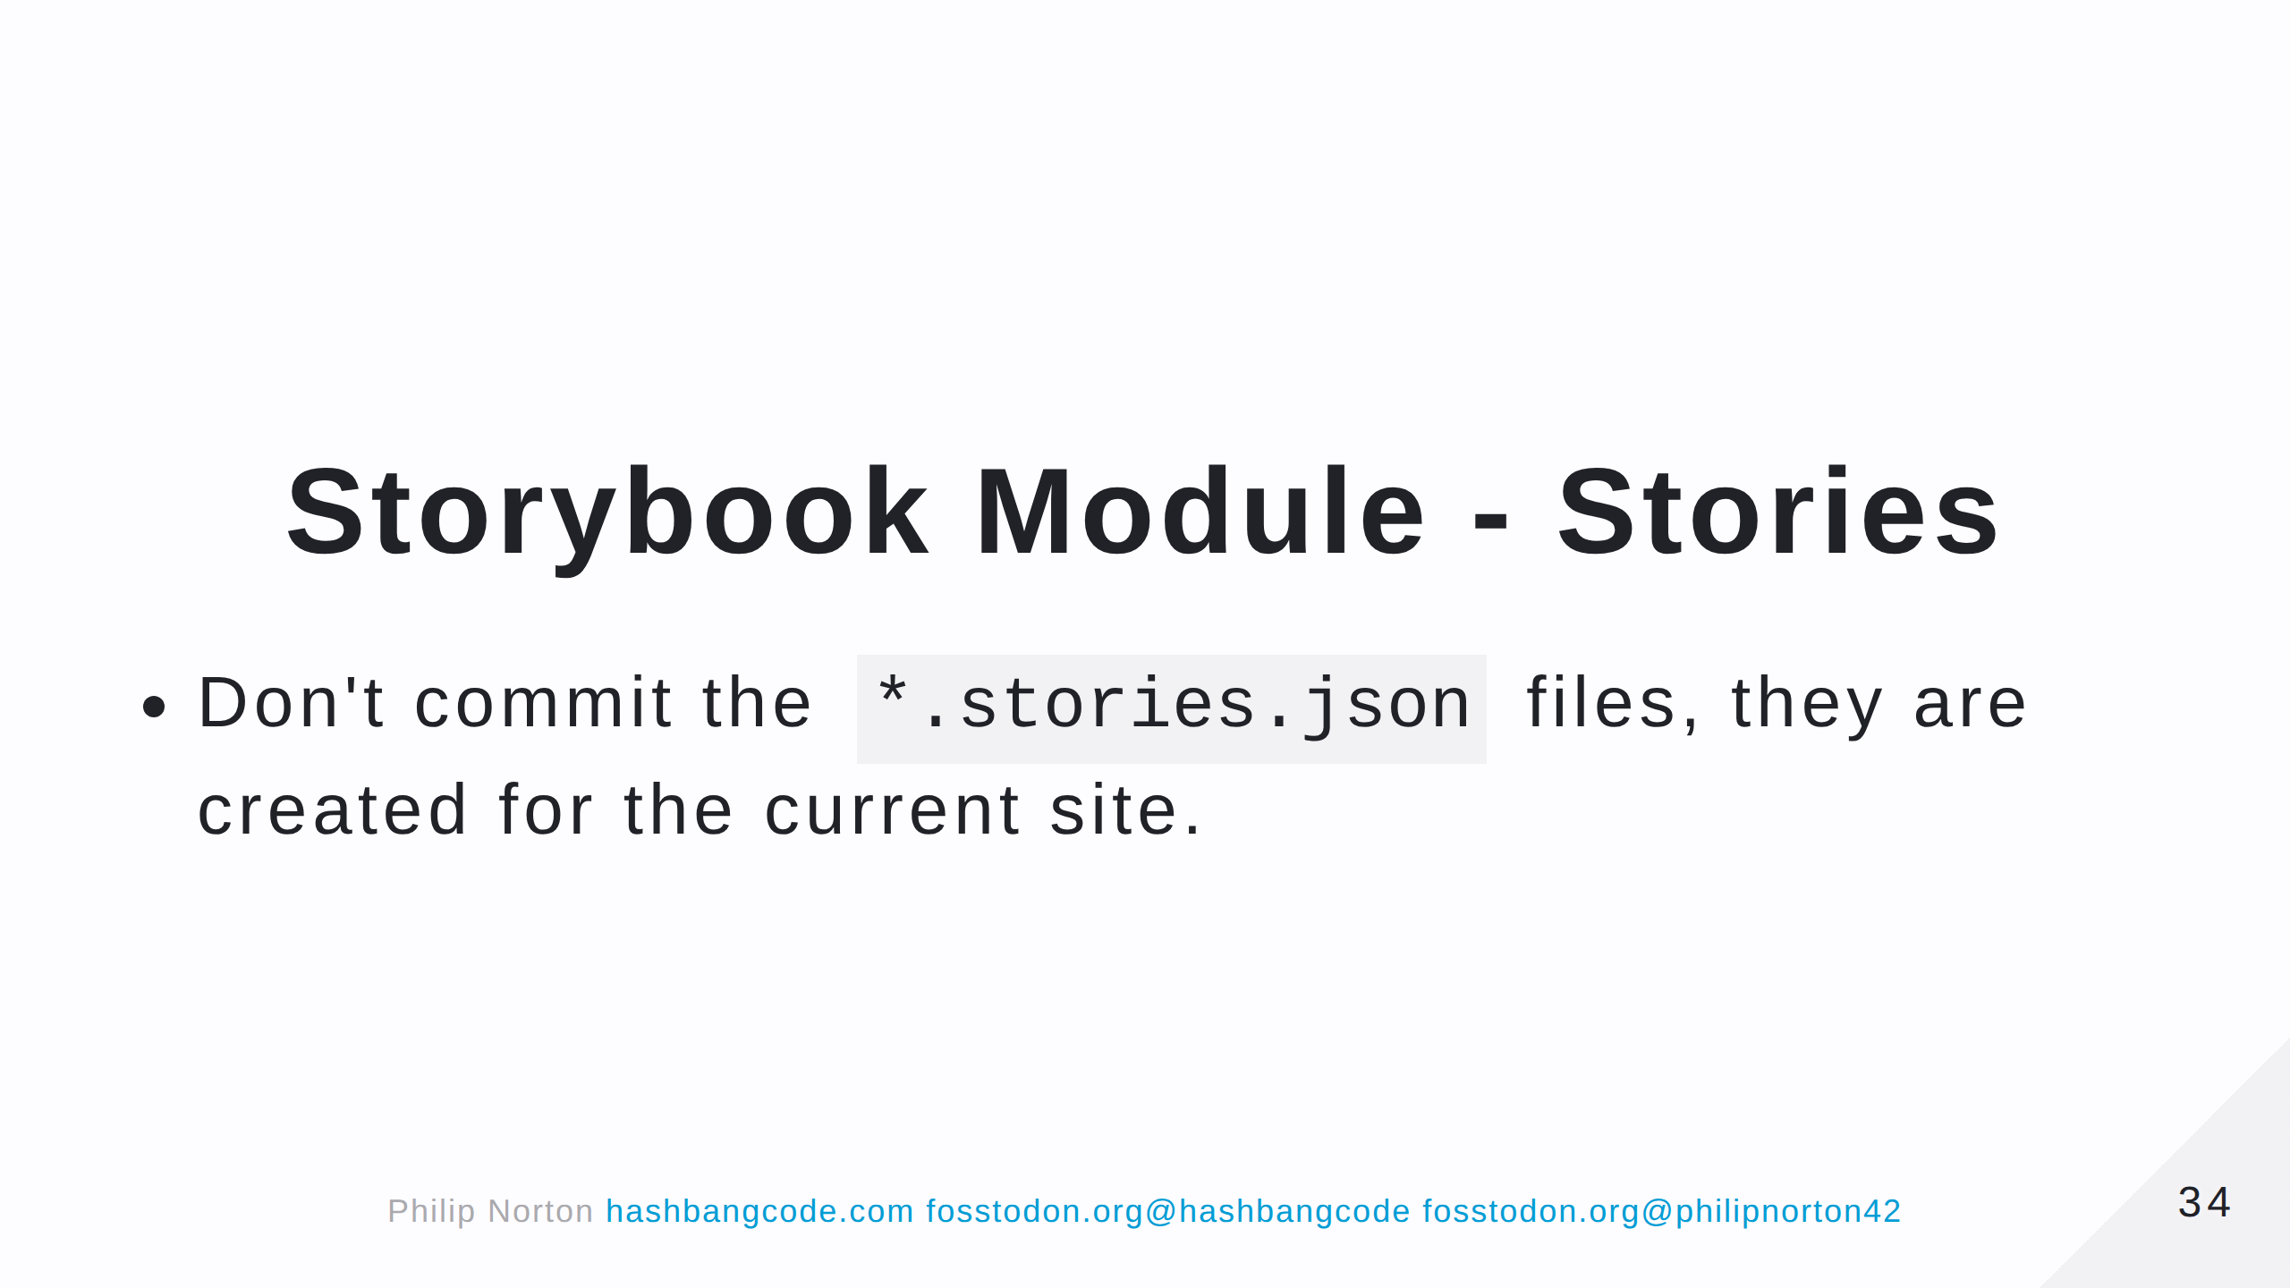

Slide 35
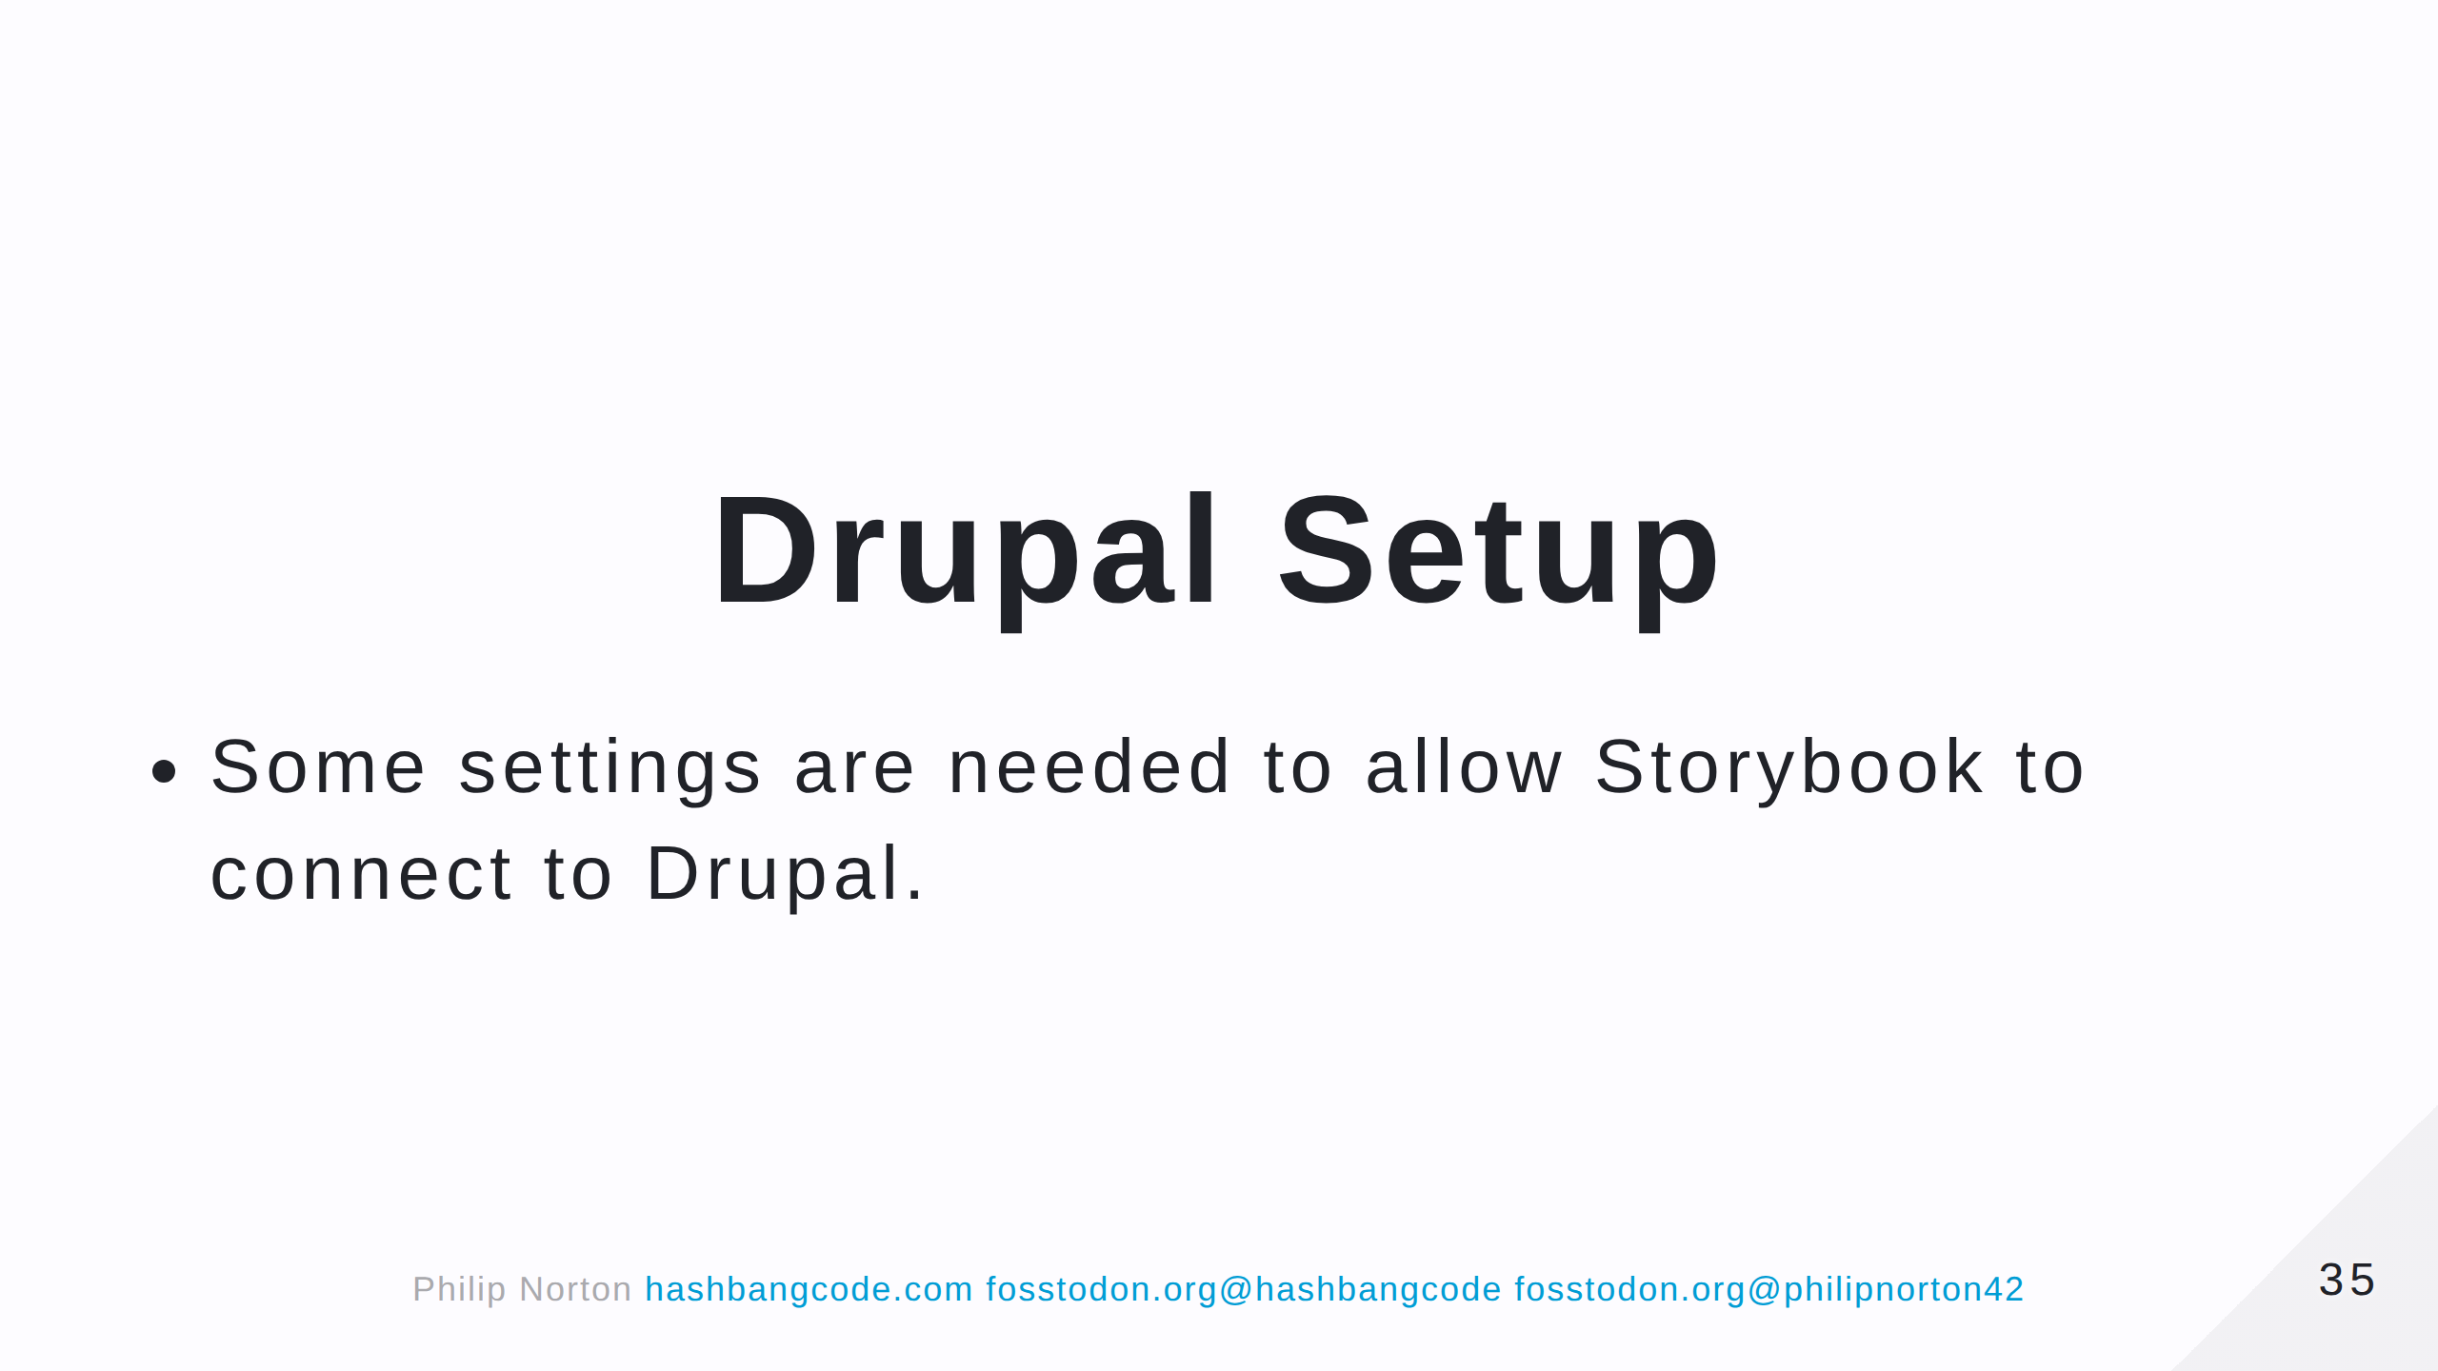

Slide 36
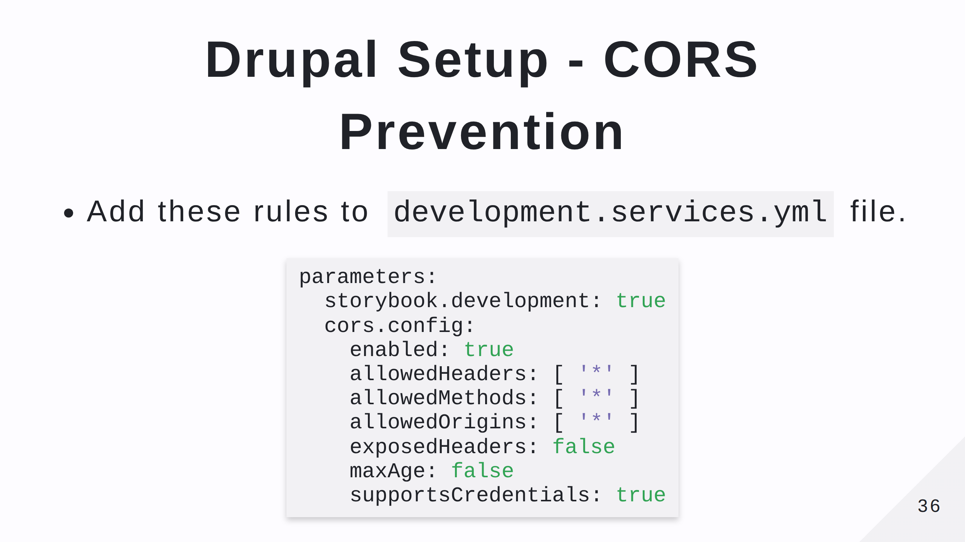
Notes:
CORS = Cross-Origin Resource Sharing Prevents websites from

Slide 37
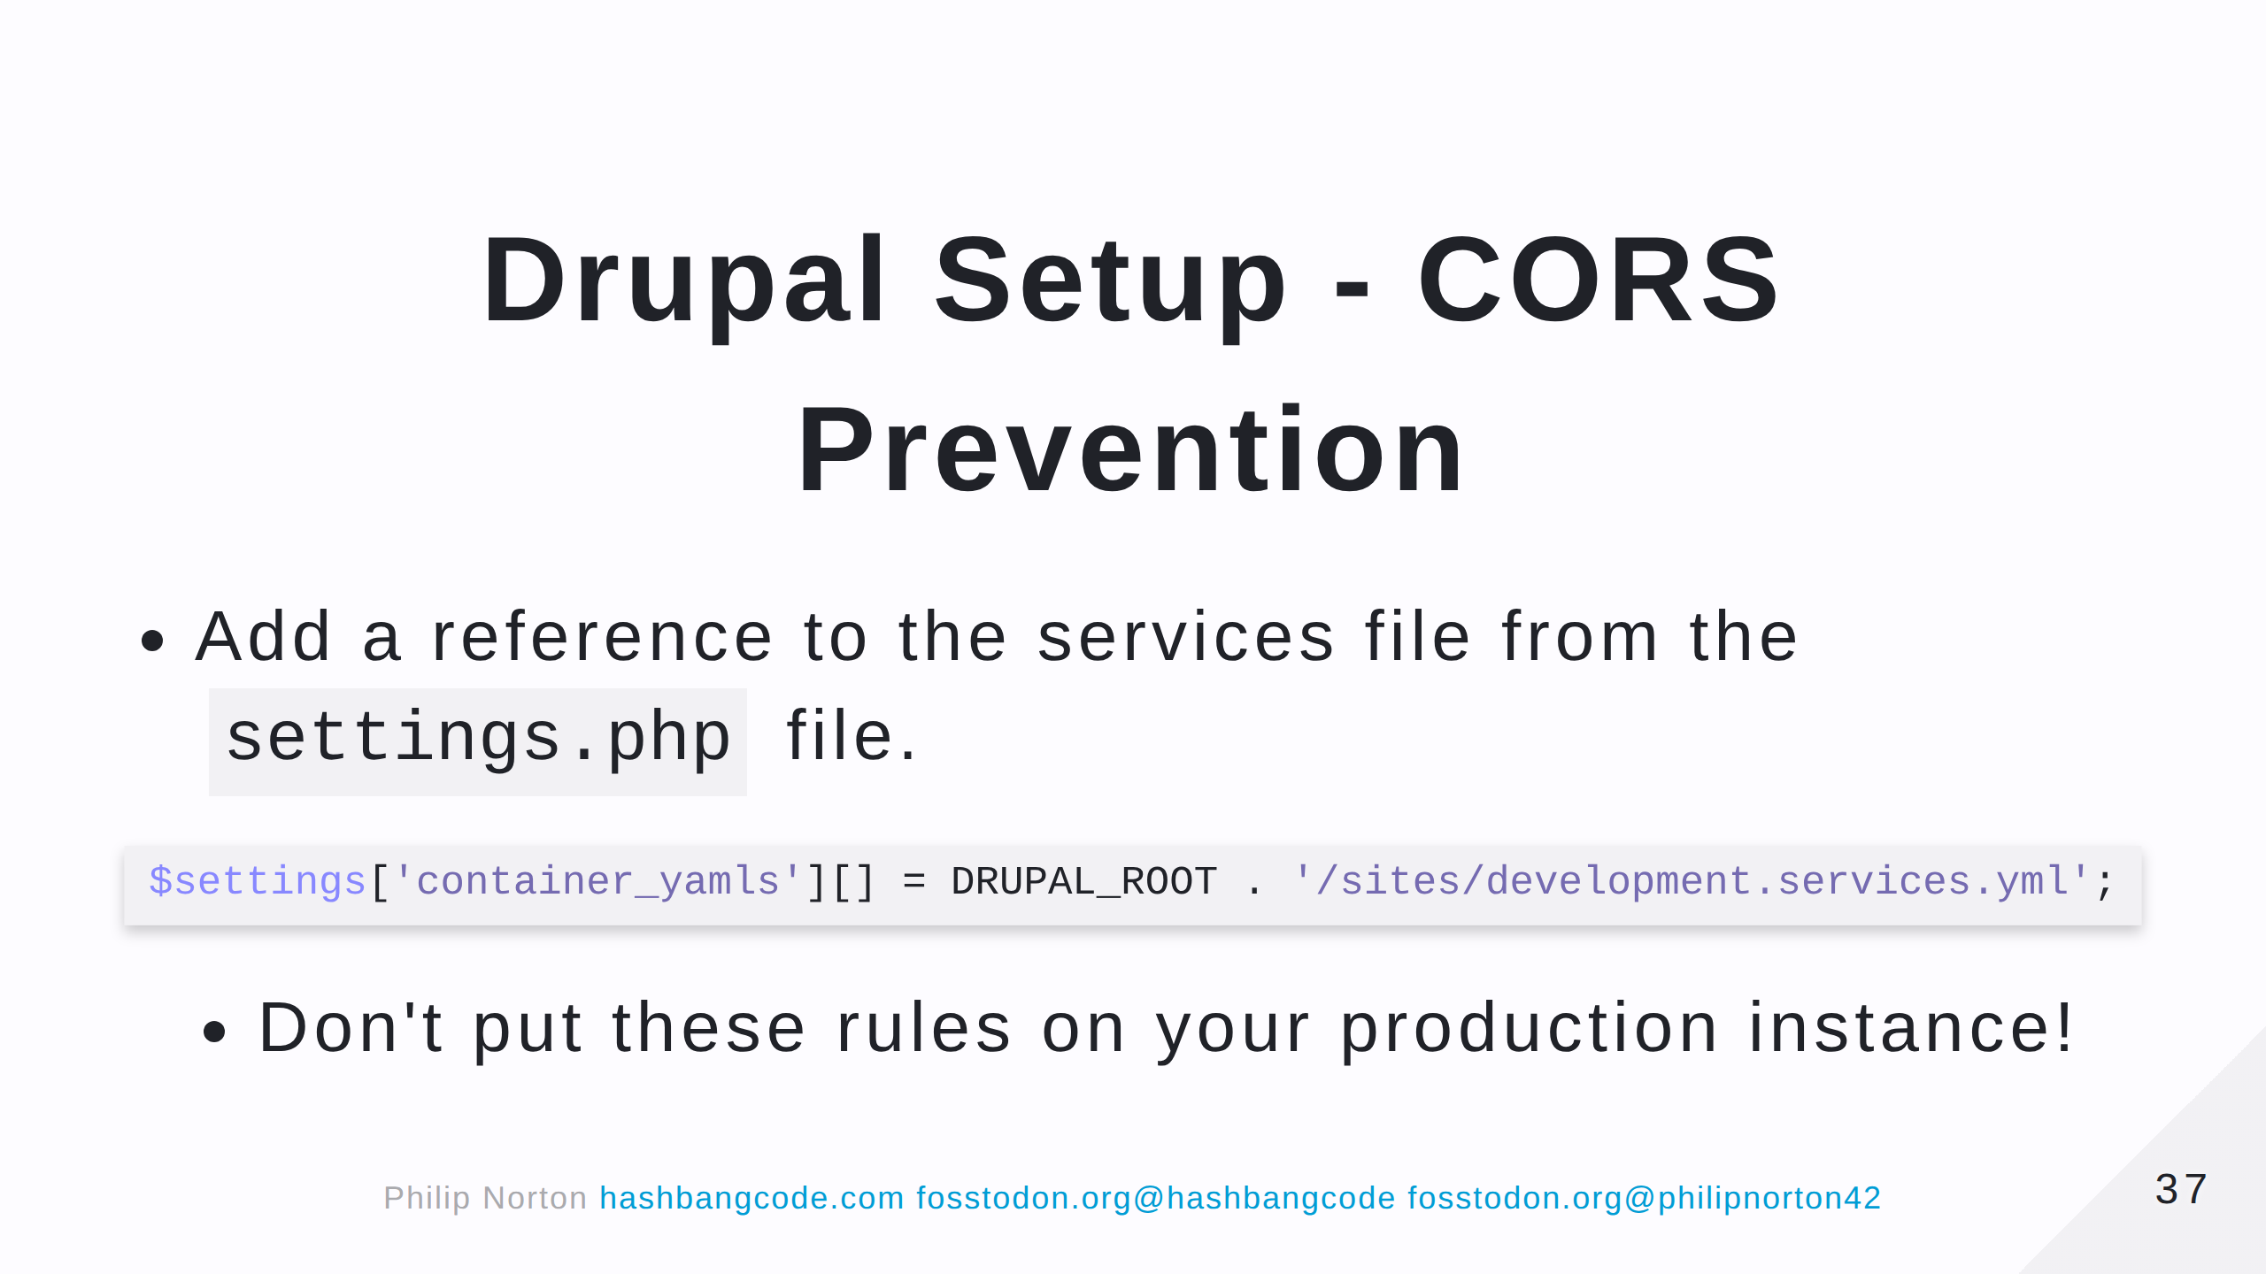

Slide 38
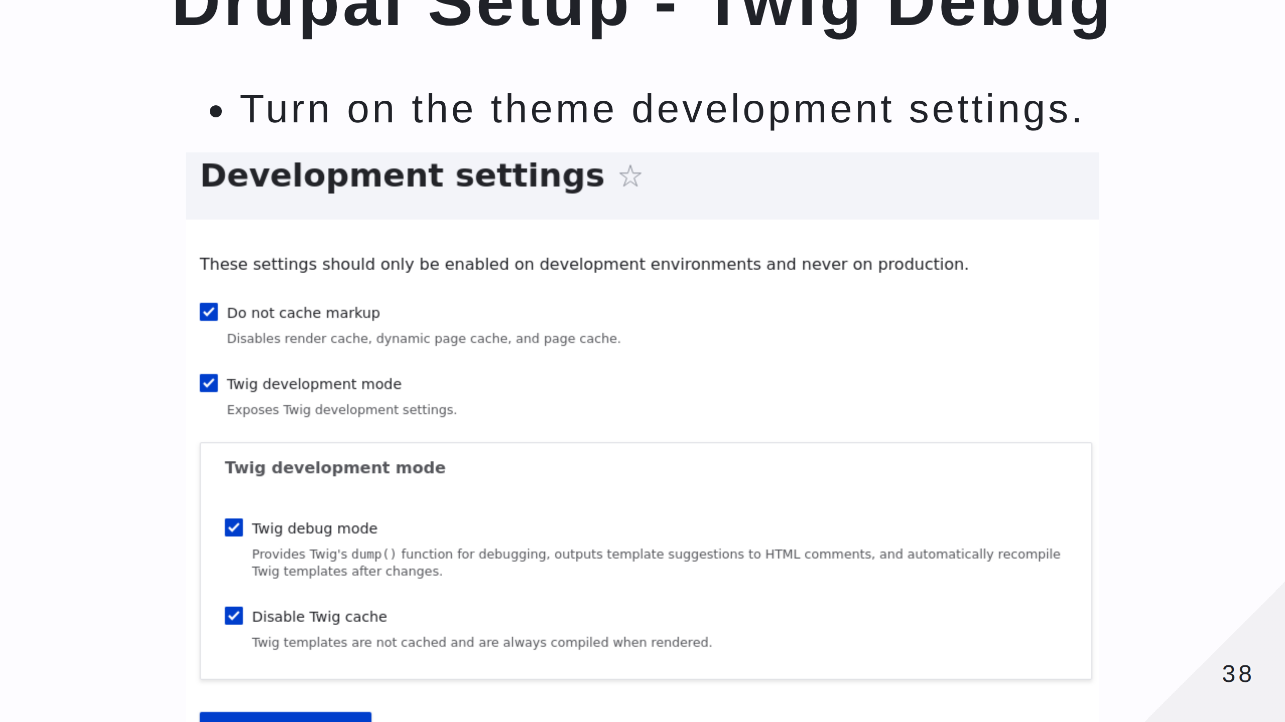

Slide 39
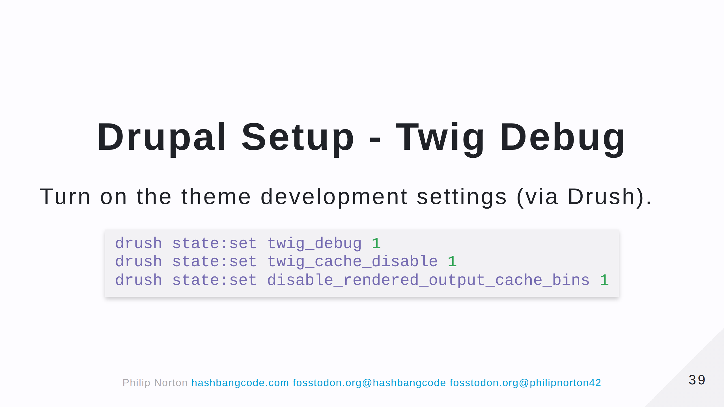

Slide 40
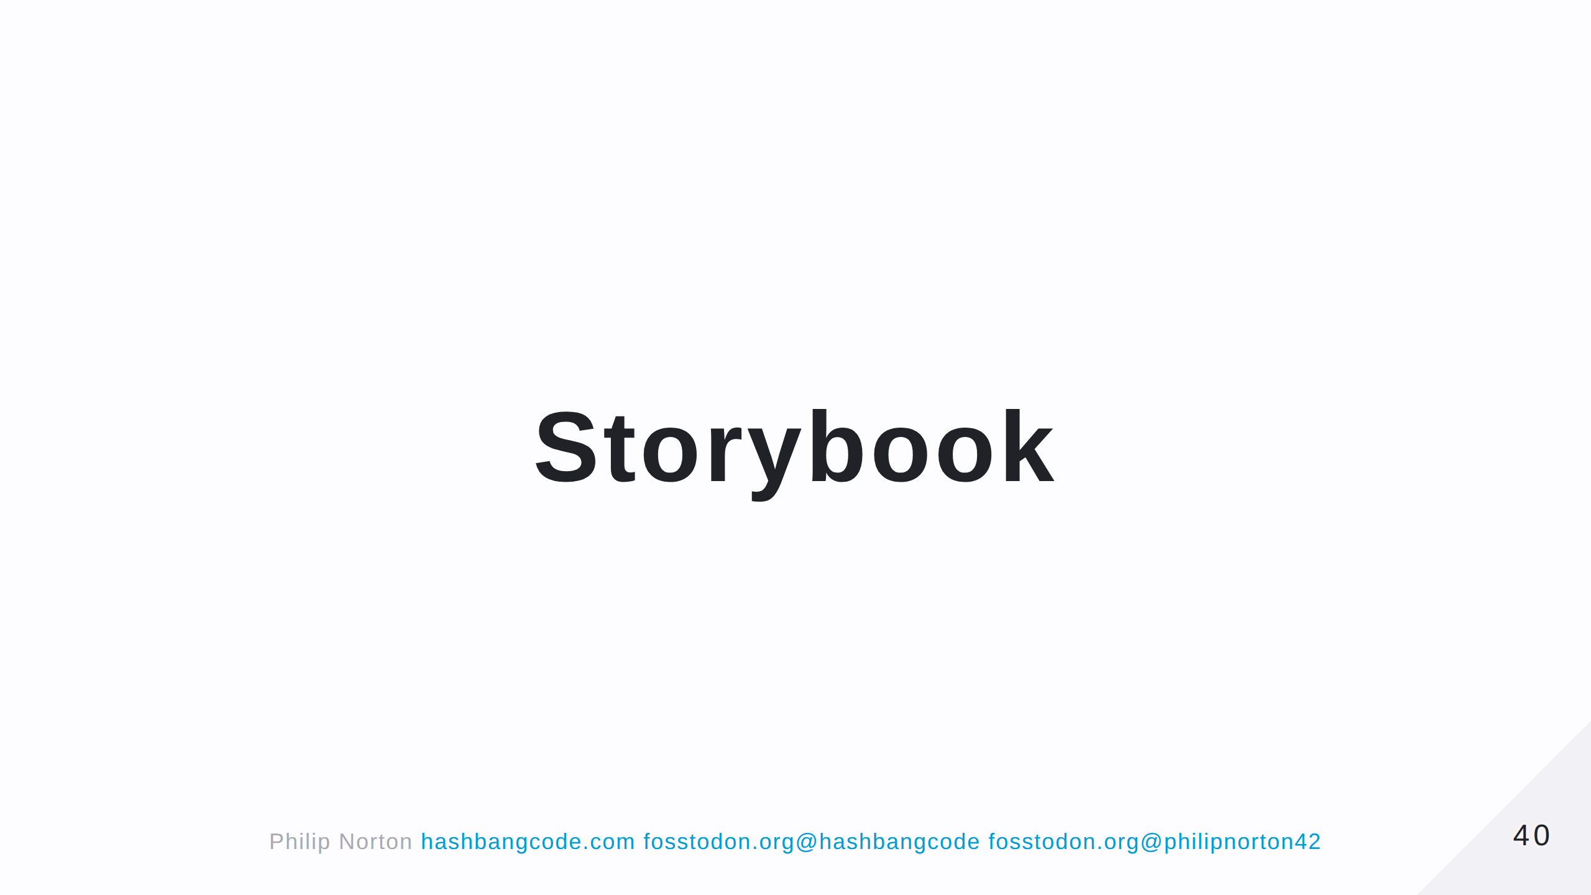

Slide 41
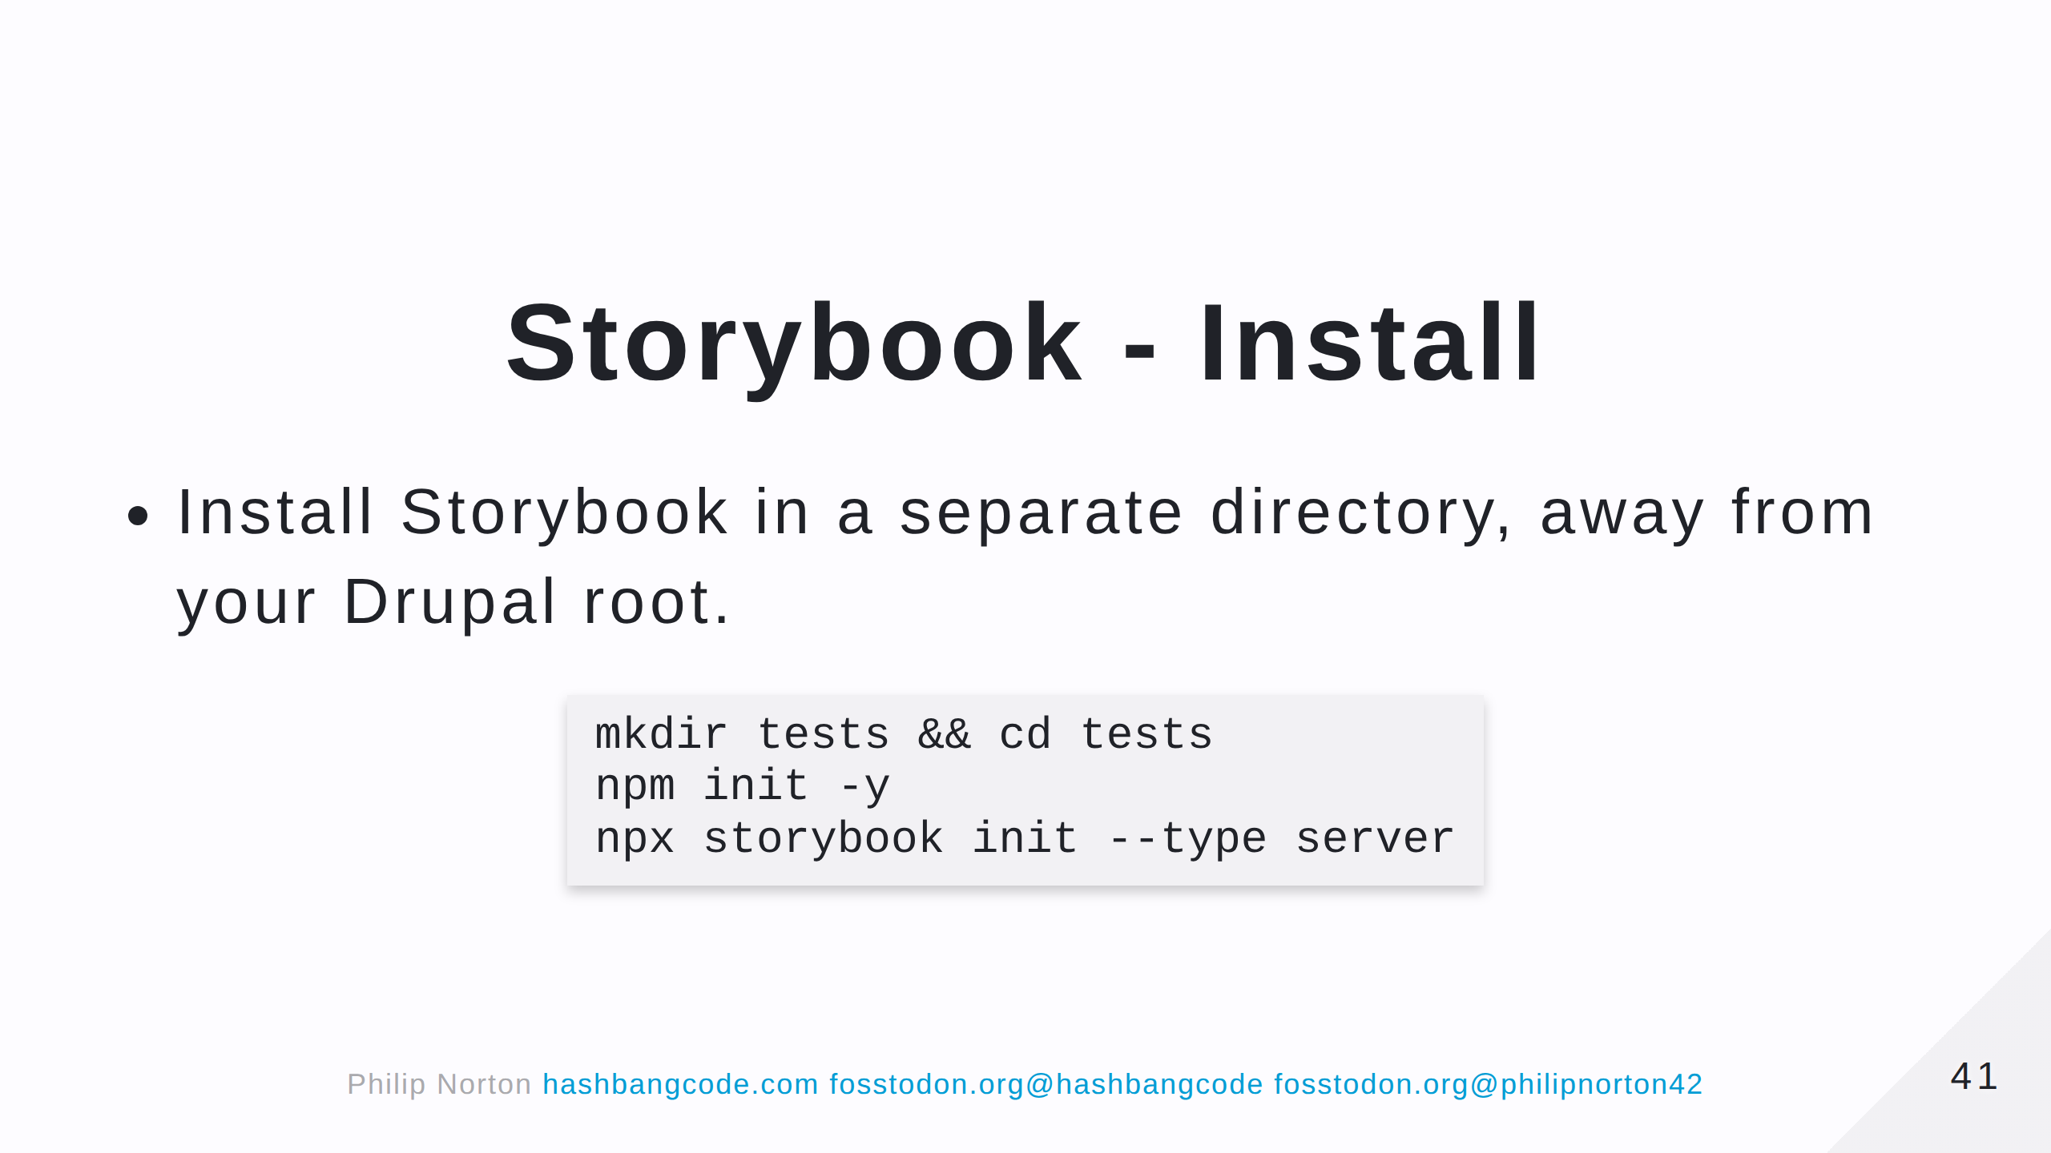

Slide 42
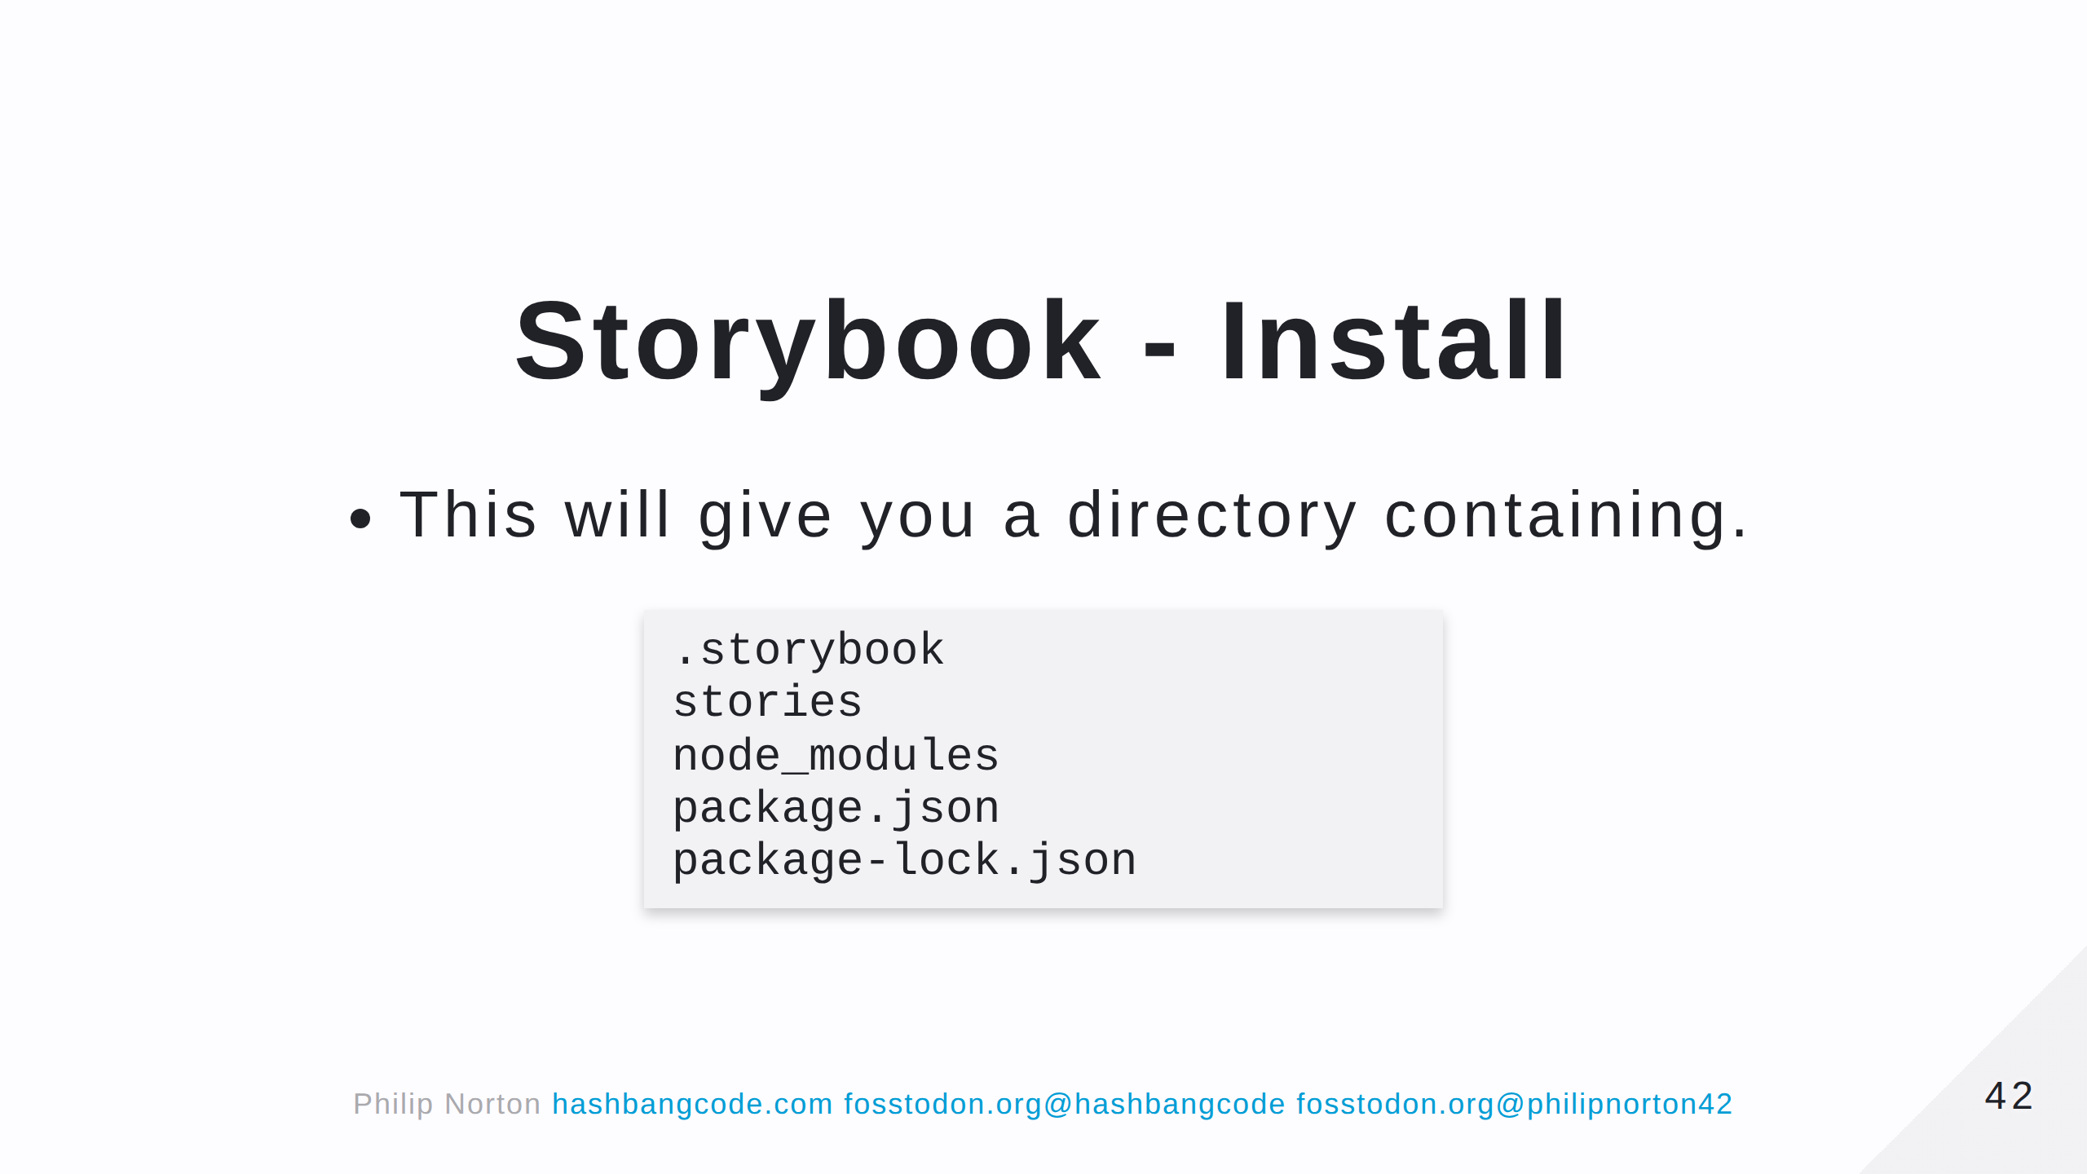
Notes:
- .storybook is the storybook configuration directory. - stories contains some example stories. - The other directories are standard node directories.

Slide 43
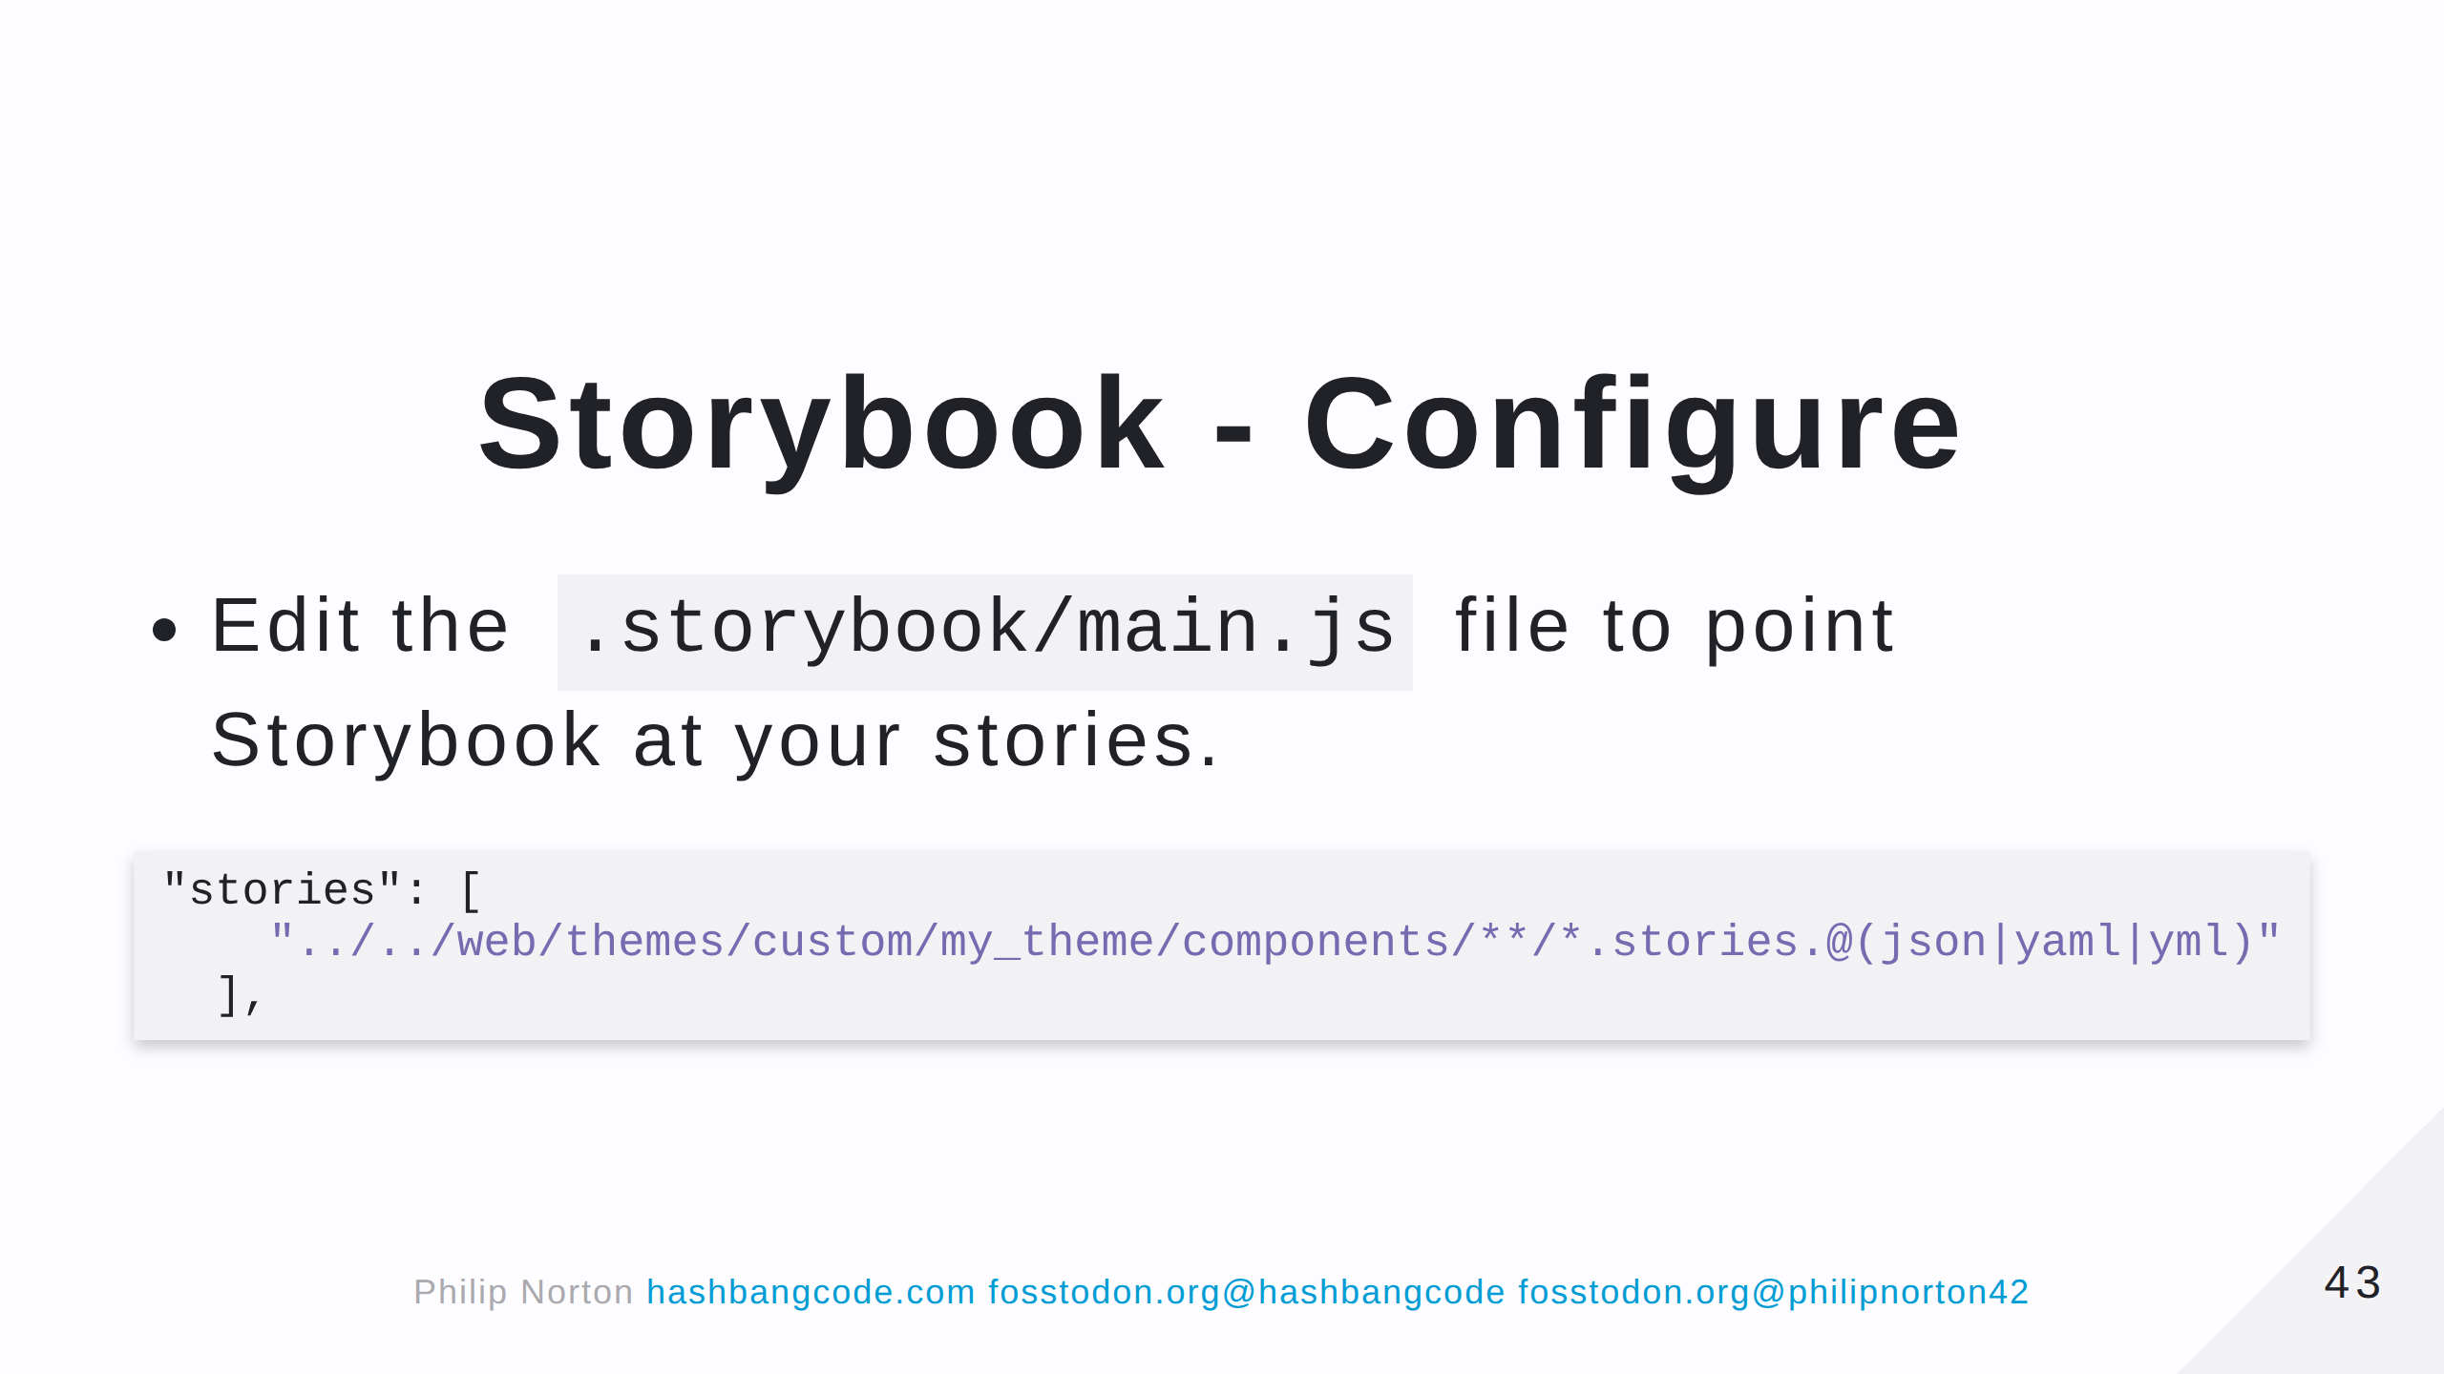
Notes:
Remember that you can have stories in themes and modules, so you can have multiple lines here pointing at different directories. The modules and themes don't need to be active, as long as they have a *.stories.twig

Slide 44
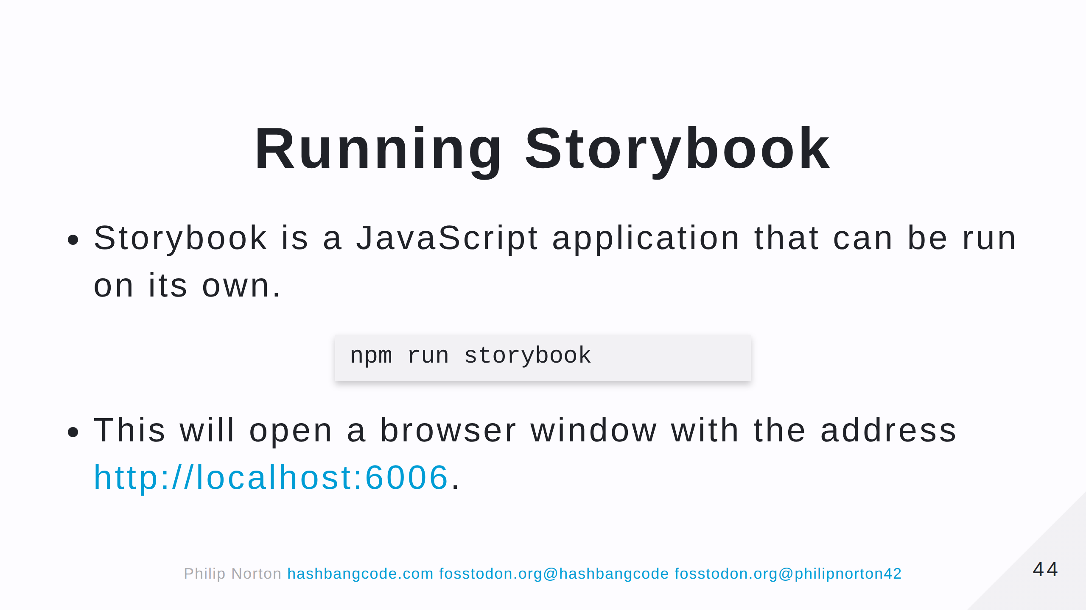

Slide 45
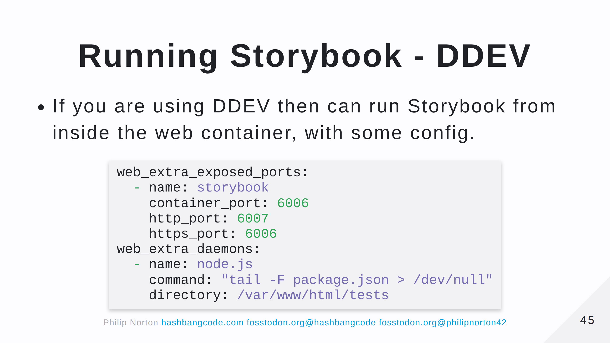

Slide 46
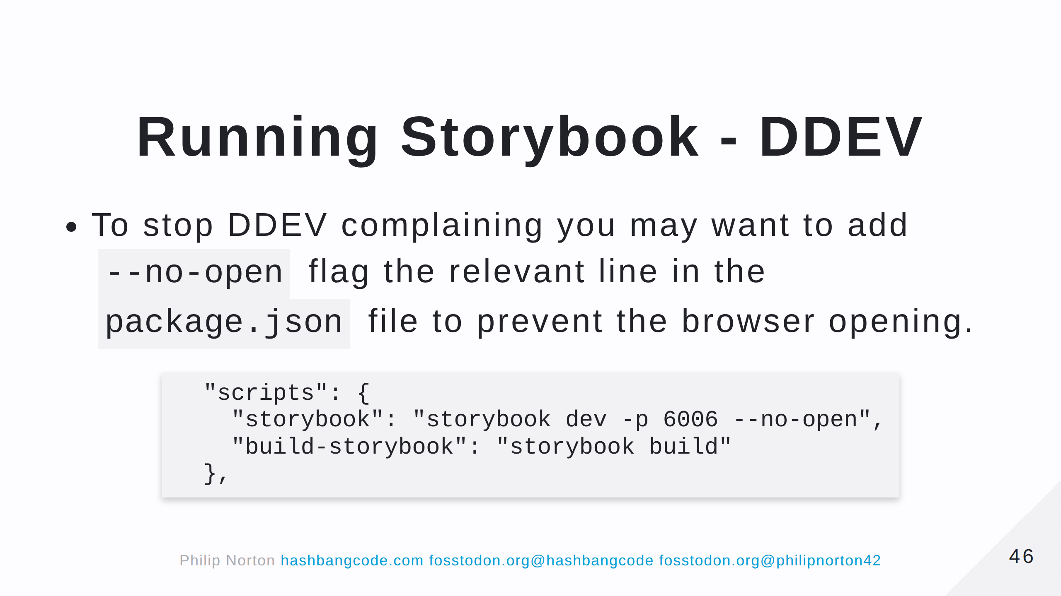

Slide 47
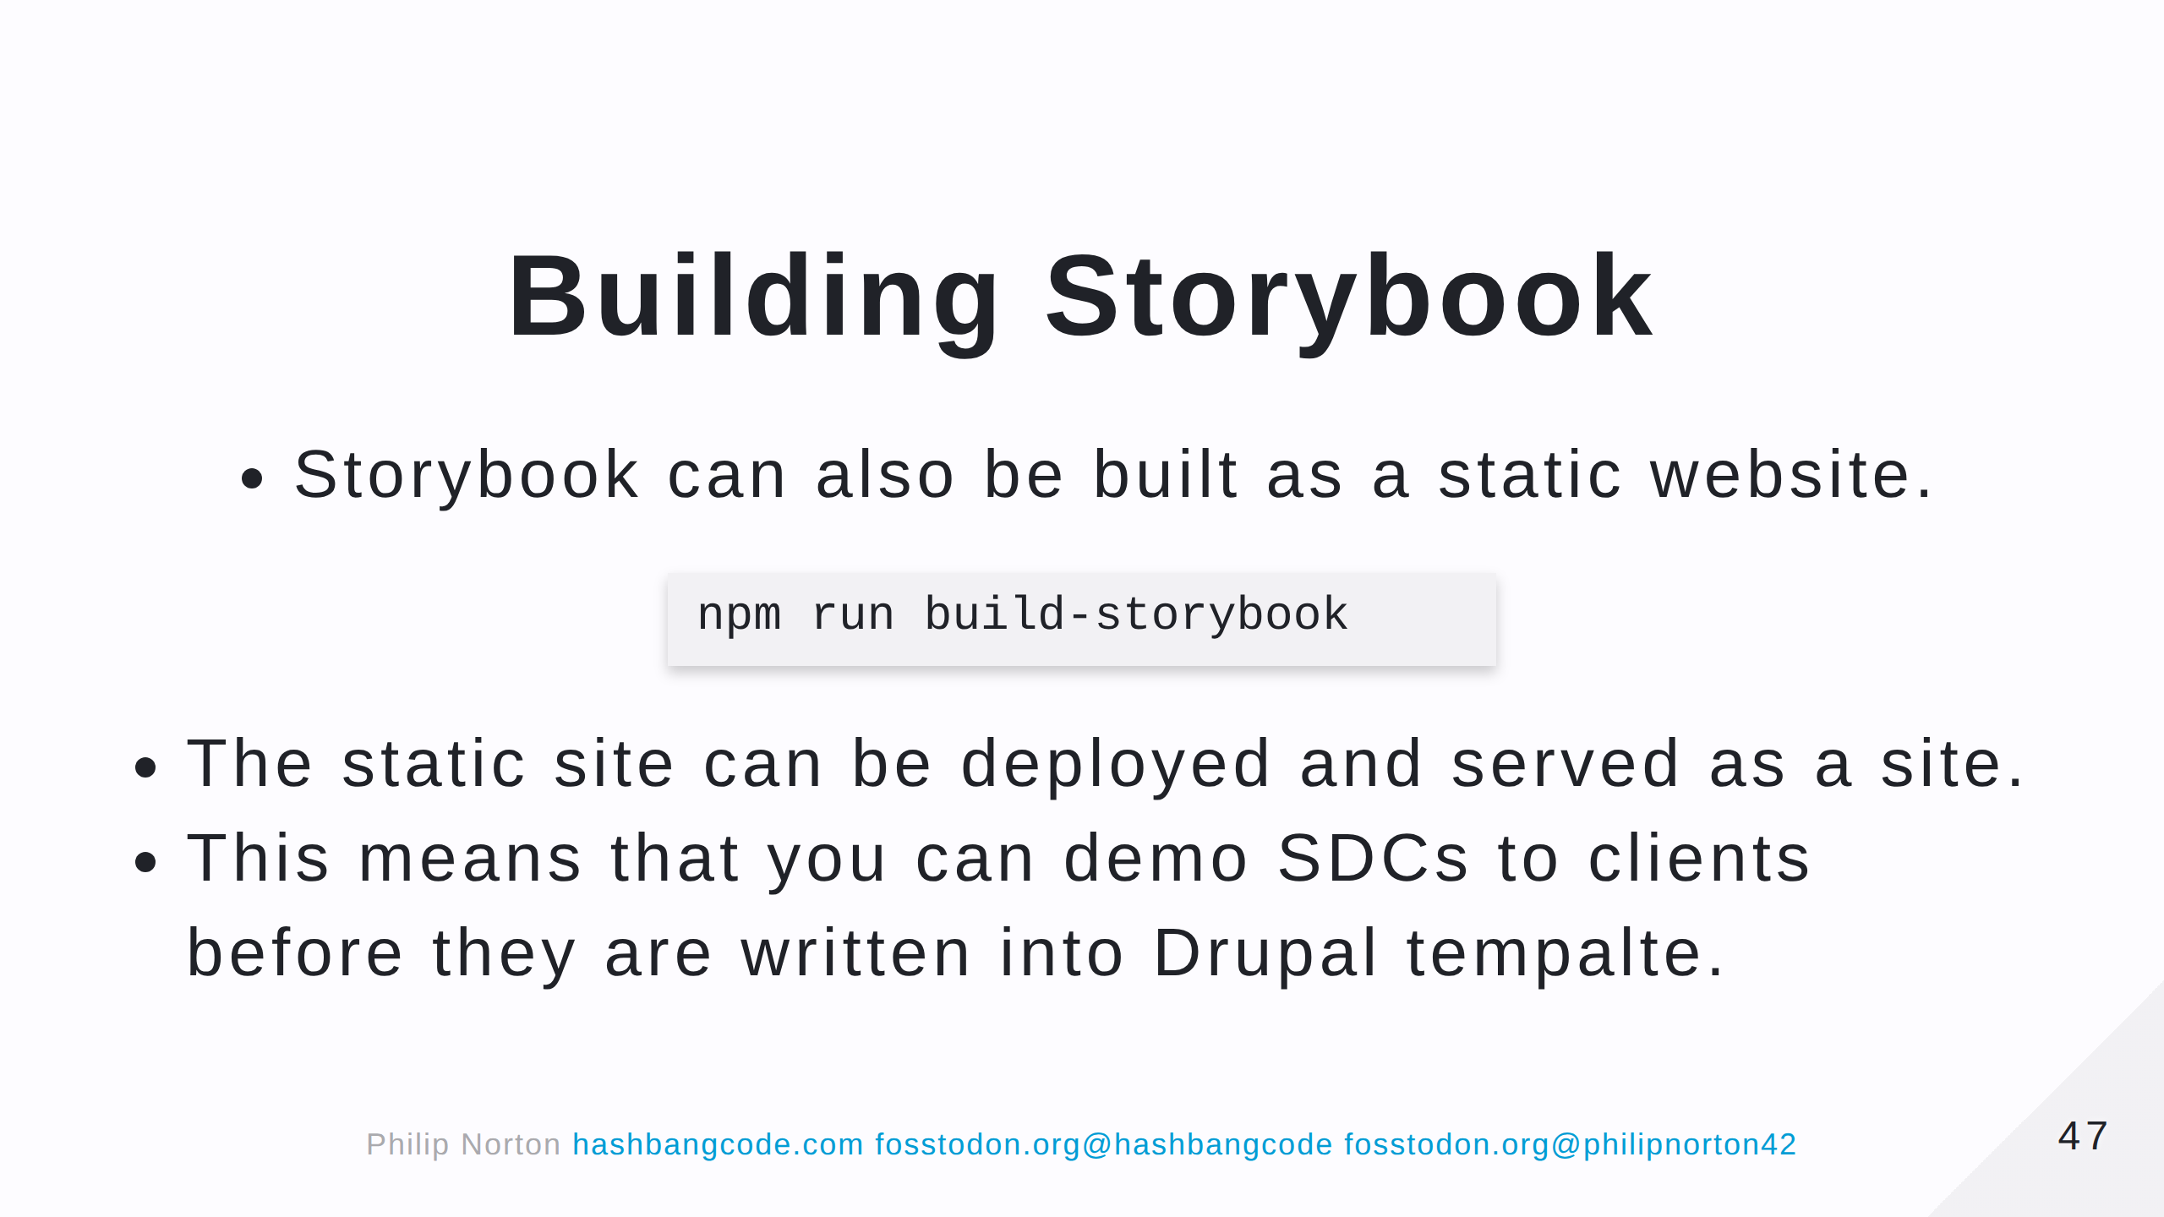

Slide 48
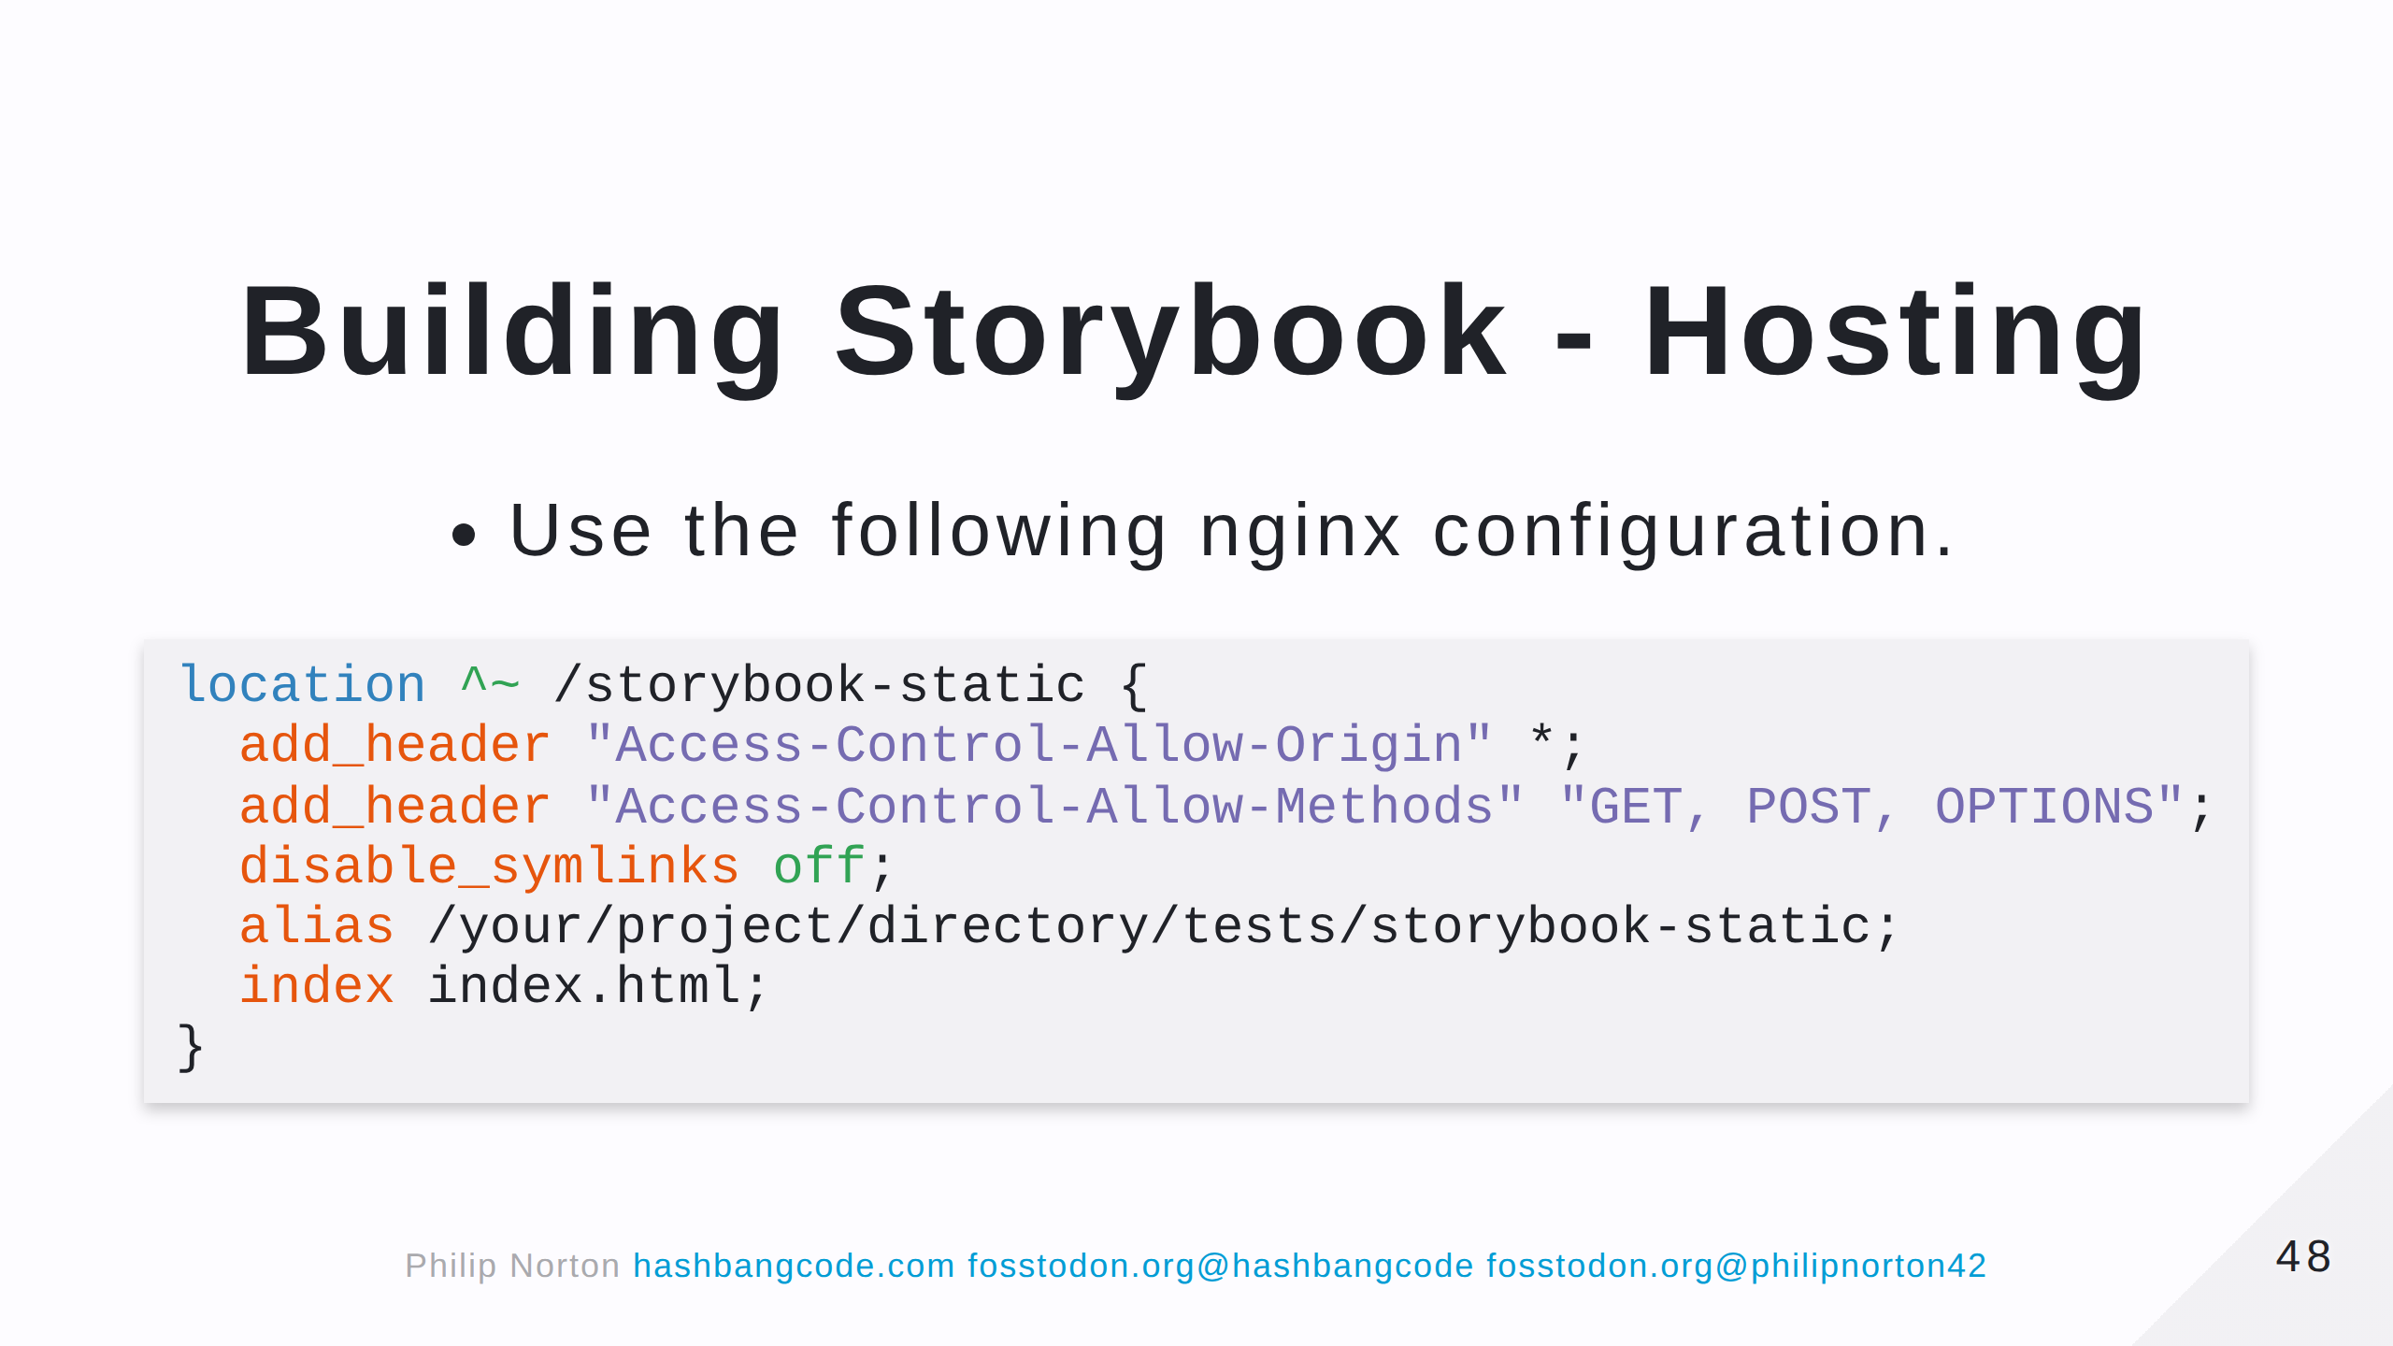

Slide 49
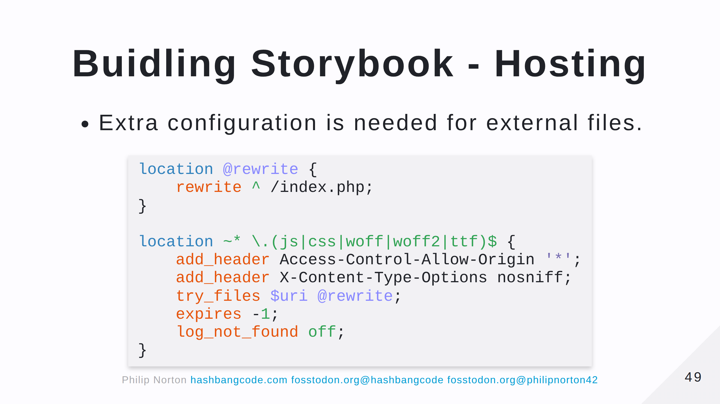

Slide 50
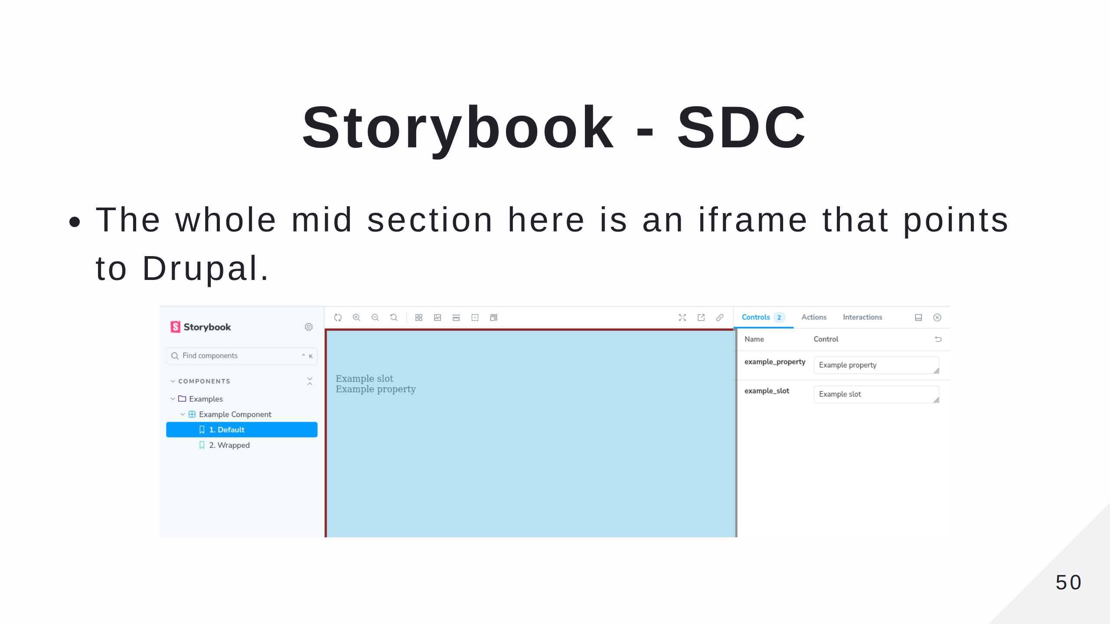

Slide 51
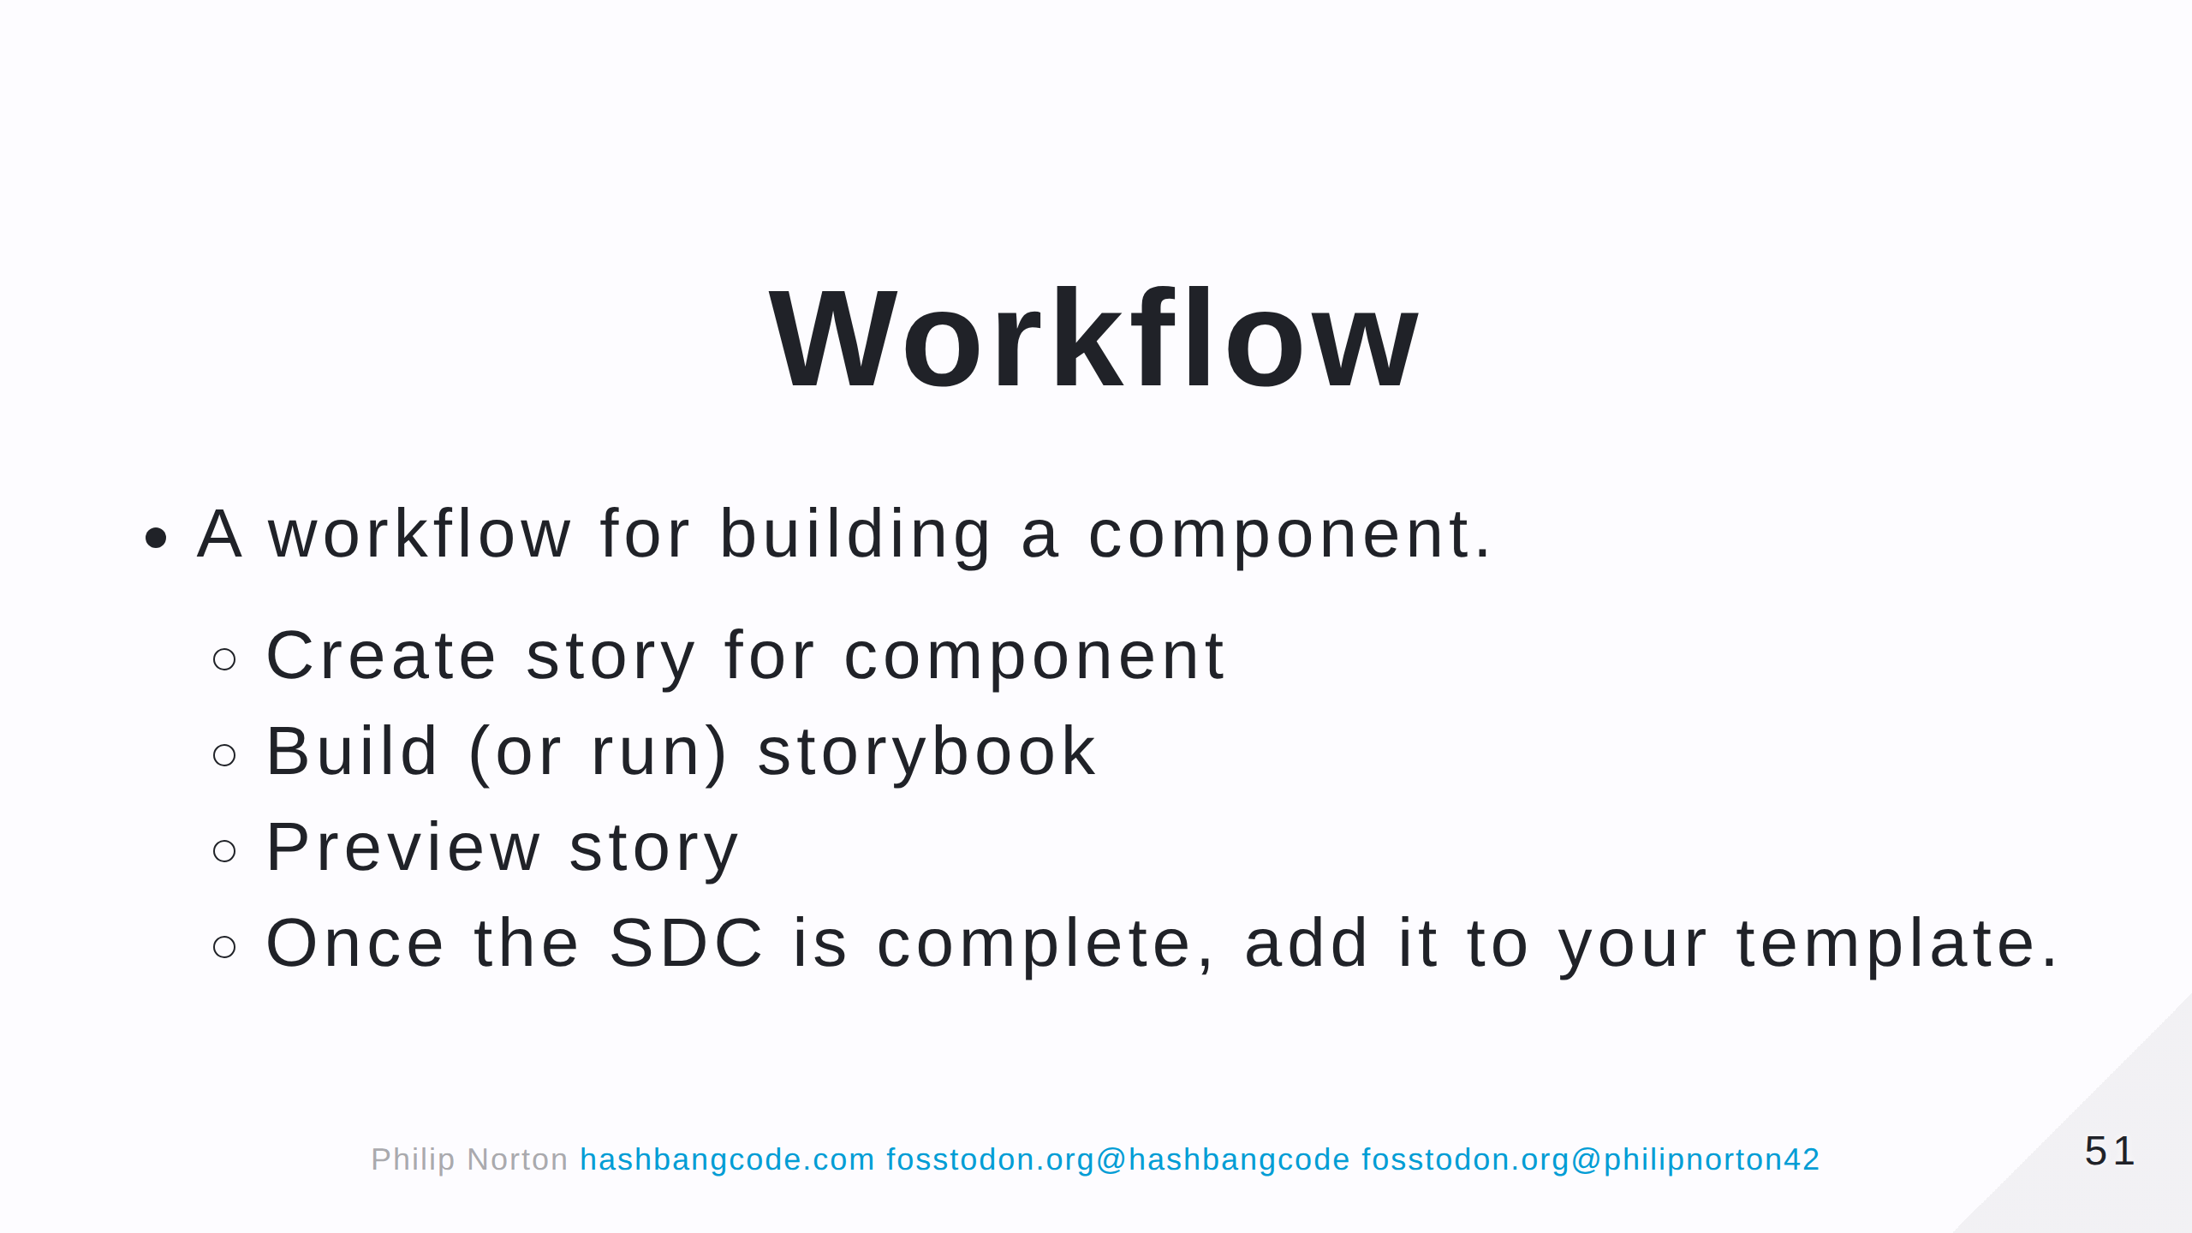

Slide 52


Slide 53

Notes:
CORS errors will likey be your biggest headache. Make notes as you solve them as you can use these notes on other projects.

Slide 54


Slide 55


Slide 56

Notes:
A good alternative if you don't want to muck about with storybook. Plus, comes with an accessibility scanner.

Slide 57

Notes:
A bit unstable in places.

Slide 58

Notes:
Whilst theoretically possible, no SDC is an island.

Slide 59


Slide 60


Slide 61


